Slide 1
2020 Legislative Session UEN Priorities
Margaret Buckton, UEN Legislative Analyst
Larry Sigel, Partner, Iowa School Finance Information Services

Slide 2
2019 Priority Successes
1) Extend the State Penny For School Infrastructure
HF 546 extends through 2051. Phases up to 30% property tax relief. Policy changes on public input for bonding or athletic facilities. Voter approval of RPS by simple majority vote (50% +1) Good example of collective and committed advocacy work coming to fruition.
2) Financial Literacy High School Mandate Intelligent Phase-in and Flexibility
SF 139 is a 1-year extension of requirement that Iowa high school graduates complete ½ unit of financial literacy course. This applies to the class of 2020-21. Fall 2019 juniors will have two years to complete the requirement.
SF 394 On-Line learning can be developed locally, in partnership with other districts, or purchased (from vendors approved by DE)
SF 159 Praxis requires DE to set score and creates conditional license for new teacher with a job offer.

Slide 3
Steering Committee Priorities for 2020
School Funding Adequacy and Equity based on Student Needs (Poverty, At-risk and ELL, New Spending Authority, Adequate and Timely SSA, Diversified Revenue Portfolio)
Teacher, Administrator and Staff Shortages (Adequate Funding, Certification/Licensure Flexibility, Experience Counts, Strong IPERS and benefits)
Student Mental Health Services (Fund Services, Telehealth Counseling, Avoid Shifting of Administrative and Billing to Schools, and fund mandates)
Resolve Formula and Transportation Inequities (Resolved $165 difference within 10 years and get to the average in transportation expenditure equity)
School Safety Resources for Safety Staff and Training (Funding for staff and training)
District Authority: School boards are responsible to make decisions on behalf of their students, staff and communities to meet the goals of their district.

Slide 4
2020 Priority
Invest in Iowa’s Future:
Adequate, Equitable, Student-needs Driven, Timely Funding

Slide 6
SSA/Formula Funding Background
FY 2020’s 2.06% SSA increase exceeded REC revenue growth estimate (1.5% growth)
Revenues were predicted to be low due to tax cuts from 2018 session, not due to recession. Exceeding REC estimate is a good measure of priority. Ask for same benchmark in setting the FY 2021 and future rates. NOTE: FY 2019 state general fund finished up 6.4%. Oct. 15 REC estimate for FY 2020 is 1.4% and for FY 2021 is 2.4%
Tax cuts enacted in 2018 are still impacting the state’s general fund. Proposals in 2019 session (elimination of inheritance tax, for example) are still alive for next session. UEN typically opposes tax cuts at the state level that will negatively impact the state’s ability to pay for adequate school funding.
Similar issue with property tax relief through the formula. As that expands, the cost of SSA to the state gets bigger and bigger. A mix of resources, like a diversified investment portfolio, insulates the state general fund from economic downturns.

Slide 7
ISFIS Analysis
 | FY 2020 | FY 2021
CRF | $587.9 | $613.6
EEF | $196.0 | $204.5
TRF | $60.0 | $127.0
Ending Balance | $187.6 | $237.8
Total Excess Moola | $1,031.5 | $1,182.9
Net Rec | $7,966.1 | $8,181.8
Surplus | 12.9% | 14.5%
Yup, that’s a billion.
LSA Fiscal Update https://www.legis.iowa.gov/docs/publications/BL/1070036.pdf

Slide 8
https://www.legis.iowa.gov/docs/publications/FCTA/1049970.pdf

Slide 9
About $95 million of State Aid to Schools is property tax relief
https://www.legis.iowa.gov/docs/publications/FCTA/1049970.pdf

Slide 10
Iowa ranks 33rd, now
$1,423 per pupil behind the national average

Slide 11
It will be hard to catch up when the state carries most of the funding burden and lowers tax revenue.

Slide 12
Note about Spending Authority
Special Education costs are fully funded: weighting in the formula, state aid, property tax, federal funding, and any deficit funded through local cash reserves.
English-language Learner costs are fully funded: weighting in the formula, state aid, property tax, and any deficit funded through local cash reserves.
This UEN Priority requires state investments in education to create new spending authority and not shift local funding to state funding while claiming to provide more funding for schools.

Slide 13
Special Education Weighting
IEP services determine which of three weightings are applied: 0.72, 1.21, or 2.74 in addition to the 1.0 regular program district cost.
Think 2.74 multiplied by DCPP ($6,880) = $18,850 + $6,880 regular program = $25,731 for one level 3 special education student.
All sped funding generates a pot from which special education services are paid. With slow SSA growth, special education deficits are growing. However,

Slide 14
Note about Special Education
Districts go to SBRC for spending authority to cover the deficit. It’s paid from cash reserve. Districts don’t get any additional spending authority or cash.
Special Education is “fully funded” with a combination of federal, state and local funds.
Any state money to alleviate the deficit is off the table for providing new spending authority, whether that’s higher SSA, increase PK weighting, ELL at preschool, poverty factor, etc. The state can only spend it once.

Slide 15
Something Else to Consider
The LSA published a recent update showing the amount of state school aid funding used to lower property taxes, found here: https://www.legis.iowa.gov/docs/publications/MOW/1069495.pdf
Shows the Statewide Average Rate Reduction of $0.50 Per $1,000 of Valuation, for a total cost of $104.5 million in property tax relief, the majority of which was funded since FY 2012.
Schools didn't get a new dollar from the state to pay teachers or buy textbooks or heat the school, they got a different dollar, with an equal reduction in local funds.

Slide 16
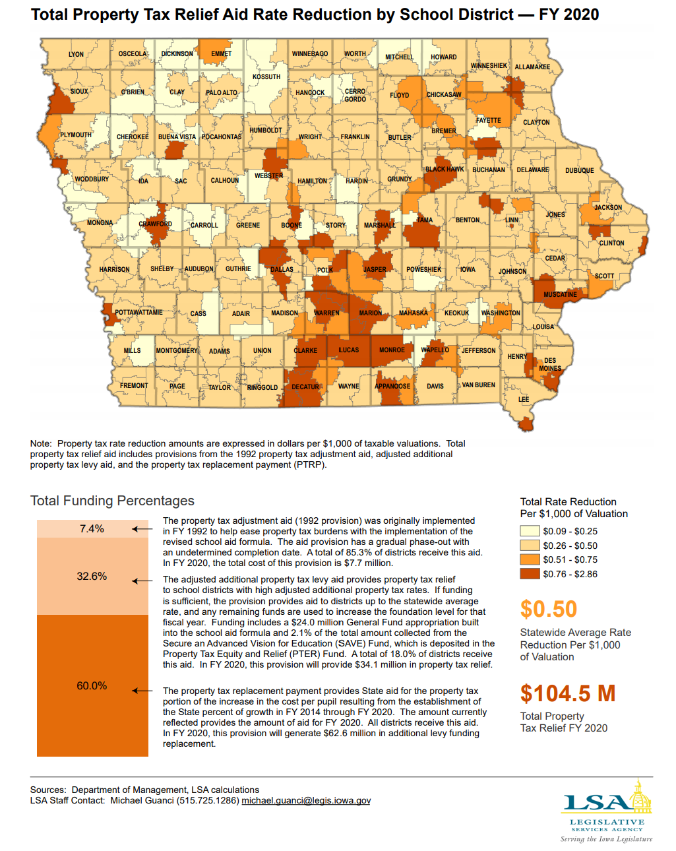
Average rate reduction $0.50, highest is $2.86 per $1,000
Total PTR of $104.5 million
About 70% of that is since 2012
Source: DOM with LSA calculations, Fiscal Update

Slide 17
More Property Tax Relief?
The state’s share of the funding formula has increased dramatically in the last decade.
Over the next two decades, the State Penny for School Infrastructure will phase in about 1% of the sales tax revenue increase (if sales tax revenue grows 4%, that 1% PTR share is a quarter of the increase.) That tops out at $349 million by 2050 according to the LSA’s fiscal note.
The Taxpayer trust fund has $60 million estimated balance in FY 2020 and $127 million in FY 2021.
Here’s some proof that school property tax rates have fallen significantly:

Slide 18
Just 9 years ago:
FY 2011 total school tax rates:
Min $8.34
Median $14.57
Mean $15.10
Max $23.63

Slide 19
Current Fiscal Year:
FY 2020 total school tax rates:
Min $8.13
Median $13.22
Mean $13.51
Max $20.80

Slide 20
LSA Total School Tax Rates 2020
https://www.legis.iowa.gov/docs/publications/FCTA/1050017.pdf

Slide 21
FY 2011 total school tax rates:
Min $8.34
Median $14.57
Mean $15.10
Max $23.63
FY 2020 total school tax rates:
Min $8.13
Median $13.22
Mean $13.51
Max $20.80

Slide 22
2019 Session status: Formula & Transportation Equity, Student- driven $$$
HF 307 in 2019 Session added transportation to formula and closed the district/state cost per pupil gap to $165 per student. Expect these two needs to be finished over time.
Sets the stage for focus on another inequity, such as cost of closing the opportunity gap for low income students.
The USA average weighting for low-income students is an additional 29%, or about $2,000 per Iowa low income student. Iowa falls well short of that mark.
The ELL bill, SF 445, introduced in the Senate, approved by Education Committee, is now in Appropriations Committee. What should policy be in the future? Choices include increased weighting or more years of eligibility (those are property tax relief), adding ELL weighting to PK students, or mirroring special education tiered weightings with levels of ELL services based on an IEP.
A little data on poverty, ELL, DCPP and PK:

Slide 23
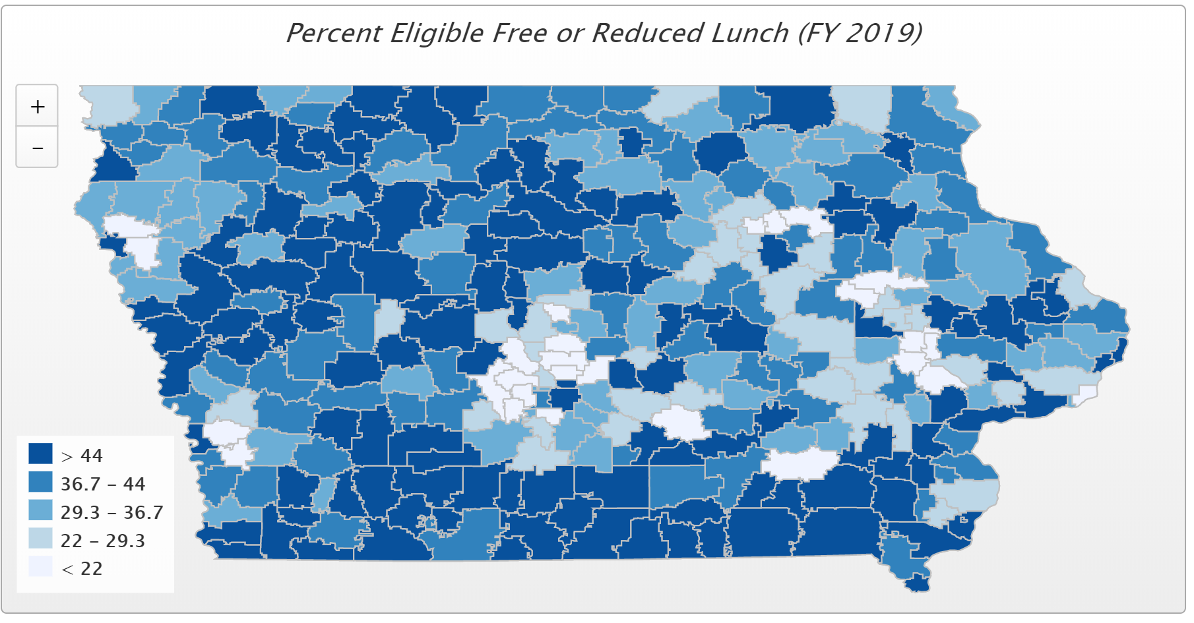
Poverty Changes

Slide 24
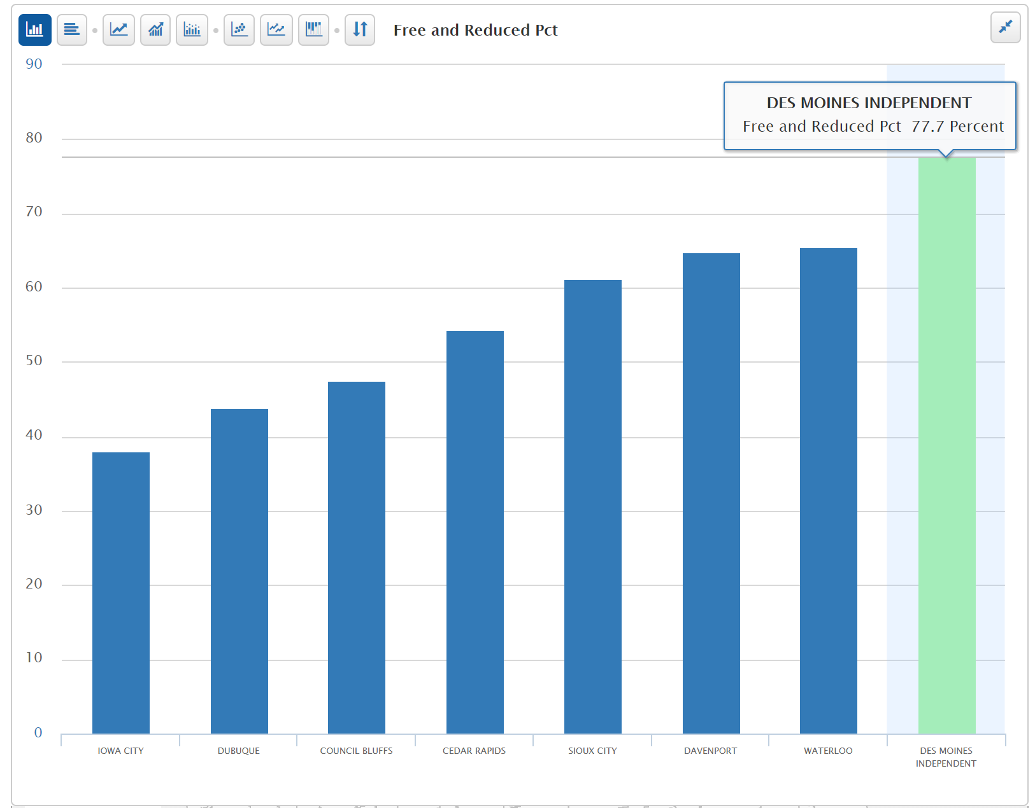
FY 2019 FRPL
UEN Charter Districts
62.6%
Council Bluffs 62.6% - working with DE to correct historical data.

Slide 26
UEN with >50% FRPL history since FY 2001

Slide 28
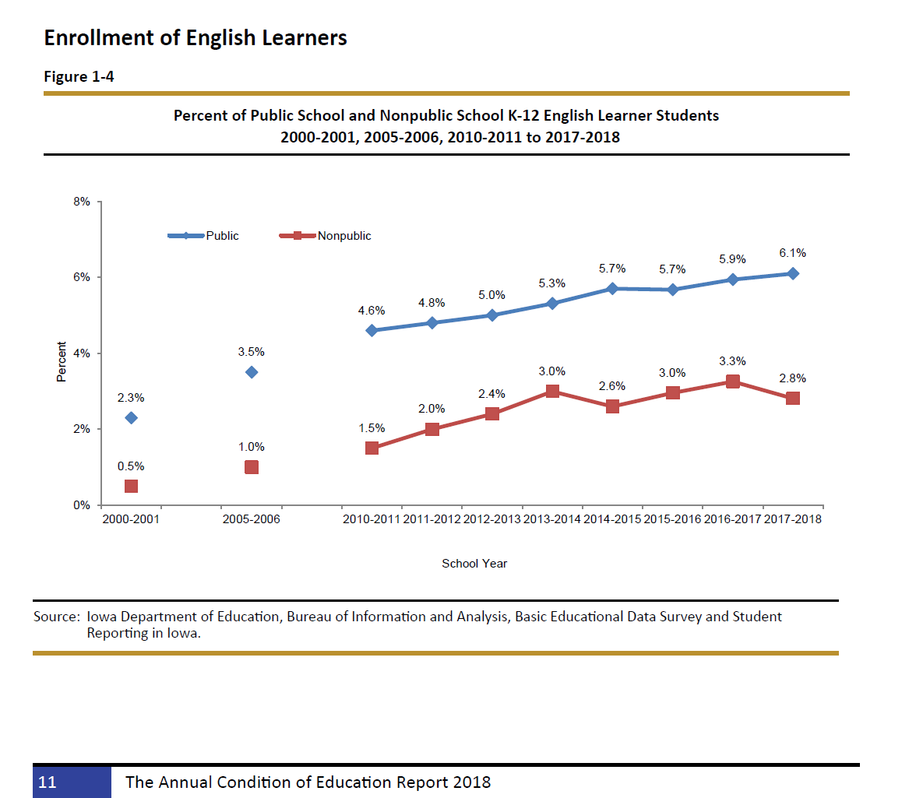
LEP weighting currently at 22% for maximum 5 years. Additional costs beyond the weighting and additional years are paid by SBRC granting of spending authority, funded by cash reserves.
This is K-12. There is no PK ELL weighting or program support.

Slide 29
UEN District Cost Per Pupil Range FY 2020
6 UEN Districts are above the state minimum of $6,880 but must use property taxes to pay the extra amount (Range is from $7 to $62 per pupil higher)
11 UEN Districts at FY 2020 minimum $6,880

Slide 30
Why does preschool matter?
The Perry Preschool Project (40 years), PK saves $17 for every dollar invested.
The majority of states now view access to high-quality PK programs as a critical long-term economic investment in the future workforce.
Education Commission of the States, Oct. 2014, http://www.ecs.org/docs/early-learning-primer.pdf: Six Rigorous long term evaluation studies have found that children who participated in high-quality preschool programs were:
25% less likely to drop out of school.
40% less likely to become a teen parent.
50% less likely to be placed in special education.
60% less likely to never attend college.
70% less likely to be arrested for a violent crime.
NCSL quotes studies on long term return on investment. http://www.ncsl.org/research/human-services/new-research-early-education-as-economic-investme.aspx

Slide 31
Want to know more about school funding adequacy?
See ISFIS School Finance Basics Video on school funding, posted on ISFIS Web Site www.iowaschoolfinance.com
The following resources are posted on the UEN web page http://www.uen-ia.org/legislation.htm
See the UEN 2019 Legislative Digest details of tax policy choices, tax credits and funding impacts
Download and share the UEN Issue Brief on School Funding

Slide 32
2020 Priority
Teacher, Administrator and Staff Shortage: Adequate funding is essential for public schools to compete with the private sector for employees. In addition to adequate base funding, other steps must be taken to help schools meet the challenge of attracting and retaining tomorrow’s educators and recruiting teachers that mirror the diversity in our students, including flexibility in certification requirements, acceptance of alternate evidence such as experience for Iowa licensure, licensure reciprocity agreements with other states, loan-forgiveness for shortage areas, creation of a public service track within Iowa’s CTE plan, creative grow-our-own programs and a strong IPERS and employee benefits system.

Slide 33
Understanding Teacher Shortages: 2018 Update A State-by-State Analysis of the Factors Influencing Teacher Supply, Demand, and Equity https://learningpolicyinstitute.org/product/understanding-teacher-shortages-interactive
IA $35,766
SD $37,419
ND $38,032
MN $37,644
WI $36,983
IL $38,820
WY $45,207
IA is in the second to lowest quintile, ranking 30th in starting teacher pay.

Slide 34
https://www.legis.iowa.gov/docs/publications/MOW/970927.pdf

Slide 35
https://www.legis.iowa.gov/docs/publications/FCTA/1050019.pdf

Slide 36
Iowa ranks 22nd in Teacher Pay as % of median Household Income

Slide 37
Iowa ranks 28nd in Teacher Pay as % of median Household Income

Slide 38
Educator Shortage is an Economic Market Issue
Low SSA for 9 of 10 years creates a pressure point for teacher pay.
If teacher pay is higher, the pool of qualified candidates would grow.
Ditto for administrators.
Here’s some economic data that tells the story:

Slide 39
Some Economic Indicators
Iowa Per capita Personal Income Grew 4.6% in last 12 months June 30, 2018 to June 30, 2019 (source https://data.iowa.gov/Economic-Statistics/Personal-Income-and-Per-Capita-Personal-Income-by-/vm3e-atwp)
FY 2019 State General Fund Revenue closed up 6.4%. (SSA was 1%). Gov. Kim Reynolds announced Sept. 30, 2019: the State of Iowa will end Fiscal Year 2019 with a balance of $289.3 million in its General Fund. (source: https://governor.iowa.gov/2019/09/iowa-budget-closes-with-full-cash-reserves-surplus-of-289m)
Governor’s Future Ready Iowa, Iowa Grant High Demand Occupations 2019 include 11 different education/teaching positions. https://www.futurereadyiowa.gov/sites/fri/files/basic_page_files/State%20program%20list-%20updated%202019.pdf
Iowa has a 2.5% unemployment rate, which ranks 3rd in the nation behind North Dakota (2.4%) and Vermont (2.1%) according to the Bureau of Labor Statistics August 2019. Iowa's private sector is clamoring for qualified workers.
NASBO annual expenditure report for all states: November 2018 NASBO report shows education expenditures as a percentages of all state expenditures, not just general fund. In that report, Iowa spends 16.9% of all state funds on elementary and secondary education.
Ranks Iowa 5th out of 7 states in the group called "Plains States" (group average 20.5% of all state funds spent on PK-12 education) with Iowa behind ND, MO, MN, KS and just ahead of NE and SD.
The national average is 19.5%, which also is significantly ahead of Iowa.

Slide 40
2020 Priority
Student Mental Health Services: Iowa must fund services, eliminate barriers, and clarify funding sources and responsibilities, including critical partnerships and wrap-around services. An array of services must include telehealth counseling provided virtually to students while at school without burdening school employees with additional insurance billing and administrative documentation. Schools should not be mandated to screen for mental health needs or provide mental services without adequate funding to do so.

Slide 41
Student Inequities and Needs
Student Mental Health: Mental health reform set a structure in place, with unanimous legislative support. It did not include services for students or appropriate any funds.
Governor Reynolds appointed a task force to make recommendations on student mental health systems.
Recommendations included requirement to screen all students but funding source is not yet identified. Screening was not included in the MH reform bill in 2019.

Slide 42
2019 Student Mental Health Actions:
MH system structure for children created in HF 690. $2.1 million to AEAs for MH training for educators (only one year and this need is ongoing)
SSB 1240 in Senate Human Resources Committee: telehealth screening and treatment in school setting. Alive for 2020 Session. Telehealth screening at school minimizes absences and barriers to care.
SF 376 adds mental health awareness and suicide prevention to grades 9-12 health curriculum. Alive for 2020 Session.

Slide 43
2020 Priority
School Safety: Urban schools need the resources, training and support necessary for Iowa school, student and staff safety at school including funding for security personnel and training to protect against active shooter and other emergency situations presenting harm.

Slide 44
2020 Priority
District Authority: School boards are responsible to make decisions on behalf of their students, staff and communities to meet the goals of their district.

Slide 45
School Choice Defense Vouchers/Tax Credits consume funds needed for public education
Bills for ESA’s/vouchers in 2018 and 2019 Sessions did not advance through a chamber, but did get through Senate Education Committee in 2019
Tax bills did expand STOs in 2018 and again 2019
Costly – tight budget applies to this issue too

Slide 46
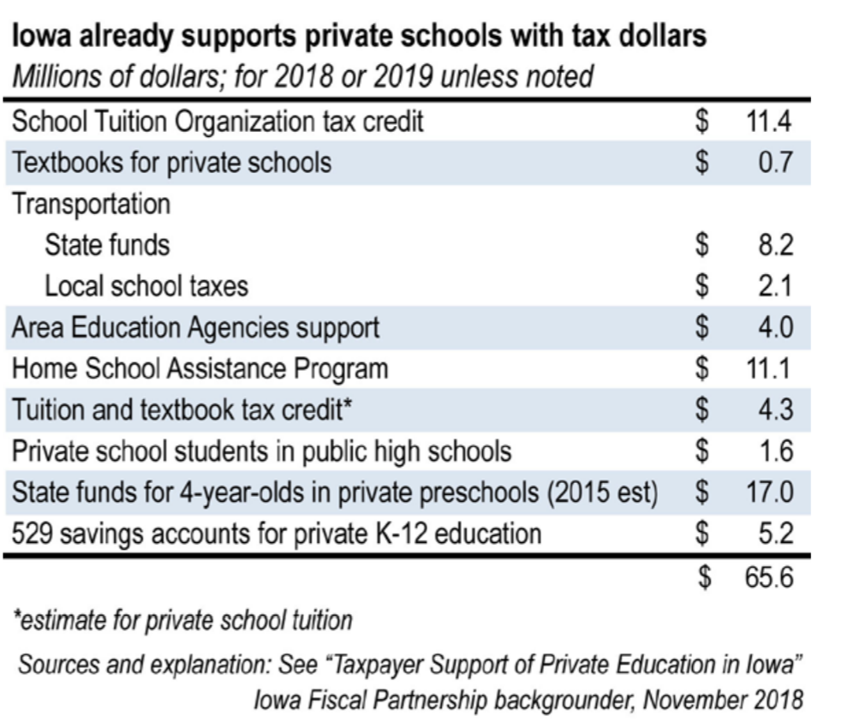
Public Dollars Already Fund School Choice: http://www.iowapolicyproject.org/2018docs/181105-roadmap-vouchers.pdf
STO’s expanded to $15 million in HF 779 Tax Changes in 2019 Session puts this number over $70 million.

Slide 47
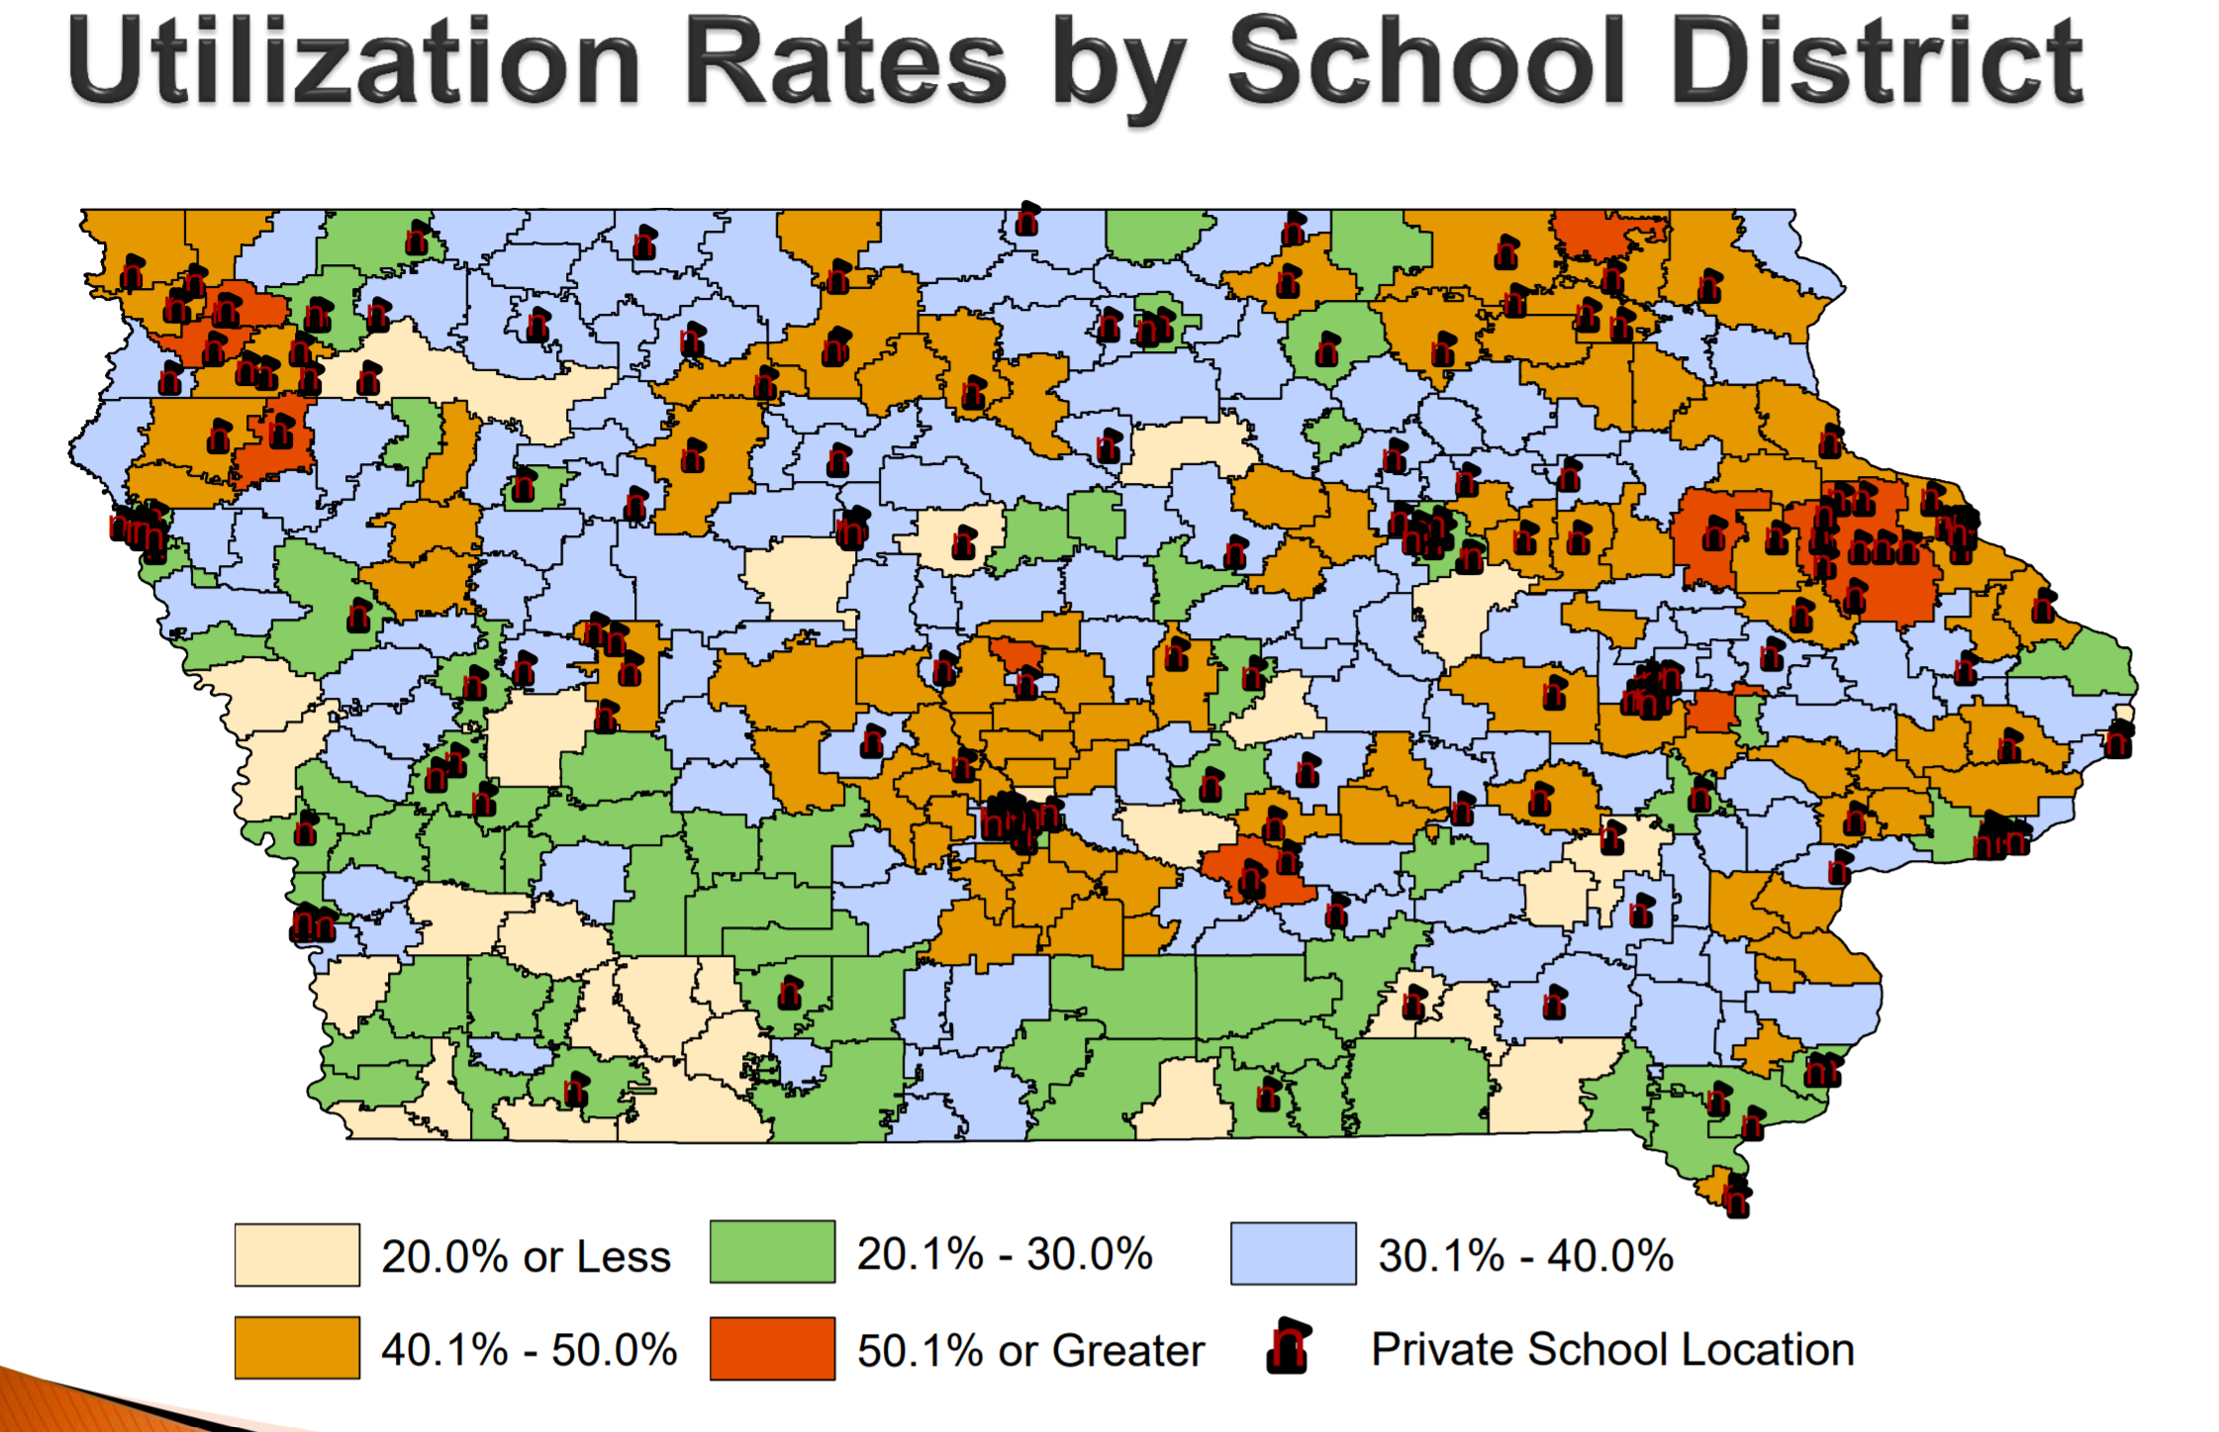
Source: Legislative tax Expenditure Committee DOR Report on Tuition and Textbook Tax Credits https://www.legis.iowa.gov/docs/publications/SD/865242.pdf
Note location of existing private schools related to legislative seats
Note location of existing private schools related to UEN districts. Impact on UEN enrollment.

Slide 48
Key Issues in Voucher Debate
Accountability: Nonpublic and home schools escape oversight. Any expansion funded with taxpayer dollars requires a level playing field.
Democracy: Taxpayers don’t get to vote for Nonpublic school boards.
Student Outcomes: Little evidence that school choice expansion improves outcomes for students, especially in a climate where strong school choice options already exist.
Competition-Iowa has it: 32,848 students attend nonpublic schools. 32,501 open enroll into another public school. Two home school options + virtual academies.
School Choice isn’t parent choice. Nonpublic schools choose who attends.
Limited Resources: Public schools have a public purpose. The state has an obligation to prioritize them first.

Slide 49
Advocacy Attitude
Start with the assumption that every senator and representative is working hard to make Iowa better.
We sometimes disagree with the way to get there, but everyone wants Iowa students to succeed.
Policy makers can’t know about the impacts of their actions on schools if we don’t tell them.
Good lobbying is: Gentle persuasion applied relentlessly. Always start and end with a thank you and be clear about what actions they can take to improve your district’s ability to educate all students to their potential.

Slide 50
Advocacy Attitude
Teamwork: we are all in this together.
Avoid pitting some schools and districts against others. Keep to the core values of local control, adequate investments in public education, respecting differences in school districts, and preserving the authority for each board to make the right choices to support education.
Find a school district represented by Legislative Leaders as a partner. Work together to meet the needs you have in common.
Where do you find willing supporters? Cross section of advocates will help you build your advocacy army.

Slide 51
Legislative Timeline
Caucuses typically meet before the end of November to set priorities. Legislative leadership and committee member changes are important to track.
Jan. 13, 2020 First Day of Session https://www.legis.iowa.gov/docs/publications/SESTT/1061746.pdf
April 21, 2020 is the 100th day of Session when per diem ends (legislators could shorten this timeline)
Although contact during Session is important, building relationships during the Interim is critical.
Election year impact (= shortened timeline and elevated importance of connecting with voters and opinion leaders.)

Slide 52
Advocacy Supports
Oct. 2019 Videos and PPTs: UEN Advocacy Actions and Issues for 2020 http://www.uen-ia.org/legislation.htm
Issue Briefs, talking points, advocacy messages
Weekly Legislative updates and Calls to Action to engage your local advocates
This PPT will be on UEN annual meeting tab soon
Testimony
Support for local legislative meetings, press releases, public forums etc.
ISFIS Staff and Capacity support to UEN (mapping, legislative estimates, cost of school aid, impact on students, surveys of school leaders.)
Call Margaret Buckton 515.201.2755 cell or email Margaret@iowaschoolfinance.com We can talk over messages, strategy, timing, or just chat about what you might do next.
Keep your UEN staff in the loop about what you are hearing.

Slide 53
Never doubt that a small group of thoughtful citizens can change the world. Indeed, it is the only thing that ever has.
Margaret Mead
Decisions are made by those who show up.
President Josiah “Jed” Bartlett
NBC’s “The West Wing”
If you’re not at the table, you’re on the menu.
David Lyons

Slide 54
ISFIS Staff
Larry Sigel, ISFIS – Partner
Cell: 515-490-9951
larry@iowaschoolfinance.com
Margaret Buckton , ISFIS – Partner
UEN Legislative Analyst
Cell: 515-201-3755
margaret@iowaschoolfinance.com

