Slide 1

Nov. 5, 2020 Urban Education Network Annual Meeting
6:00 – 7:30 PM

Slide 2
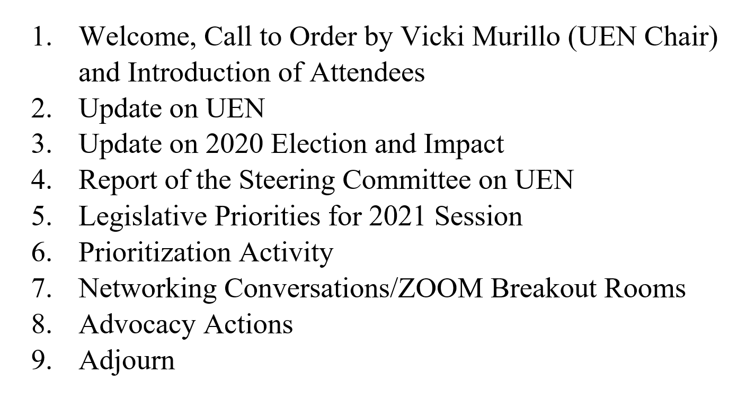
Annual Meeting
Agenda

Slide 3
Introductions
1. Name, Role, District
2. What is one great thing about education in our urban schools (in 10 words or less)
All Enter into the Chat.
We’d like to actually hear from one person from each member district

Slide 4
Update on UEN
Purpose Statement
Association Management/ISFIS Role
Members

Slide 5
The UEN. . .
. . .keeps the state’s lawmakers, media, and public informed about the progress and problems in our state’s largest and most diverse schools, through advocacy, legislation, communications and research.
. . .helps to build capacity in urban education by facilitating connections between member districts to improve student academic performance, narrow achievement gaps, improve professional development; and strengthen leadership, governance, and management.
Joint efforts with other state organizations and policymakers extend the UEN’s influence and effectiveness to the broader community that will ultimately benefit from the contributions of today’s urban students.
All members of the UEN help determine program priorities. For guidance, the members rely upon data retrieved from local, state, regional and national sources. In addition, specific issues arise addressing contemporary events, legislative concerns and current trends. The priorities of the UEN continually evolve, reflecting the changing needs of urban students, families and communities.
New: Nov. 2019

Slide 6

UEN Association
Management from ISFIS
Support and staff, accounting, association management, website development and maintenance, billing, meeting organization and tech support. New procedures and policies for UEN operations.
Policy development, strategic planning, legislative and fiscal analysis.
Job-alike meetings for 18 different director-level leaders to share best practice, learn together, receive updates and connect with state-level experts.
Lobbying services, legislative advocacy, communications, media, sharing best practice, survey tools (like the instructional model survey we sent to you Monday!)
Jen Albers jen@iowaschoolfinance.com
James Passick james@iowaschoolfinance.com
Larry Sigel larry@iowaschoolfinance.com
Margaret Buckton margaret@iowaschoolfinance.com

Slide 7

UEN Member Districts 2020-21
Welcome to new members Ames and Ankeny!

Slide 8
A few facts . . . UEN Districts
Enroll 38.5% of Iowa's 504,063 PK-12 students
Enroll 70.3% of Iowa's PK-12 students of color, including 76.3% of Iowa’s African American students and 53.7% of Iowa’s Hispanic Students
Enroll 62.4% of Iowa's limited English speaking students
Serve 45.5% of Iowa's K-12 low-income students (UEN enrollment of Free and Reduced Lunch eligible students is 55.0% of total UEN enrollment compared to the statewide average of 42.9%.)
Educate 25,979 students with Individual Education Plans (IEPs) (41% of state total)
Employ 36.6% of Iowa's PK-12 certified staff
Employ 28.1% of Iowa’s school principals
Demonstrate a student to administrative staff FTE ratio of 231.4 (state average of 122.5 students per administrative FTE)
Maintain 548 permanent school buildings with a total replacement cost of $4.3 billion (in FY 2014 dollars)
Transport students 8,594,962 route miles
Have an average daily student attendance rate of 94.1%
Graduate over 91% of high school students in the 5-year graduation cohort

Slide 9
Election Update
National Front & Iowa https://www.desmoinesregister.com/elections/results/2020-11-03/?utm_source=retention&utm_medium=email&utm_campaign=elections&utm_content=vote

Slide 10
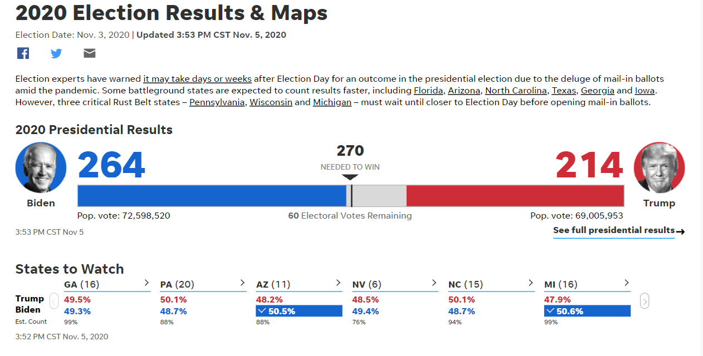
Presidential Race
https://www.desmoinesregister.com/elections/results/2020-11-03/?utm_source=retention&utm_medium=email&utm_campaign=elections&utm_content=vote

Slide 11
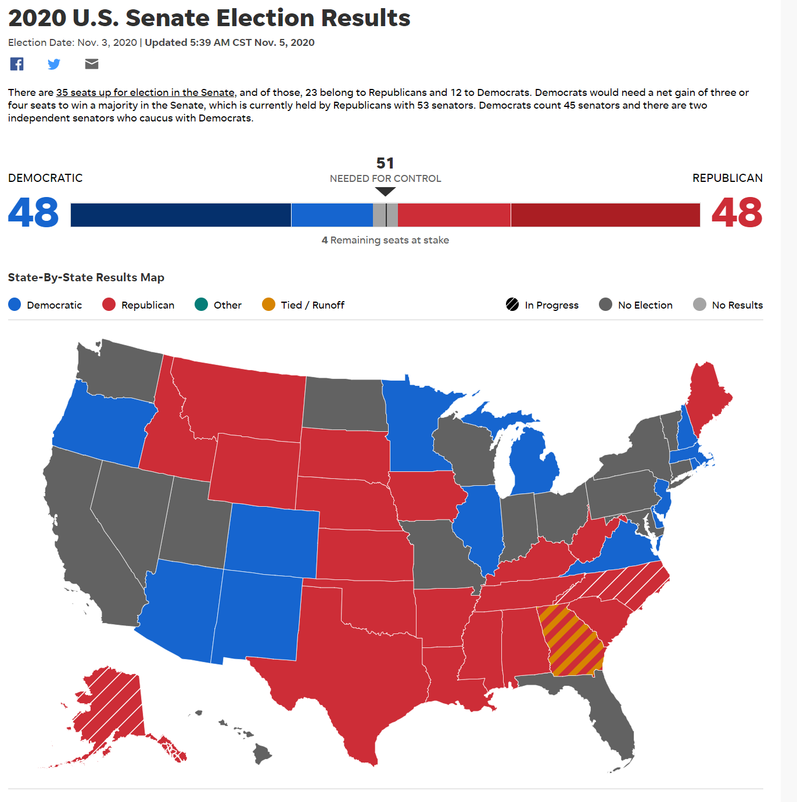
North Carolina and Alaska leaning Republican
One or both seats in Georgia are destined for a run off election in January (must have 50% of the vote if more than two candidates are on the ballot)

Slide 12
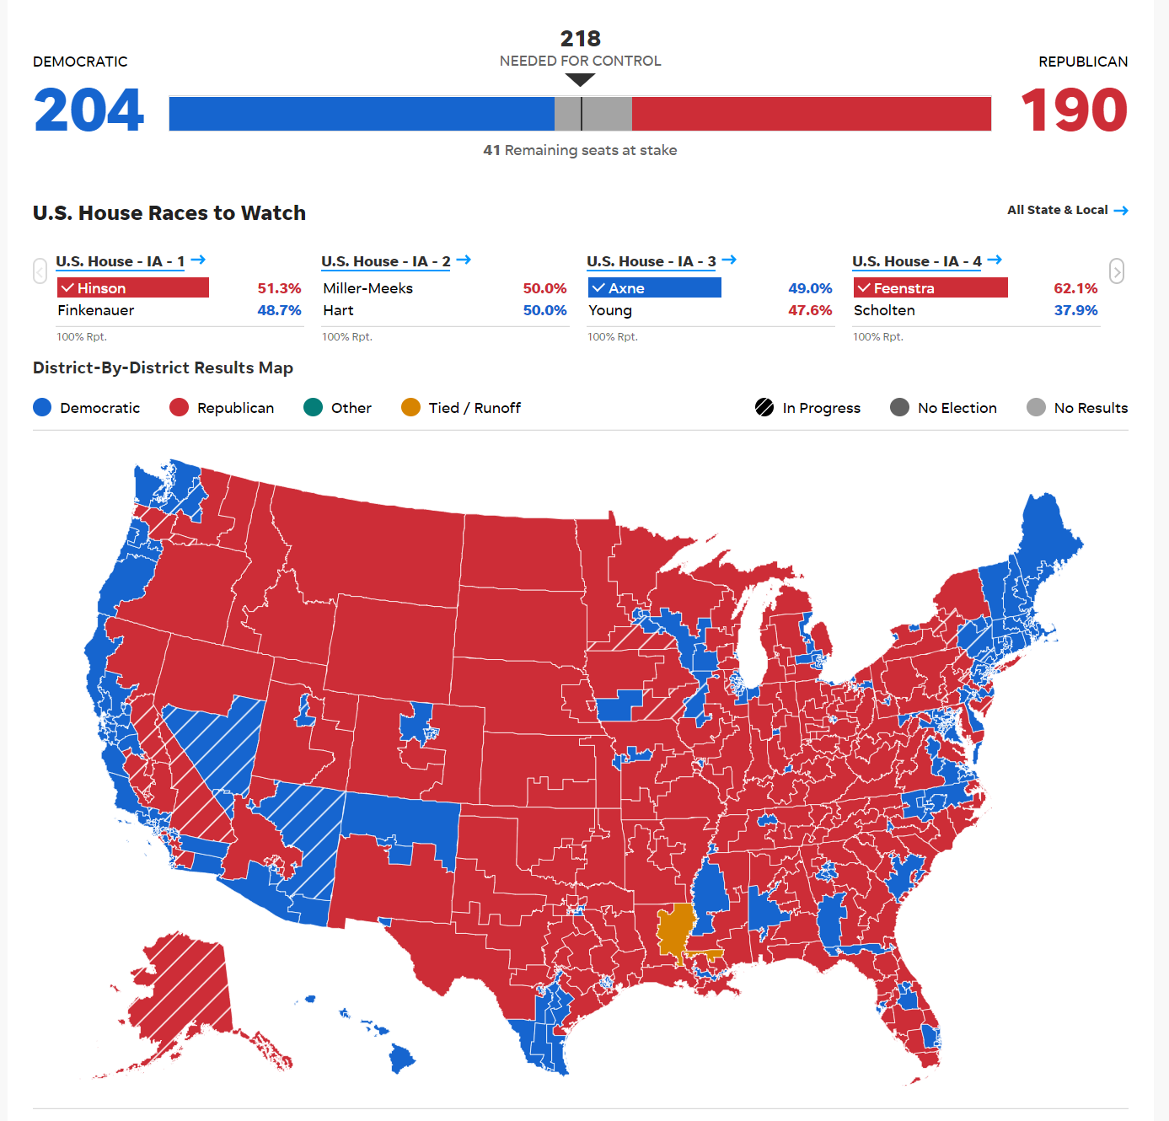
North Carolina and Alaska leaning Republican
One or both seats in Georgia are destined for a run off election in January (must have 50% of the vote if more than two candidates are on the ballot)

Slide 13
Federal Policy Issues at a Glance
COVID stimulus package details and extent of funding
Internet Access and Affordability, E-Rate and technology
Title funds distribution based on public school poverty or to private schools from public school share
Free and Reduced Price Lunch waivers and formulas for 2021-22 baseline
Medicaid billing and health care for low income children
Tax policy: increase federal taxes lowers Iowa state revenues (federal deductibility)
IDEA and federal share of special education funding
Teacher loan forgiveness programs
Energy policies, farm policies, insurance and health care impacts on the Iowa economy
The courts, judge appointment and rulings on parent choice and special education liabilities

Slide 14
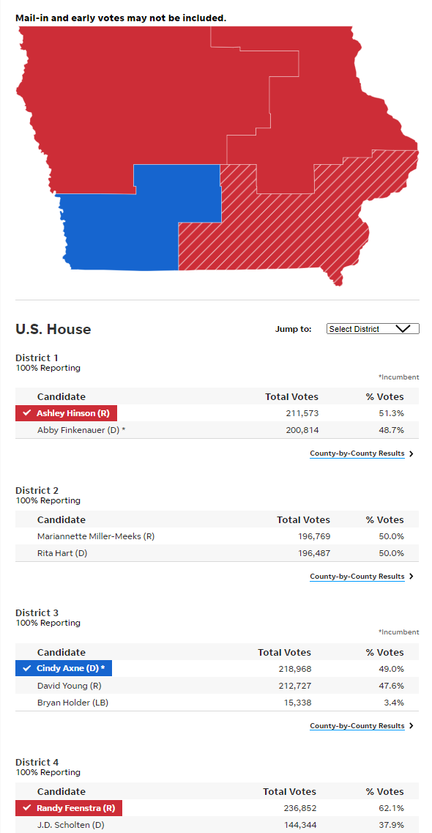
1.7 million voters. Iowa is mostly Red
Sen. Ernst retains her Senate seat.
Rep. Elect Hinson ousts Rep. Finkenauer
Rep. Axne squeaks by with 1.4% margin to retain the only D seat that is certain.
Rep. Elect Feenstra easily carries District 4.
District 2 still too close to call, with Miller-Meeks ahead of Hart. Difference of 282 votes is 0.07% of 393,256 votes with mailed ballots still pending.

Slide 15
Iowa Capital Dispatch 11.5.2020
https://iowacapitaldispatch.com/2020/11/04/to-rebuild-iowa-democrats-have-to-fill-their-leadership-vacuum/?eType=EmailBlastContent&eId=9d980ad8-96de-49e9-86d8-3a6e3996c230
Democrats have to fill a vision and leadership vacuum.
“There are a lot of reasons why a year when everything seemed to be going Democrats’ way — a record turnout, the most unpopular president in recent history, a raging pandemic without competent management by the state or federal GOP administrations — ended in an embarrassing rout.
But the problem Democrats need to solve first is the glaring lack of leadership at the top of the party. There hasn’t been a clear Democratic leader in Iowa since Harkin, the long-time former senator, announced his retirement in 2014.”

Slide 16
Iowa Senate (IALNS Newsletter 11.4.2020) still 32:18
In the Senate, Republicans held a 32-18 advantage coming into the election.
R’s defended six open seats and defeated one Democratic incumbent, Sen. Rich Taylor in District 42.
D’s won one open seat, District 22, (Sen. Schneider retired), keeping the margin in the Senate at 32-18.
One R seat, Senate 41, held by Senator Miller-Meeks, will be open and subject to a special election if Miller-Meeks wins the US House 2 race.

Slide 17
Iowa House (IALNS Newsletter 11.4.2020) Likely 59:41
In the House, Republicans came into the 2020 election with a 53-47 member advantage, and the margin has grown to 59-41. (May have a couple of recounts)
Democrats won in one open seat 67 (Open - Hinson) held by Republicans, but lost seven incumbents: 26 (Ourth), 38 (Matson), 39 (Derry), 58 (McKean), 64 (Open - Berenger); 81 (Gaskill); (83) (Kurtz).
No Republican incumbent lost. R’s successfully defended seven open seats. D’s defended three open seats.

Slide 18
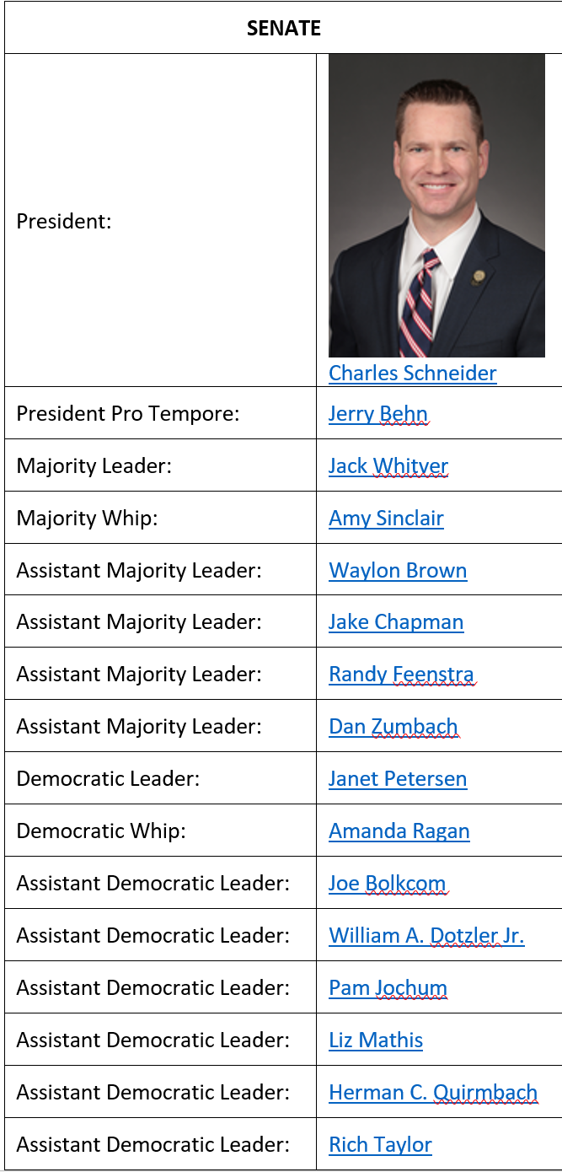
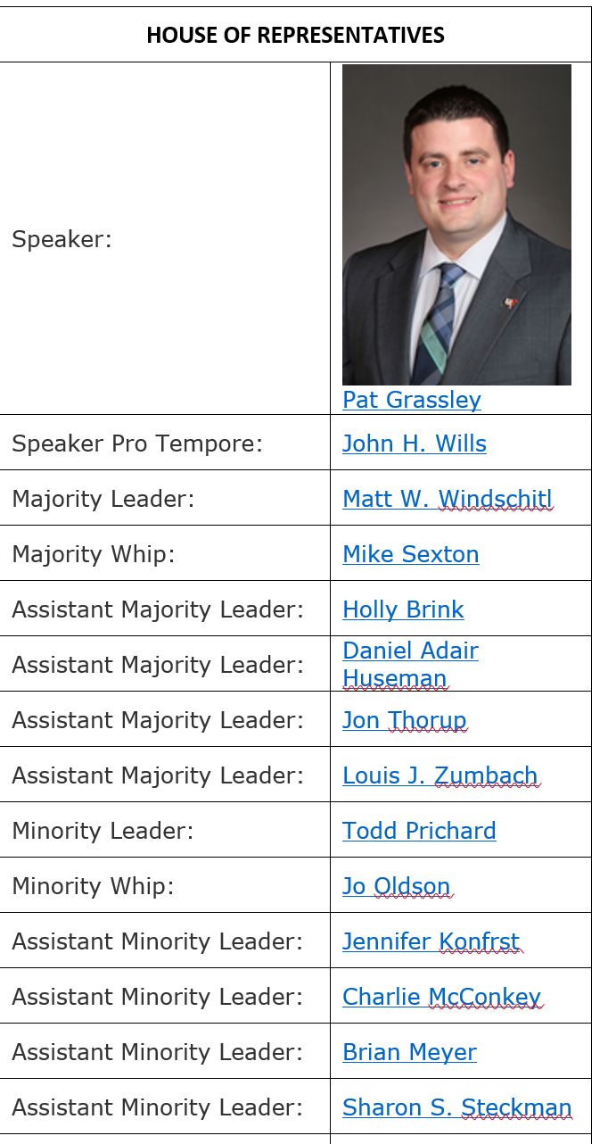
Leadership Impacts

Slide 19
New Faces in Both Chambers
Out of 100 House seats, 18 are newly elected; 14 Republicans and 4 Democrats.
Out of 50 Senate seats (25 of which were up for election), 8 are newly elected; 7 Republicans and 1 Democrat

Slide 20
Committee Changes
Sen. Behn is the only non-returning member of the Senate Education Committee, although current members may be assigned to other committees. Sen. Sinclair may move to Appropriations Committee, leaving a chair opportunity in Senate Education.
House Education has more turnover, with two retirements and one election defeat;

Slide 21
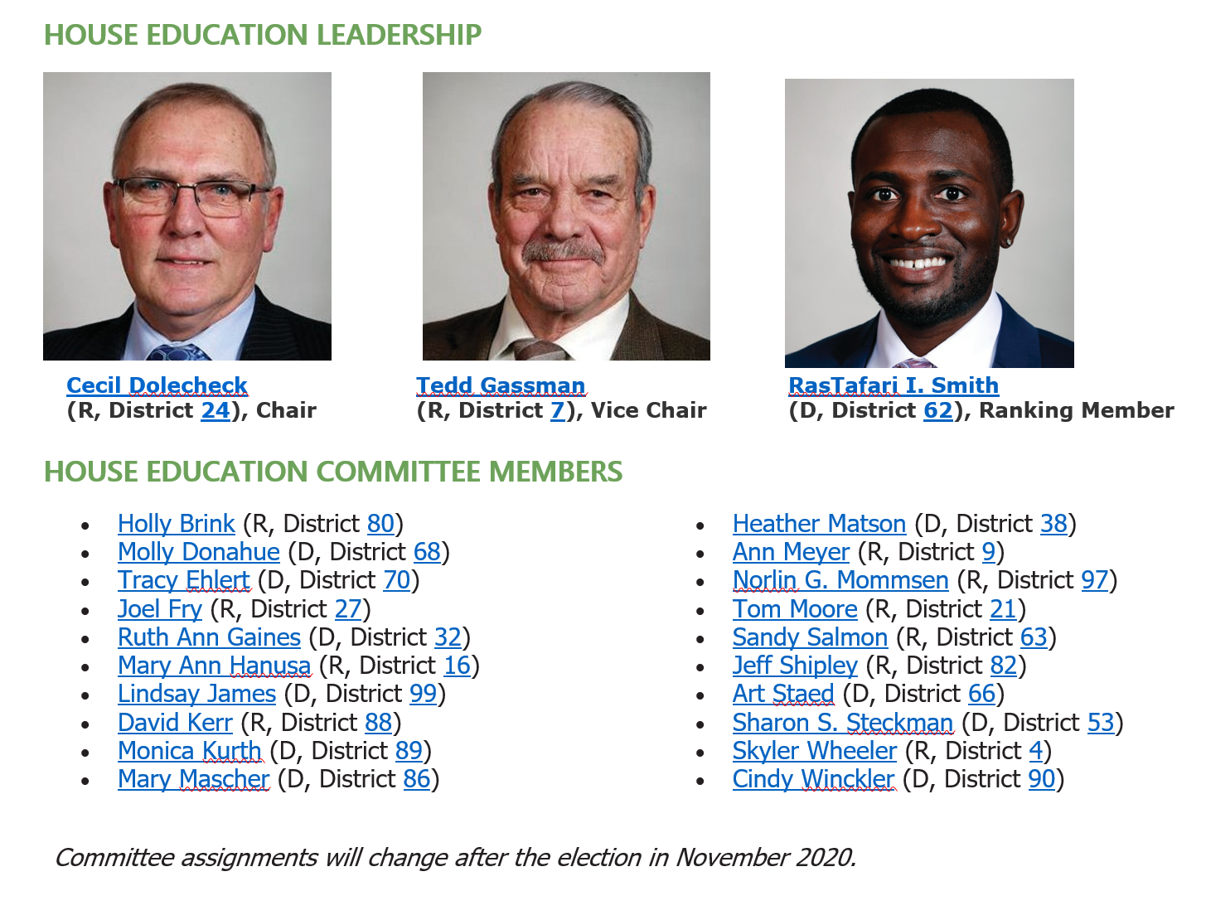

Slide 22
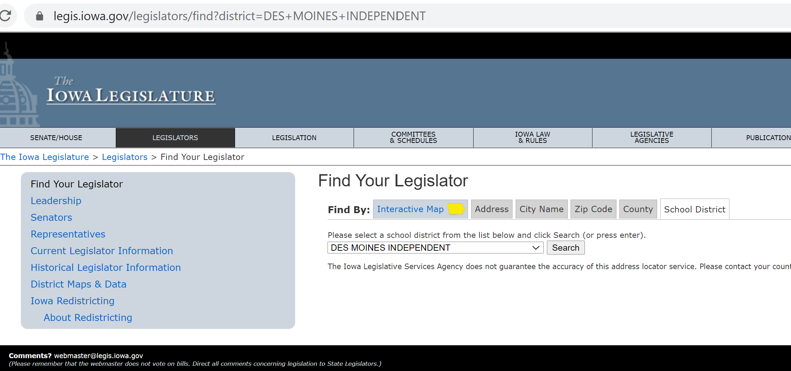
https://www.legis.iowa.gov/legislators/find
Select School District tab and your district from the dropdown box

Slide 23
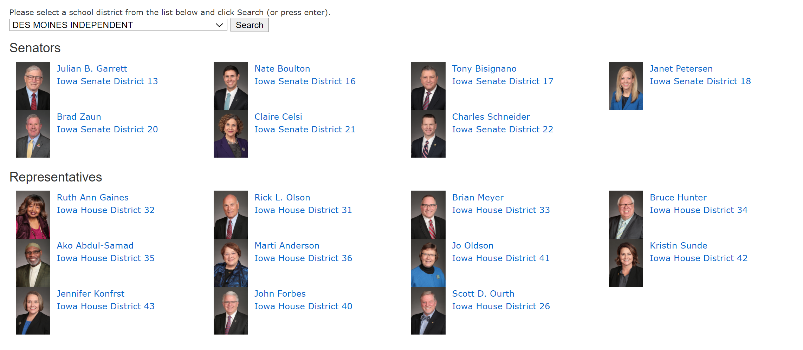

Slide 24
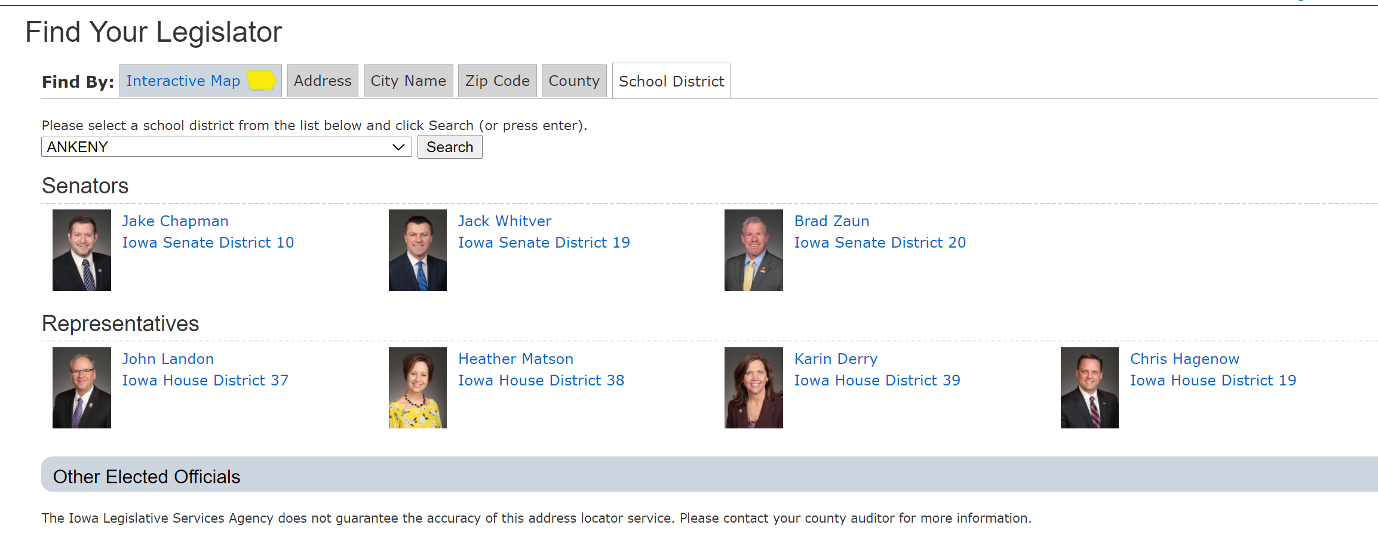
Rep. -Elect Garrett Gobble
Rep. -Elect Eddie Andrews
Rep. -Elect Carter Nordman
Click on the district and see the map or click on the Legislator name and see contact information and committee assignments:

Slide 25
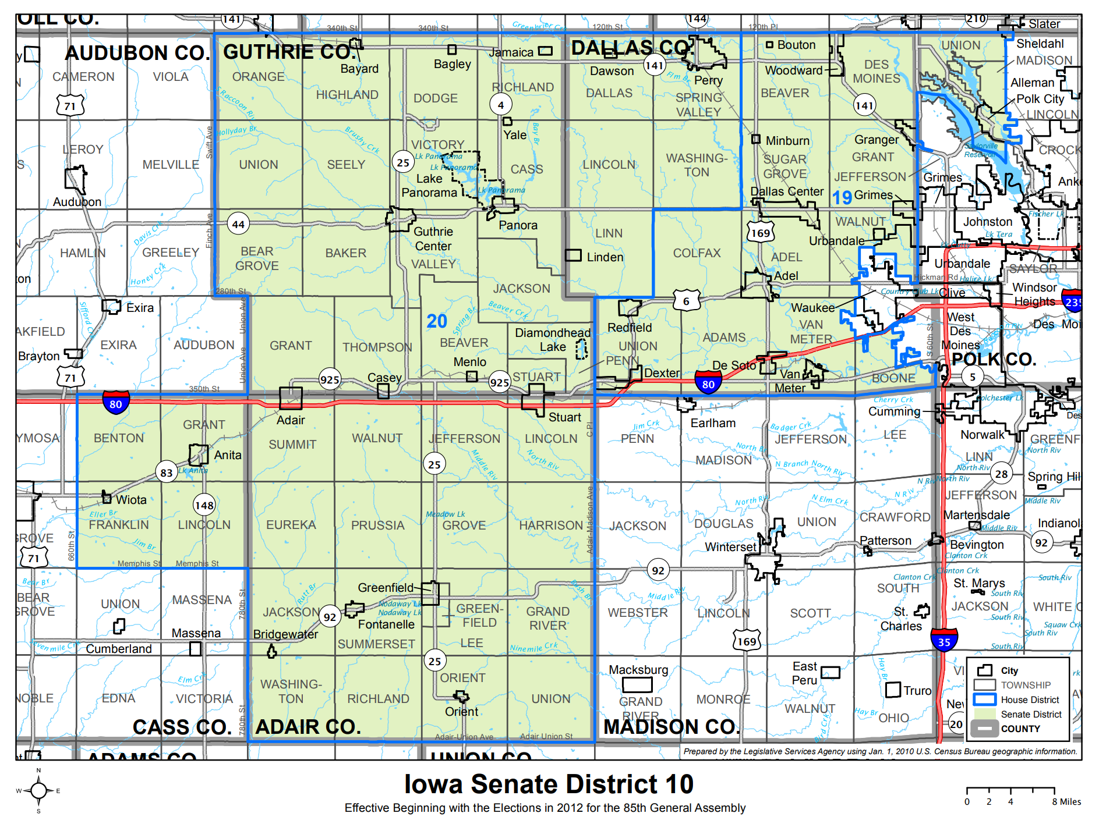

Slide 26
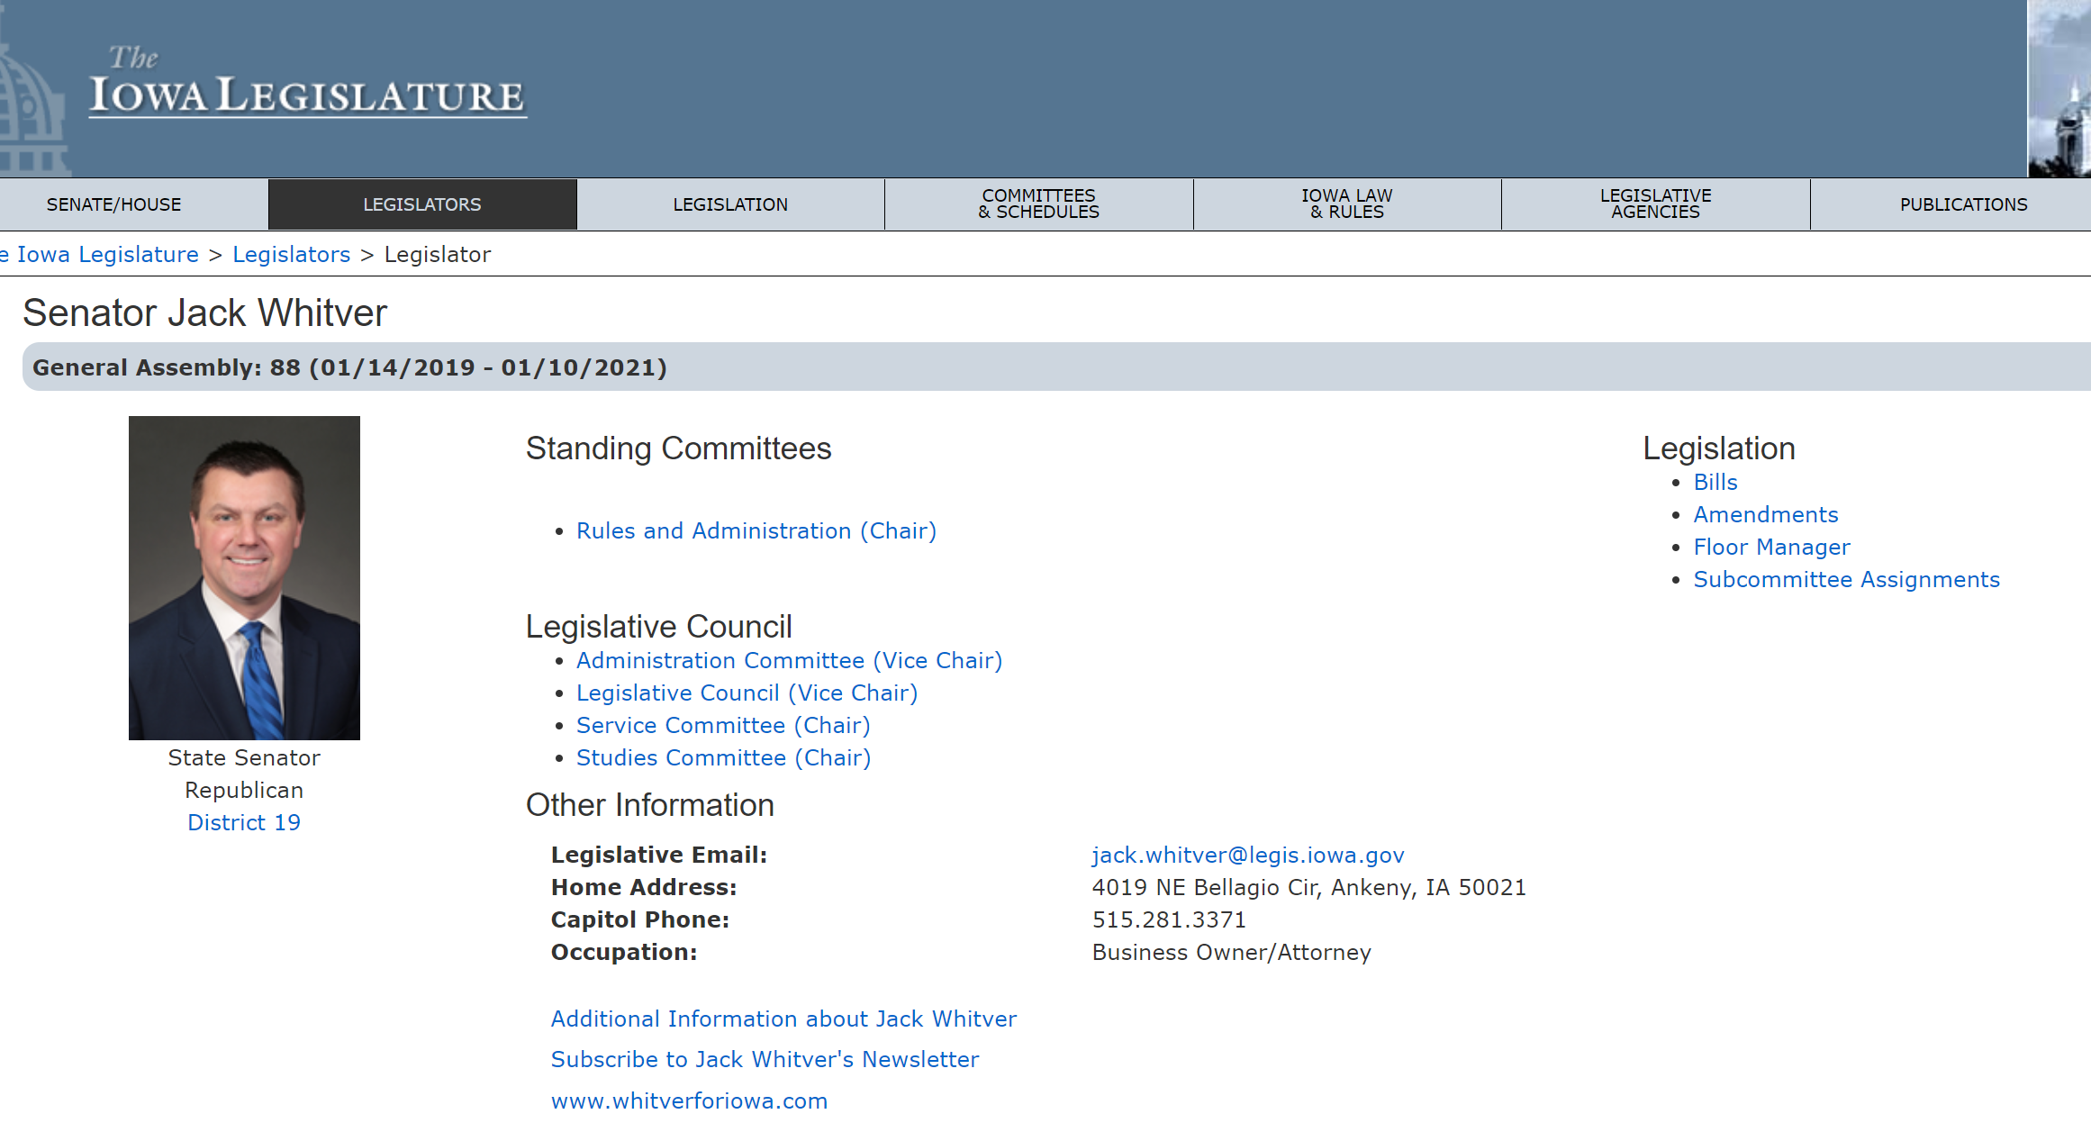
From here, see contact info, subscribe to newsletters, etc.

Slide 27
ISFIS SitRep Nov. 6 at 10:00
Click Here to Register
Recap of the General Election
  Partisan balance
  Issues of likely importance
  List of winners (so you can send that congrats note)
A look at State General Fund resources (revenues to fuel the budget) for FY 2022 pending the Dec. REC meeting

Slide 28
Report of the Steering Committee

Slide 29
Steering Committee Agenda
http://www.uen-ia.org/attachments/meeting_agenda/UEN%20Steering%20Committee%20-%20Agenda%20-%202020.11.05.pdf
1. Welcome, Call to Order by Vicki Murillo (UEN Chair), and Introduction/Roll of Attendees
2. Approval of Agenda
3. Approval of Minutes from September 24, 2020 Steering Committee Meeting
4. YTD Financial Report
5. Preschool Enrollment, Funding Implications, Advocacy Implications
6. ISFIS Contract for FY 2022 and FY 2023
7. Update on 2020 Election
8. UEN Legislative Priorities for 2021 Session
9. UEN Annual Meeting Steering Committee Responsibilities
10. Other Business

Slide 30
UEN 2021 Legislative Priorities

Slide 31
Invest in Iowa’s Future:
Public schools educate a diverse workforce with the skills necessary to fuel our future. Adequate funding is required to:
  fulfill the goal of restoring Iowa’s first in the nation education status,
  deliver world-class learning results for all students,
  prepare creative, caring and motivated citizens,
  close learning gaps to support excellence in Iowa’s diverse economy,
  develop a world-class workforce to secure Iowa’s economic future, and
  recruit, retain and reward Iowa’s school staff and educators of today and the future.
The cost per pupil must be sufficient to fuel school districts and AEAs and must be set no lower than 3.75% for the 2022 school year to form a strong foundation for Iowa schools to educate all students.
A strong school finance system is based on the principles of primacy, adequacy, equity, and flexibility. Iowa’s investment in public education should mirror economic growth and make up for shortfalls when the economy is robust. UEN school leaders appreciate the continued commitment to 2.3% SSA and transportation/formula equity investments for the 2020-21 school year, even after COVID-19 began to negatively impact state revenues. As the economy rebounds, Iowa students depend on the state to increase investments in education to make up for learning loss and other expenditures associated with pandemic recovery not accounted for in prior years’ budgets. Iowa’s future depends on a stable and balanced tax policy that generates enough money to fund Iowa’s priority of educating our children.
A strong system requires a diversified revenue portfolio. New state resources must supplement, not supplant existing resources. Increased state funding for schools must increase spending authority rather than simply using the school aid formula as a vehicle for property tax relief. Iowa’s 31st in the nation ranking of local school funding as a percent of total education revenues demonstrates that our revenue portfolio is out of balance.

Slide 32
Student Opportunity Equity (Close the Gap)
Equity requires a needs-driven formula that funds programs for low-income, non-English speaking, and at-risk students.
Iowa’s funding formula has not kept pace with the changing needs of Iowa students. The formula must recognize the disproportionate cost of providing equal educational opportunities to students from low-income families. School districts should be granted spending authority for Free/Reduced Price Lunch (FRPL) eligible students’ fees mandated to be waived by state and federal law. The COVID-19 experience has also shown us glaring differences among student home support. This includes both the ability to engage in learning based on lack of internet connectivity, as well as the inability of some working parents to stay home to support required continuous learning. Experts anticipate a COVID-19 ripple effect will increase achievement gaps.
UEN supports full attention to and implementation of the December 2019 School Finance Interim Committee recommendation to study the impact of poverty on educational outcomes, including other states’ formulas that provide resources for students from low-income families, which are showing successful student achievement outcomes for at-risk students. HF 2490 Poverty Weighting Study was approved with strong bipartisan support in the House Education Committee in the 2020 Session and serves as a good starting point for continued conversation.

Slide 33
Student Opportunity Equity (Close the Gap)
Early investment increases access to quality preschool programs which prevent higher costs later. Barriers to preschool access must be eliminated, and schools must have the funding and flexibility to provide preschool and wrap-around services for a full day, prioritizing high-need students first. UEN supports poverty and English-language learner weightings for preschool students and formula protections against the negative budget and program impacts of preschool enrollment swings.
In addition to a poverty weighting in the Formula, UEN calls for resolution of other Formula inequities, including the elimination of the $155 district cost per pupil difference within 9 years and correcting the perverse proration formula for the Instructional Support Program by providing funding over the long term and spending authority in the meantime.
The proration formula established for Iowa’s Instructional Support Program years ago assumed full state funding. With zero state share, that formula has a perverse impact on resources for districts with low property value and low-income families, which actually require more, not fewer resources for instructional support. The proration formula is outdated, given strong systems in place to promote property tax equity and relief over the last decade. All school districts should be able to access the full instructional support amount approved by their voters or their school boards going forward.

Slide 34
Teacher, Administrator and Staff Shortage:
Adequate funding is essential for public schools to compete with the private sector for employees. Licensure reciprocity with other states enacted in the 2020 Session is a great start. In addition to adequate base funding, other steps must be taken to help schools meet the challenge of attracting and retaining tomorrow’s educators and recruiting teachers that mirror the diversity in our students, including flexibility in certification requirements, acceptance of alternate evidence such as experience for Iowa licensure, loan-forgiveness for shortage areas or high-needs schools, creation of a public service track within Iowa’s CTE plan, creative grow-our-own programs and a strong IPERS and employee benefits system.

Slide 35
Mental Health Services:
Iowa must fund services, eliminate barriers, and clarify funding sources and responsibilities, including critical partnerships and wrap-around services. Enabling the delivery of mental health services, when appropriate for students, via telehealth, enacted in the 2020 Session, is a good first step.
Additional State efforts are needed to establish and fund comprehensive community mental health systems to offer preventative and treatment services and comprehensive school mental health programs that include in-school access for students to mental health professionals, provisions for reimbursement by Medicaid and private insurers, and programs to fill in gaps for students without coverage.
In addition, funding for additional and ongoing teacher, administrator, and support staff training to improve the awareness and understanding of child emotional and mental health needs is needed. Additional mental health services for our school staff are also required. Schools should not be mandated to screen for mental health needs or provide mental services without adequate funding to do so.

Slide 36
District Authority:
School boards are responsible for making decisions on behalf of their students, staff and communities to meet the goals of their district. UEN believes that those locally elected leaders closest to the community care most about those impacted by their decision making and are in the best position to determine the best interest of students, staff and stakeholders. Local school boards are accountable to those who elect them.
In education policy, one size does not fit all school districts, classrooms or students. District leaders need maximum flexibility to provide a great education to all students. The state role is to define what outcomes are necessary for all students, leaving flexibility to schools in expenditures and policy to best determine how to deliver those intended outcomes.
Statutory Home Rule, articulated in Iowa Code 274.3, gives locally elected school boards broad and implied authority. The Legislature, the Governor/executive branch and the courts should follow the law and liberally construe the Iowa Code and legislation to effectuate local control.

Slide 37
NEW - Public School Priority:
Our public schools are well designed to provide a range of choices for parents and students. UEN believes that Iowa law provides sufficient choice through public schools, public charter schools, open enrollment, homeschool assistance, independent private instruction, post-secondary enrollment options, public virtual academies, and nonpublic school alternatives. Additional tax credits towards nonpublic tuition for investments in options without oversight are not necessary to provide choice to the families in Iowa.
Education supported by public funds, including property taxes, state aid or federal monies, should be held to the same governance and educational standards as public schools.
The state should provide full funding to public schools to meet the evolving needs of public school students before increasing financial supports for private schools. Additionally, federal legislation and rules should require grant funding distribution methods and resources to fully meet public school students’ needs before providing additional resources to private schools.

Slide 38
NEW - Remote Learning and Instructional Time:
UEN supports the ability for local leaders to determine when in-person learning is not advised, for emergency situations and safety, including but not limited to weather cancellations, emergency infrastructure conditions, or for purposes of public health, as long as engagement in virtual learning opportunities is required for students and staff and the needs of all students are anticipated and met.
Local leaders know and are committed to providing additional attention to those students and staff who may need more support during virtual learning opportunities. Under such conditions, instructional time delivered during required virtual learning counts toward minimum instructional days or hours.

Slide 39
NEW - Internet Connectivity and Access:
UEN supports continued state and federal efforts at expanding access to high-speed internet to all Iowans for student and staff access to critically needed information. Access to virtual learning and information is required for students to fully experience quality STEM programs, required virtual learning and the extraordinary array of information and resources available to promote full student engagement in 21st Century learning.
The quality of life, workforce readiness, entrepreneurship and access to a whole host of critical services depend on citizen access to high-speed internet.
UEN supports incentives, investments, and creative solutions to close the technology gap for all students, their families, businesses and community members in Iowa. Lack of sufficient income should not be a barrier to internet access for our students and families.

Slide 40

http://www.uen-ia.org/attachments/end_of_session/UEN%202020%20Legislative%20Digest%20-%20Final%2009.14.2020.pdf

Slide 41

Adequate School Resources
SF 2142 was approved by 51 House members with 46 voting no and the Senate passed it on March 9, 31:17, sending it to the Governor (signed on March 12).
Set the SSA at 2.3% for FY 2021, second highest increase in 11 years, yet below the UEN ask of 3.75%.
When Session reconvened after COVID closure, UEN requested the 2.3% remain intact, and it did.
In context: combined with transportation, formula equity and formula funding, despite anticipation of economic decline due to the pandemic, it’s fair to say the 2020 Session made a good effort and kept their commitment for funding schools.
Setting up 2021: Zoomland folks, when we get to breakout rooms in a bit, talk about your greatest needs, not in terms of $$, but rather, what do those $$ net in student achievement?

Slide 43
State Revenue Policy
School funding adequacy is a function of sufficient state revenues and mix of revenue sources for schools.
Continued property tax relief focus confuses the issue – state investment increases to make up for a reduced property tax dollar but schools don’t receive those funds as additional revenue.
Check out the Legislative Digest for additional information on tax cuts, policy decisions limiting state revenue, and increased tax credit thresholds of private school scholarships (STOs) – increased to $15 million in the 2020 Session.
REC (Oct. 13) estimated 4.1% growth in revenues net of transfers for FY 2022. That’s $316.5 million. FYI: 41% of that is $130 million. Watch for that number to be invested in PK-12 to preserve the PK-12 investment as a percentage of the state budget. It will take more if statewide enrollment has dropped significantly, which saves the state money through the formula.

Slide 44
Resource Needs:
Adequate increase in SSA to fund:
  Continued programs and new expectations: computer science, dyslexia training, school safety and emergency plans, internships and college-level coursework
  Educators to teach and lead our schools; adequate salaries, benefits, training and ongoing support
  Bus drivers and support staff (paras, food service, custodians, secretaries)
  Course supports: science lab materials, career and technical education costs, fees to community colleges or other school districts for shared courses and content, music/art/drama opportunities for students
  Student needs: offset fees waived, provide instructional materials (online and at school), social workers and mental health supports, translators and ELL instructional materials and supports, behavior supports all the way up to therapeutic classrooms and mental health placements, talented and gifted content
  Extra- and co-curriculars: not just the heart of the community, but in many cases where students find their passion and learn to set goals and work collaboratively with others. Connect to peers and caring adults.

Slide 45
Question of the day:
How many of our priorities would fall off the list if schools had been adequately funded in the past or you knew they would be adequately funded going forward?

Slide 46


Educator Shortage and Quality Instruction
HF 2629 Future Ready Workforce provides for computer science which may be delivered exclusively online.
SF 2310 Online Learning allows financial literacy, world languages and computer science taught exclusively online under certain conditions. Also allowed use of federal funds for AEA online learning program.
HF 2359 Praxis test eliminated as an entrance exam to enroll in a college teaching program.
HF 2454 allows AA degree for some CTE teachers. Proposed BOEE Admin. Rules allowed for AA degree and other flexibility for substitutes. Governor’s declaratory order provides substitute flexibility.
HF 2627 requires licensure reciprocity with other states with 1 year of experience, effective January 1, 2020.

Slide 47

Student Inequities and At-risk Needs
Despite the School Finance Interim Committee recommending and the House Education Committee approving a bill, HF 2490, the study of the impact of poverty on education and funding formula options to meet the needs of students did not advance out of House Appropriations Committee.
A bill also approved in the House Education Committee, HF 2497, would have allowed SBRC to grant spending authority up to 5% for Dropout Prevention (DoP), but died in the House Appropriations Committee.
Bills were introduced in both chambers to begin the conversation with the House carrying them further along the way than in the Senate.
FYI: Children from families with incomes at or below 130% of the poverty level are eligible for free lunch those 130-185% eligible for reduced lunch.

Slide 48
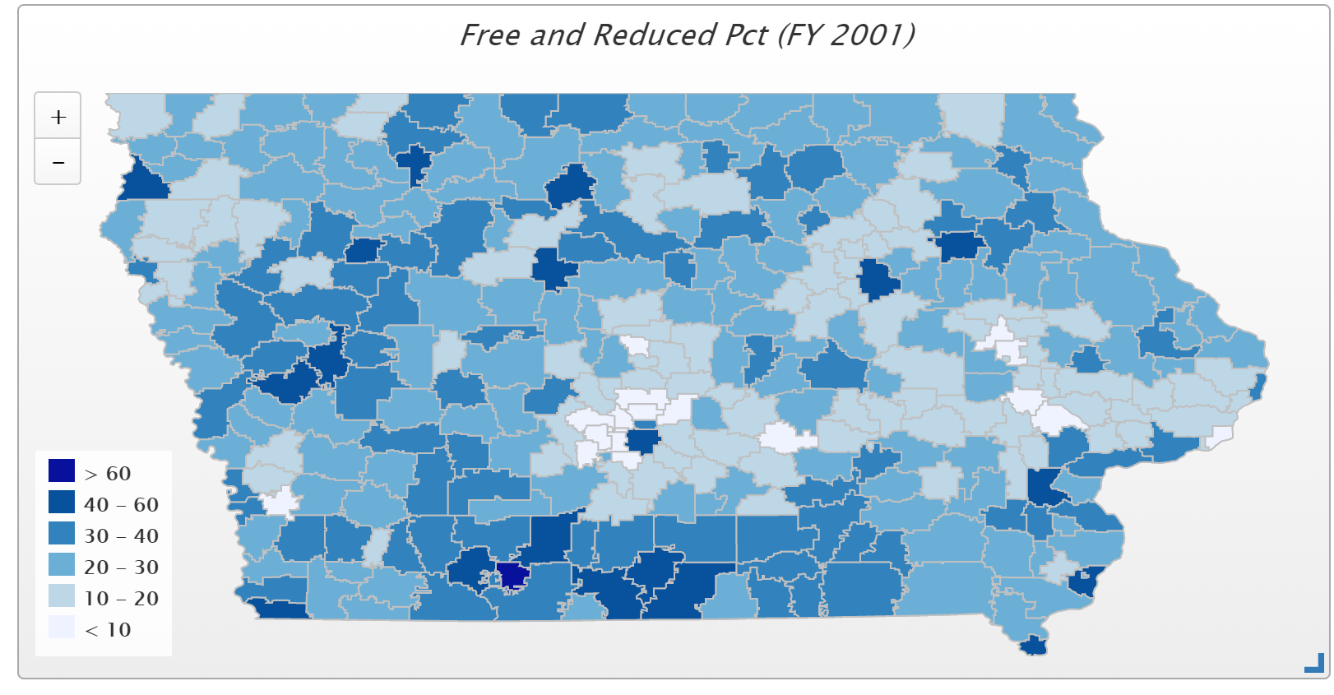
In 2001, only 4 districts had more than 50% of students eligible for FRPL (Waterloo, Keokuk, Wayne and Diagonal. Diagonal was the state high at 60.2% and the only district above 60%)

Slide 49
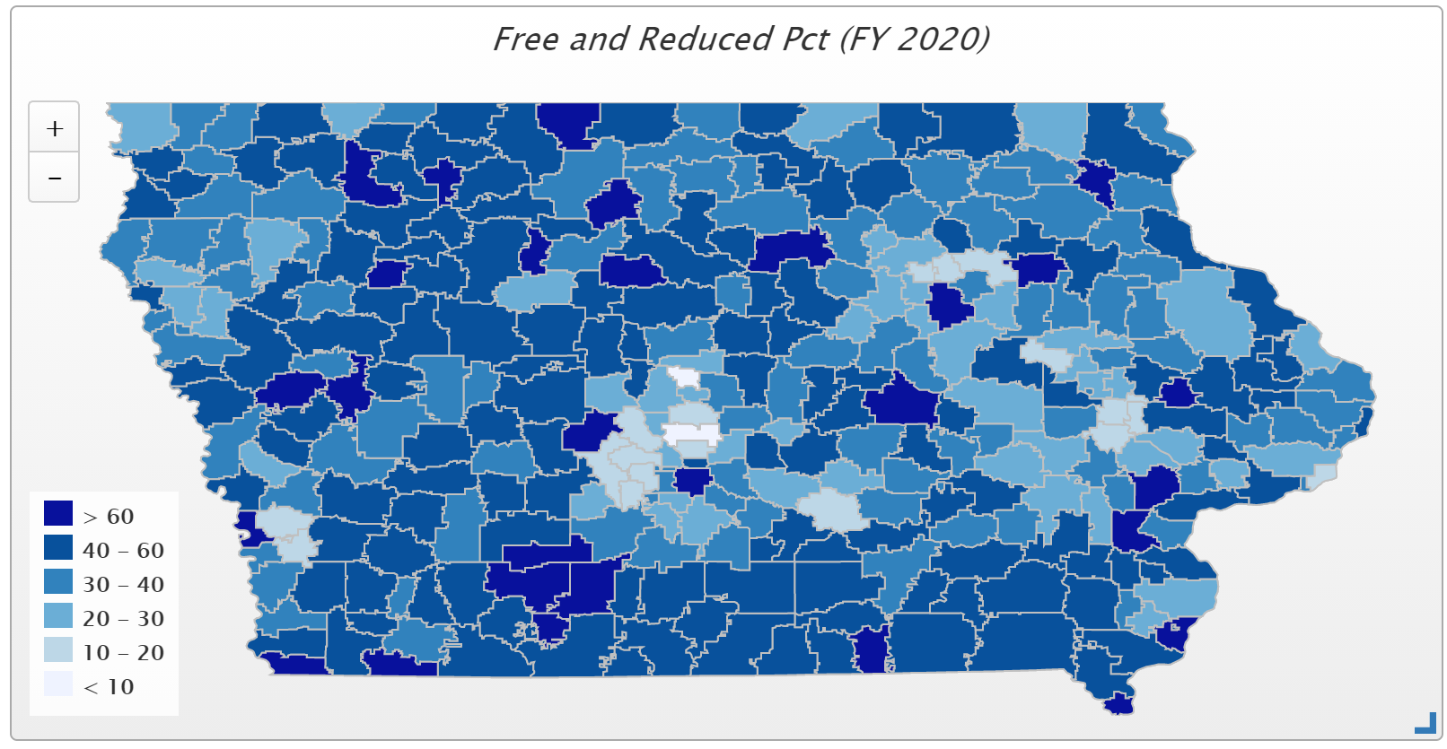
In FY 2020, 77 districts have more than half of their student on FRPL, and 29 districts have more than 60% of students eligible for FRPL. Those above 70% include Waterloo, Orient-Macksburg, Hamburg, Denison, Perry, Storm Lake, Des Moines, Lu Verne, and Postville.

Slide 50
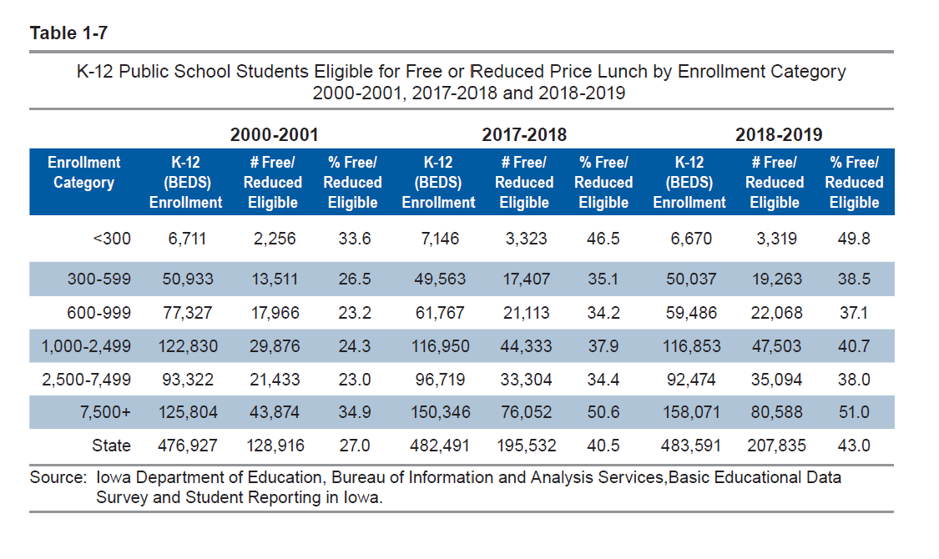
Districts in the largest and smallest enrollment categories had the highest percentage of students eligible for free or reduced price lunch (Table 1-7).

Slide 51

Quality Preschool

Slide 52
Quality Preschool
HF 2460 would have allowed districts to serve and count young 5-year-olds in PK, was approved by the House Appropriations Committee, but did not get approval of the full House.
COVID-19 Impact: PK enrollments lower in Fall 2020. PK does not have an on-time funding component or budget guarantee, so next year’s PK budget will be based on this Fall’s enrollment count. Also, DE guidance prohibits school districts from using general fund for PK expansion.
Is the solution a one-time hold harmless or permanent fix to the formula that sets up funding for PK expansion?

Slide 53
School Safety
Little progress in 2020, with only small scale solutions advanced.
SF 284 would have added School Resource Office (SRO) position to operational sharing, but did not move forward.
SF 2155 would have allowed additional ISL funds to pay for one SRO per district, although approved in the Senate Education Committee, did not advance out of the Senate Ways and Means Committee.
There were no school safety bills in the Iowa House.

Slide 54

District Flexibility/Board Authority
SF 2310 language was confusing (drafting legislation without much public conversation, during COVID closure, added to the confusion.)
Board authority to determine COVID closure as long as based on the RTL plan, with in person instruction as the primary method of instruction.
However, Governor very tightly defined primarily in person to mean 50% over every two-week period.
State oversight (application to close and permission granted or not, with reapplication needed every two weeks, was also a very heavy handed interpretation.)
Governor’s proclamation allowed virtual days for weather closures, flexibility for substitutes, and some flexibility for how attendance is counted for days and hours.

Slide 55

COVID Impacts
Increase Costs (cleaning, PPE, technology, social distancing means being inefficient on purpose – changes staff to student ratio, and substitutes)
Loss of Revenue (not selling lunches, no gate receipts, fee waivers, child care, foundations/philanthropy, etc. and lost 2021-22 formula revenue due to enrollment decline)
Enrollment changes – hold harmless policy options
  Use the higher of Oct. 2021 enrollment or Oct. 2020 count for budget – easy to implement but spends state money on relieving property taxes twice and doesn’t help otherwise growing suburbs prepare for next fall’s return of students.
  Higher SSA – fewer districts on budget guarantee and builds the base for future while still keeping budget guarantee and on-time funding (MSA) in the formula and lowers the special education deficit
  PK in particular – no budget guarantee or MSA for growth in PK and many districts have seen enrollment declines.
  One time money for general fund use related to COVID or enrollment decline. State will save $25-35 million on their share of SSA if statewide enrollment loss is 5,000-6,000
    Summer or expanded time to close the COVID learning gap
    Social emotional/mental health increased costs
    One time appropriation is more aligned to conservative Republican budgeting principles, given concern about ongoing economic COVID impact in 2022 and 2023.

Slide 56

https://www.mckinsey.com/industries/public-and-social-sector/our-insights/covid-19-and-student-learning-in-the-united-states-the-hurt-could-last-a-lifetime
Learning loss and school closures
“To that end, we created statistical models to estimate the potential impact of school closures on learning. The models were based on academic studies of the effectiveness of remote learning
relative to traditional classroom instruction for three different kinds of students.
We then evaluated this information in the context of three different epidemiological scenarios.
How much learning students lose during school closures varies significantly by 1) access to remote learning, 2) the quality of remote instruction, 3) home support, and 4) the degree of engagement.
Two charts follow:

Slide 57
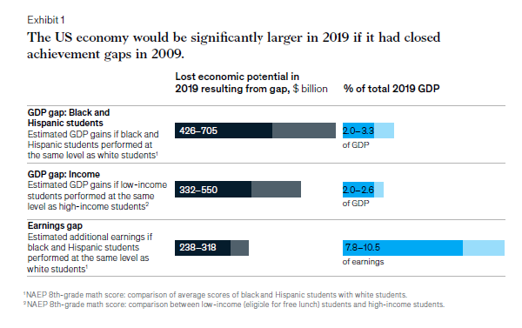
Achievement Gaps in Economic Terms

Slide 58
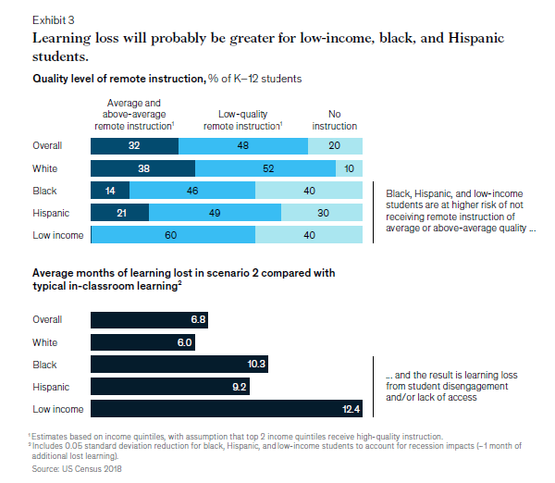

Slide 59
COVID Learning Gap https://www.edweek.org/ew/issues/reopening-schools/overcoming-covid-19-learning-loss.html?r=1482394025 1/
EdWeek Project: Overcoming COVID Learning Loss
> Full report: How We Go Back to School
> Part 1: Socially Distanced School Day
> Part 2: Scheduling and Staffing
> Part 3: Transportation
> Part 4: Remote Learning
> Part 5: Teaching and Learning
> Part 6: Overcoming Learning Loss
> Part 7: Teaching SEL Skills
> Part 8: Closing Equity Gaps
“There’s no question that the shift to remote learning was a blow to many students who were already vulnerable before the pandemic even started—particularly students of color and low-income children and youths. Yet, educators and experts say that the new school year doesn’t have to be a repeat of the spring, if educators are committed to focused work in accelerating learning, reaching out to families, supporting technology needs, and revising and evolving plans when necessary.”
Deep Dive: Fighting for Fairness Amid a Pandemic

Slide 60
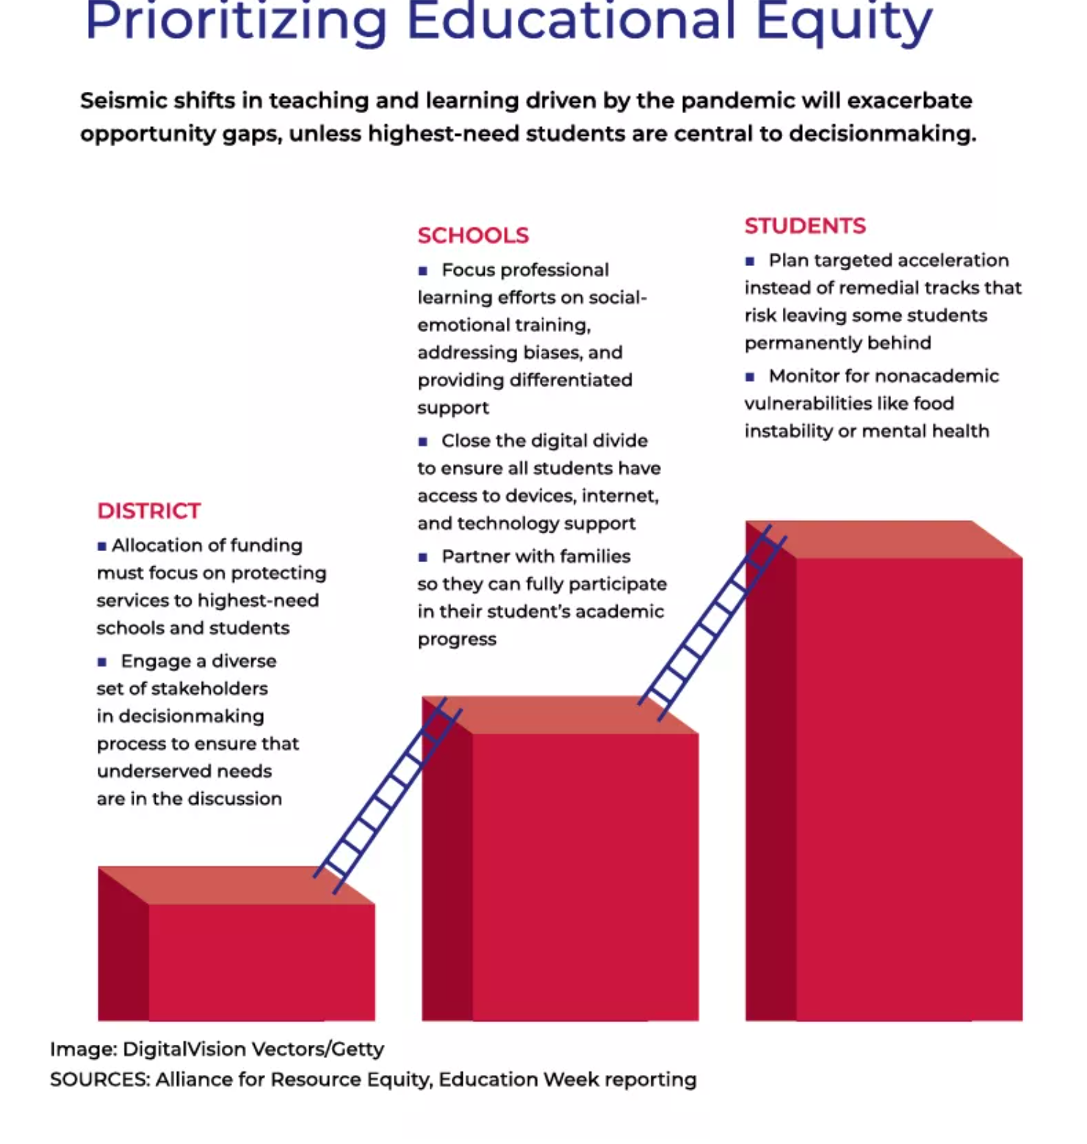
Putting Highest Needs students first: in funding allocations, focused PD, digital divide, family engagement and targeted acceleration.
Lots of monitoring. . .

Slide 61
Next steps
Prioritizing your priorities:
Survey will be entered in the chat soon.
But before you do that, here are instructions for your breakout room discussions:
Breakout room discussions:
Small groups to discuss the importance of these priorities.
How we can best advocate for them?
What supports you will need?
Have a note taker record key takeaways and put in the chat when we reconvene the large group.

Slide 62
Priorities for 2021 Session: Looking through the COVID & Equity Lens
Adequate Resources (SSA and Formula Equity)
Poverty/Opportunity (Weighing, ELL, ISL and PK)
Educator and Staff Shortage
Mental Health System Funded
School Board Authority
Remote Learning and Instructional Time
Internet Connectivity and Access
Priority of Public Schools
Survey link in chat
Select your #1, 2, and 3 priorities
Weighted analysis of priorities of the whole group of participants will be shared after your breakout room discussions.
We will share results when we come back into the large ZOOM session.

Slide 63
Priorities Survey and Breakout Rooms Discussions
Reconvene at What time?

Slide 64

Is Advocacy Really My Job?
New Admin Prep Standards
(Public Hearing for State Board of Education Administrative Rules 9.15.2020)

Slide 65
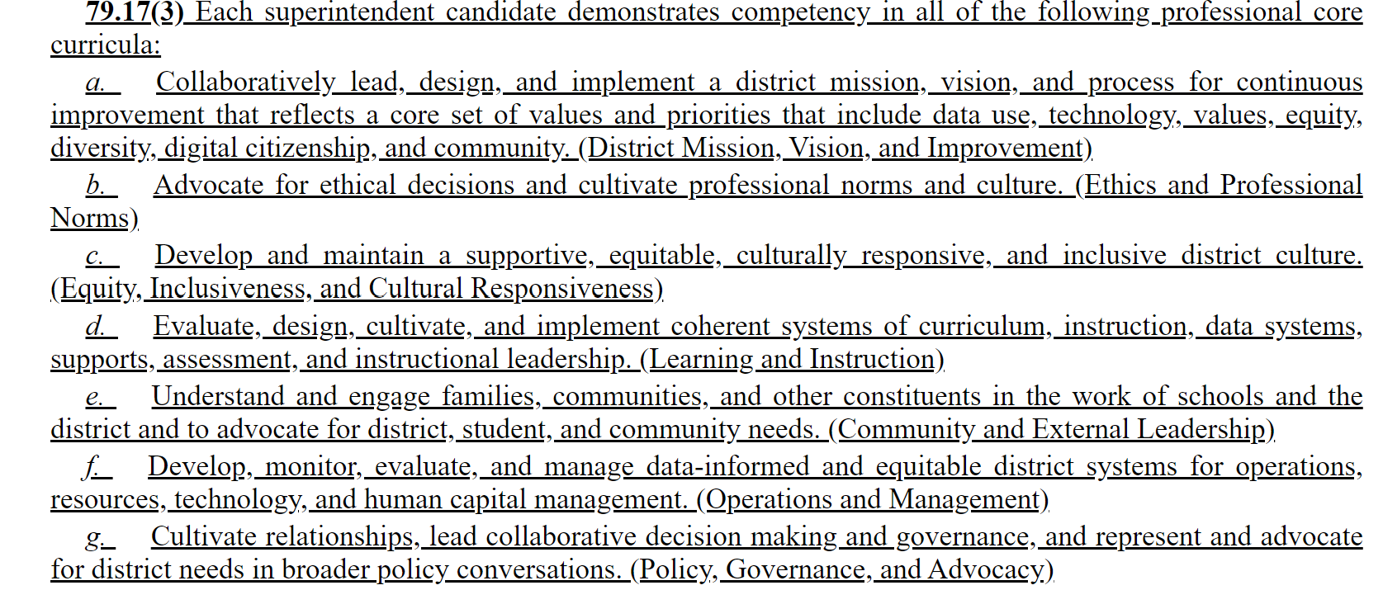
https://rules.iowa.gov/Notice/Details/5148C
Student success depends on effective advocacy for resources, supports, staff, programs, the priority of public education

Slide 66
Now in Particular
Issues of school board flexibility and instructional options during a global pandemic may still be relevant through second semester.
Additional school needs due to COVID, student needs due to different instructional models, staff needs due to health concerns, have all elevated needs at a time of compressed resources
New social distancing rules may flummox the typical ways of lobbying and connecting with legislators as session starts (fundraisers, receptions, local eggs and issues forums, even visits to the Capitol)
Getting your school’s needs, your name and your issues on their radar now before the election is even more important

Slide 67
Who else is at the party?
992 Registered Lobby Groups
Anti-tax organizations
Business groups
Farmers organizations
Unions
Utilities
Builders
Civil Liberties groups
Lawyers
Hospitals/Health Care
Law Enforcement
Cities and Counties
Colleges and Universities
Doves Hunters and PETA
Textbook Companies
Testing Companies
Environmental Groups
Insurance companies
Bus builders
Truckers
Religious groups
Nursing homes
Home schools/private schools
Media
Alcohol distributors
Gaming Institutions
Gun Owners
Gun Control Advocates

Slide 68
Is it worth it?
Joel Blackwell, the “Grassroots Guy”, says that so few people actually engage in the process, that those who do have disproportionate power.
If you can break through the social media noise and establish a good relationship, you can be one of those people.

Slide 69
First Steps
Send a congrats note – include contact information and offer to be an informational resource (offer to review legislation for them, share impact of proposals on your district, staff, students or taxpayers, or just answer questions) Find contact information for legislators you don’t know on the Iowa Secretary of State’s Website here: https://sos.iowa.gov/elections/pdf/Candidates/generalcandidatelist.pdf
Share organizational priorities soon after the election (caucuses set priorities for the Session soon after the election, so don’t delay)
Find out what committees they want to be on – if education, local government, ways and means or appropriations are on that list, pay attention.
Get a meeting – zoom or coffee or DQ
  Introductions
  Exchange contact information
  Give them a position paper/issue brief or two or ask about their priorities for education
  Learn something about them – where did they go to school? How about their children, or grandchildren? Anyone in their family ever teach or get elected to school board?

Slide 70
Next Steps: Create a Coalition
Who could care?
Usual suspects: parents, teachers, board members, SIAC members.
Unusual suspects: Farm Bureau, Chamber of Commerce, Vendors, Taxpayer organization, city/county government, economic development, law enforcement. (Success examples include four-year-old preschool and the state penny)
Infiltrate and educate.
Find one or two persuasive voices from those groups
and be thinking about encouraging future school board candidates from these groups – the old two birds with one stone concept

Slide 71
First Month of Session
Joint effort with other school leaders, with school boards or individually.
Go to home-based forums (eggs and issues) during the Session. Take someone with you who can ask a question.
Reach out to us to get resources before you go and get some timely questions to ask or updated materials to share.
School funding is typically decided (or supposed to be) within 30 days of release of the Governor’s budget, so ask about that up front.
Share the impact of various proposals on your budget, your students, and your community.
Send a thank you note whenever you can – even if you don’t agree on the vote or outcome, let them know you appreciate their work to represent your district and constituents (you can even say, I hope you’ll be able to support our position in the future.)

Slide 72
Finding Core Values/Common Ground
As Americans, we have more in common, despite all claims to the contrary in the current political environment, than you might think.
“Public decisions involve choices and public choices always involve values.”
  Liberty: freedom, autonomy, choice, opportunity, individuality, privacy;
  Community: safety, security, belonging, social order, quality of life;
  Equality: fairness, justice, tolerance, diversity, equal treatment, equal opportunity; and
  Prosperity: productivity, efficiency, growth, markets.
        Phillip Boyle, Local School Board Governance, Spring 2004
Which of these core values is critical in any particular policy choice?

Slide 73
Finding Core Values/Common Ground
Find out what is central to your legislators’ framework.
Tie your goals back to that central theme (translate your needs into their language)
Example: Prosperity/growing the Iowa Economy
  Investments in PK save tax dollars down the road (prevention is worth a pound of cure or efficient use of tax dollars)
  Quality schools prepare a quality workforce (prepared graduates become tax contributors rather than tax eaters)
  Economic market factors – what does it take for a quality teaching workforce? Sufficient salaries and benefits to compete for human capital.

Slide 74
Ask us for help
Data from mapping tool to explain history
Talking points specific to your district
Edit letters to legislators or your local paper
Help thinking about replies to email or questions from legislators
Prep for lobby days or local conversations
Quick resources to share with your board members to prepare them for advocacy moments.

Slide 75
THANK YOU FOR YOUR VOICE on behalf of Iowa students!
Stay connected through the Interim and into the Legislative Session
Let us know what you need to beef up your advocacy efforts.
Margaret Buckton, margaret@iowaschoolfinance.com
UEN Executive Director, ISFIS Partner
1201 63rd Street, Des Moines, IA 50311 (515) 201-3755 cell

