Slide 1

Welcome!
Nov. 15, 2021 Urban Education Network Annual Meeting
6:00 – 8:30 PM

Slide 2
Annual Meeting
Agenda
Welcome, Call to Order by Noreen Bush (UEN Chair) & Introduction of UEN Leadership
Update on UEN [break for dinner]
2021 Session Review and 2022 UEN Legislative Priorities
Advocacy Actions & Supports
Networking Conversations: Advocating with Common Core Values (School Choice/Vouchers)

Slide 3
About UEN
Purpose Statement
Association Management/ISFIS Role
Members

Slide 4
The UEN. . .keeps the state’s lawmakers, media, and public informed about the progress and problems in our state’s largest and most diverse schools, through advocacy, legislation, communications and research.
. . .helps to build capacity in urban education by facilitating connections between member districts to improve student academic performance, narrow achievement gaps, improve professional development; and strengthen leadership, governance, and management.
Joint efforts with other state organizations and policymakers extend the UEN’s influence and effectiveness to the broader community that will ultimately benefit from the contributions of today’s urban students.

Slide 5

UEN Association
Management from ISFIS
Support and staff, accounting, association management, website development and maintenance, billing, meeting organization and tech support. New procedures and policies for UEN operations.
Policy development, strategic planning, legislative and fiscal analysis.
Job-alike meetings for 18 different director-level leaders to share best practice, learn together, receive updates and connect with state-level experts.
Lobbying services, legislative advocacy, communications, media, sharing best practice, survey tools.
Jen Albers jen@iowaschoolfinance.com
James Passick james@iowaschoolfinance.com
Larry Sigel larry@iowaschoolfinance.com
Margaret Buckton margaret@iowaschoolfinance.com

Slide 6
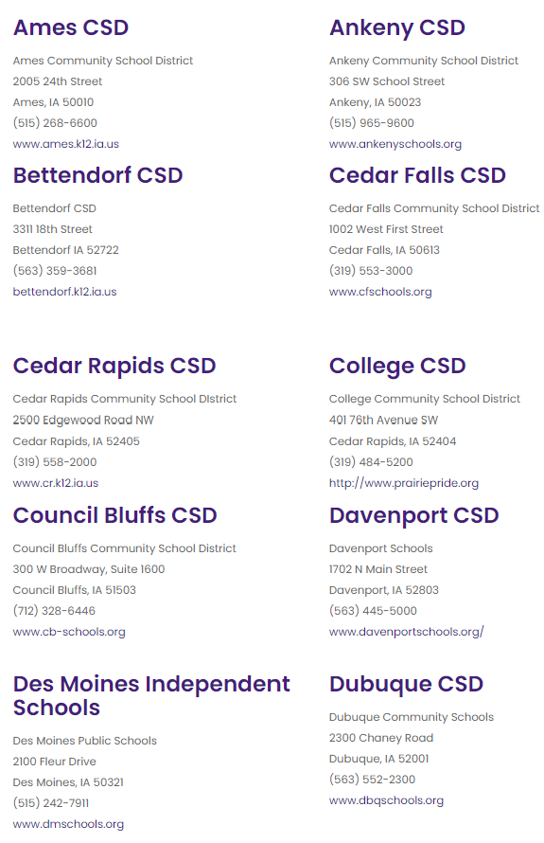
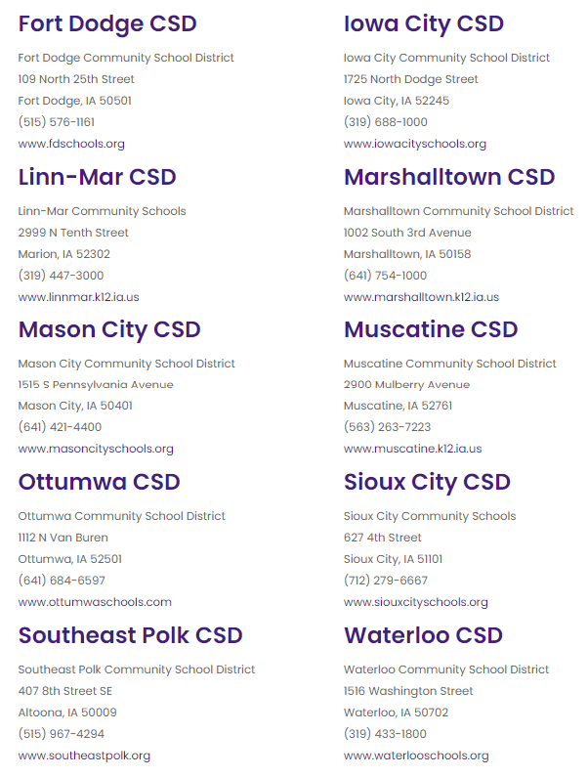
UEN Member Districts 2021-22

Slide 7
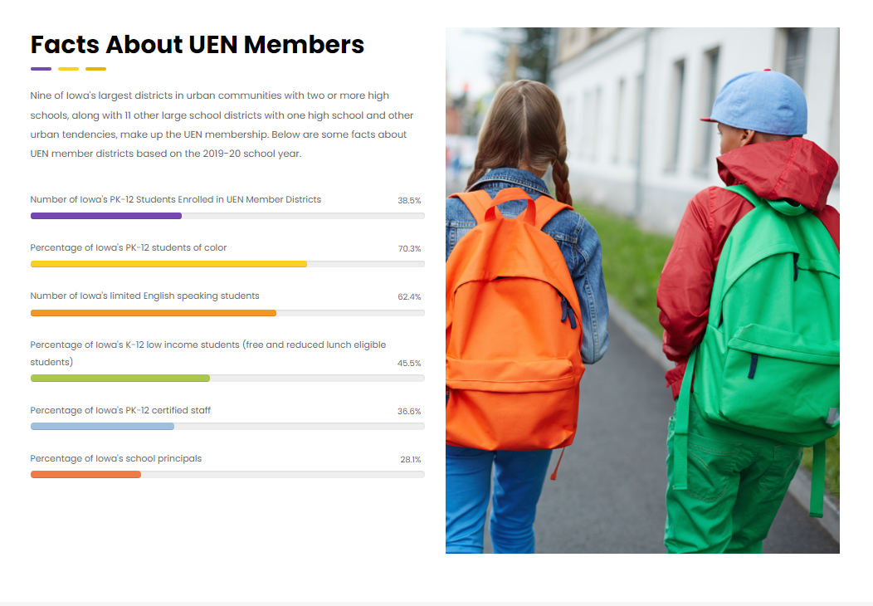

Slide 8
A few more facts . . . UEN Districts
Educate 25,979 students with Individual Education Plans (IEPs) (41% of state total)
Demonstrate a student to administrative staff FTE ratio of 231.4 (state average of 122.5 students per administrative FTE)
Maintain 548 permanent school buildings with a total replacement cost of $4.3 billion (in FY 2014 dollars)
Transport students 9,688,776 route miles (FY 2019)
Have an average daily student attendance rate of 94%
Graduate over 91% of high school students in the 5-year graduation cohort.

Slide 9
Report of the Steering Committee

Slide 10
Steering Committee Action
1. Welcome, Call to Order by Noreen Bush (UEN Chair)
2. Approval of Agenda
3. Approval of Minutes from September 24, 2021 Steering Committee Meeting
4. YTD Financial Report
5. Approve the 2022 Legislative Priorities
6. UEN Annual Meeting & Steering Committee Responsibilities
7. Executive Director Report
8. Superintendent Updates
9. Other Business
10. Upcoming Meeting Dates ‐ https://www.uen-ia.org/calendar
  February 11, 2022 (11‐1)
  May 20, 2022 (11‐1)

Slide 11
UEN 2022 Legislative Priorities
Margaret Buckton and Larry Sigel

Slide 12
Invest in Iowa’s Future:
Provide adequate school funding with SSA set at 5.0% with a minimum of 3.75% SSA for inflationary costs and competitive wage and benefits for staff and an additional 1.25% SSA for childcare and workforce pipeline challenges for 2022-23 school year. Funding should be set predictably, timely, sustainably and equitably. Continued progress on the inequity within the formula is important. Districts must have adequate funding to address growing inflation and teacher and other staff shortages in Iowa’s competitive employment economy.
Messaging: This is about our students’ future, our economy’s future and our state’s future. With 6.6% inflation set as the PERB benchmark for arbitrations, Iowa schools need adequate funding to compete with private sector employers for staff.

Slide 13
Student Opportunity Equity (Close the Gap)
Close achievement gaps by increasing resources in the short term for English-language learners, minority students and early childhood/ preschool with a long-term focus on low-income and at-risk students.
Preschool budget protections from enrollment swings; including state funding for 2021-22 PK enrollment growth if federal funding is not forthcoming.
Messaging: Federal pandemic funds give schools an opportunity to invest wisely to meet the needs of low-income, minority, non-English-speaking students and students with disabilities. The Pandemic has increased needs. Prevention is an efficient and affordable strategy (PK).

Slide 14
Teacher, Administrator and Staff Shortage:
Promote staff diversity and talent, waiver of one-year experience for licensure reciprocity in recruiting diverse staff to better reflect diversity in student populations, flexibility in hiring, loan forgiveness programs and hiring retirees without negative IPERS implications.
Iowa’s Future Ready Workforce should include an educator focus to replenish the talent pool and attract high school and college students to a career in education.
Messaging: Iowa’s growing economy and inflation have made private sector jobs more attractive. Fewer college students are choosing education careers. Student loan debt and lower beginning teacher pay drives new teachers to other states.

Slide 15
Mental Health Services:
Structure and funding to eliminate the shortage of professionals. Funds to provide case management and service coordination is required when Medicaid, special education or other categorical funds do not cover it. School districts require capacity and/or funding to provide:
  1) transition support and services for students returning to school after a mental health placement,
  2) ongoing teacher, administrator, and support staff training to improve awareness and understanding of child social emotional, behavioral and mental health needs,
  3) actionable classroom strategies to address student needs, and
  4) Integration of mental health promotion into instruction when appropriate
  Messaging: the pandemic has intensified student needs and continues to shine a light on barriers to services. Schools can not do this alone. We must work with communities, providers, payors and the state to provide a system of service opportunities to meet student needs. Federal Pandemic funds can help for those districts with significant distributions. However, ESSER funds are time limited and will be exhausted soon.

Slide 16
District Authority:
Home Rule in Iowa Code 274.3 requires liberally construing the laws affecting schools to effectuate the purposes of local control. UEN makes a strong statement that the legislature and governor should focus their efforts on flexibility rather than state-mandated one-size-fits-all action.
A specific ask: request flexibility to use school general fund to pay for expanded preschool slots.
Messaging: locally elected officials are closest to the needs of students and communities. Local voters will hold school boards accountable. Local leaders not only listen to but engage parents and communities to best serve and prepare students for a successful future.

Slide 17
Other Issues (Election Year)
Expect to play defense on School Choice/Vouchers/Education Savings Account
Watch for information about tax cuts and advocate for the right mix of tax relief and funding of our education priorities
Future Ready Workforce and CTE enthusiasm might provide some inroads into additional programs for students
ELL tiered-weighting last year set up a process. Additional funding might be considered this next session.
UEN considers proposed legislation through the lens of these core values:
        opportunities for students
        equitable outcomes for students
        understanding of large systems
        support and respect for school staff
        local control
        risk management
        partnerships with other stakeholders
  We encourage members to weigh in on our registrations and will call in Steering Committee and job-alike groups for additional information or guidance.

Slide 18
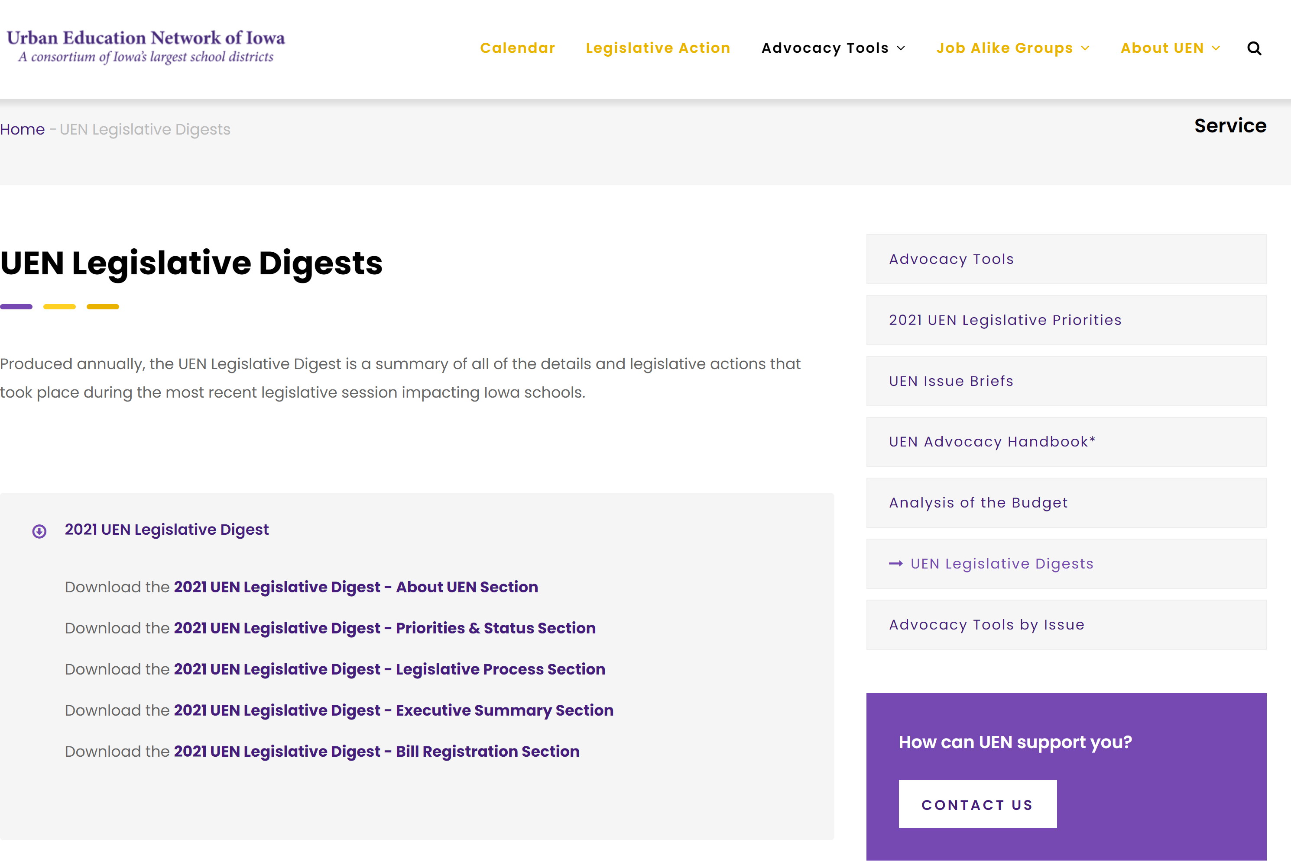
https://www.uen-ia.org/legislativedigest

Slide 19

School Funding: How does Iowa stack up when compared with other states?

Slide 20
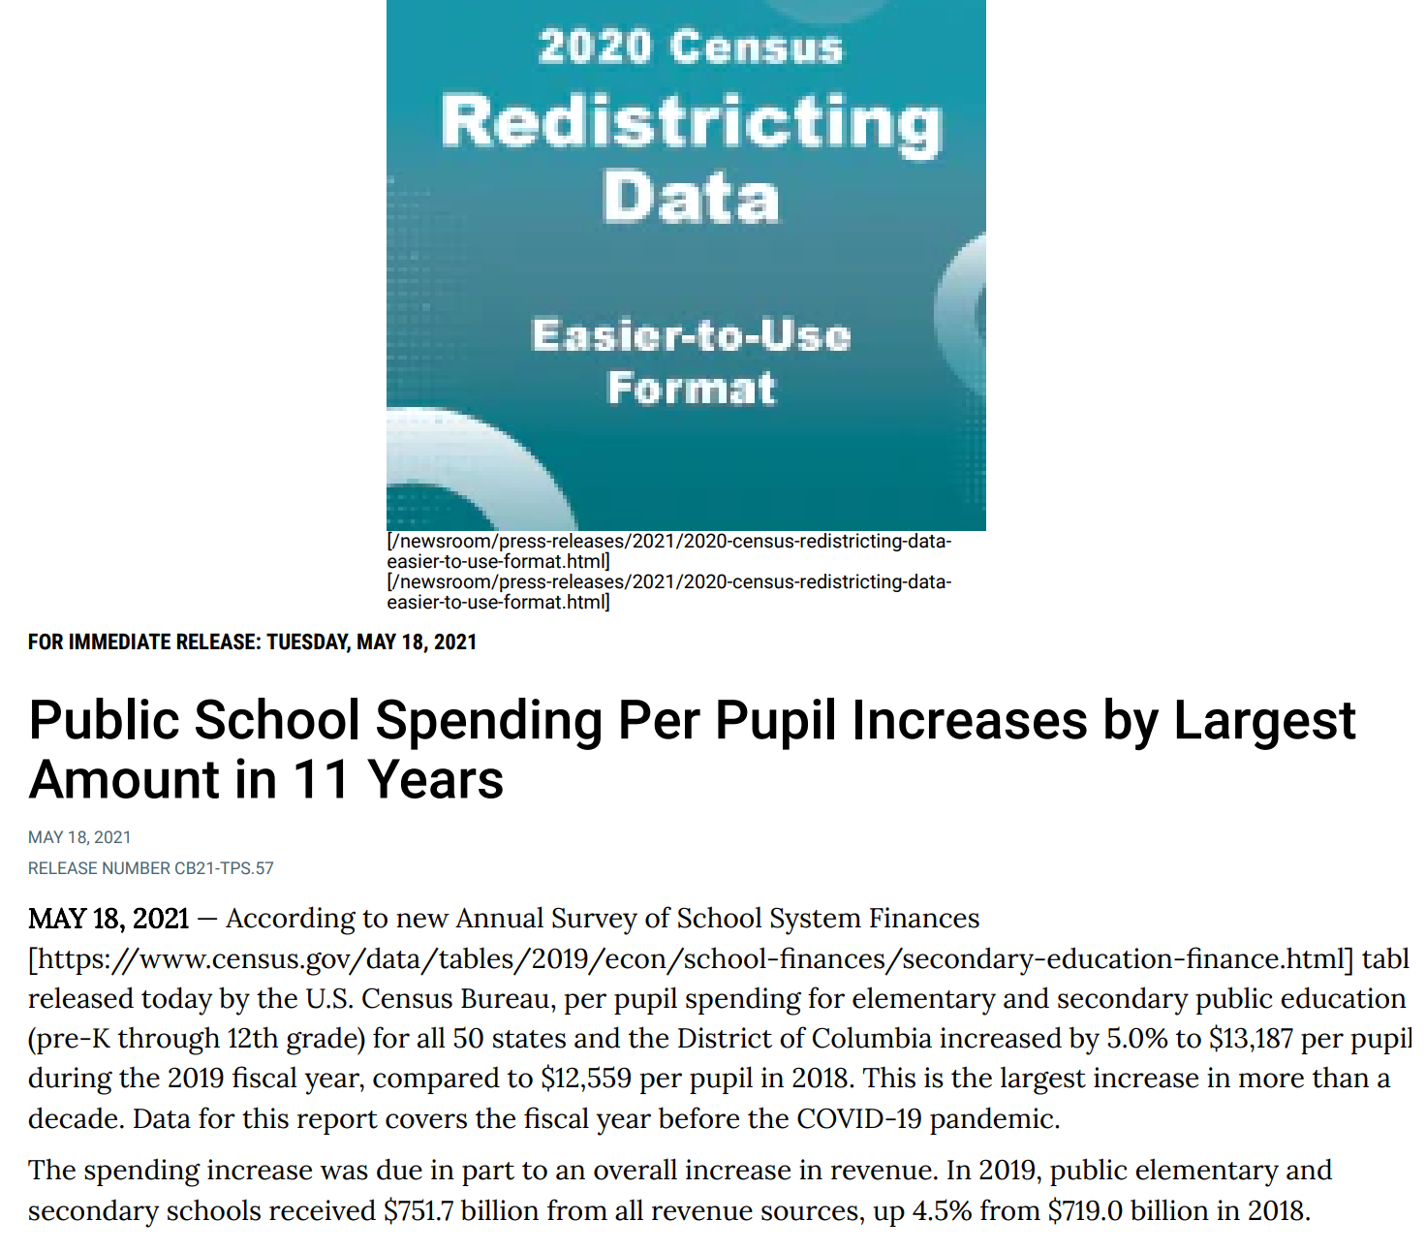
https://www.census.gov/data/tables/2019/econ/school-finances/secondary-education-finance.html

Slide 21
Table 8. | Per Pupil Amounts for Current Spending of Public Elementary-Secondary School Systems
 | by State: Fiscal Year 2019
(Dollars.)
Geographic area |  |  |  |  | Instruction |  |  | Support services
 |  |  |  |  |  |  |  |  |  | Instructional
 |  |  | Salaries and | Employee |  | Salaries and | Employee |  | Pupil | staff | General | School
 |  | Total ¹ | wages | benefits | Total ¹ | wages | benefits | Total ¹ | support | support | administration | administration
United States................................................................ |  | 13,187 | 7,498 | 3,299 | 7,963 | 4,996 | 2,206 | 4,701 | 818 | 638 | 257 | 738
Iowa.............................................................................. |  | 11,907 | 7,550 | 2,564 | 7,148 | 4,994 | 1,678 | 4,271 | 716 | 755 | 301 | 673
 |  | $ (1,280) | 52 | (734) | (816) | (2) | (529) | (429) | (102) | 117 | 44 | (65)
$1,280 less spending per pupil
$734 less per pupil in benefits
$816 less per pupil in instruction
$429 less per pupil in support services of which $65 per pupil is less in school administration
US Census SOURCE: 2019 Annual Survey of School System Finances. Data are not subject to sampling error, but for information on nonsampling error and definitions, see introductory text. Data users who create their own estimates from these tables should cite the U.S. Census Bureau as the source of the original data only.

Slide 22
Increase in Per Pupil Spending
2014-2019: Iowa ranks 40th
2019 US Census data updated May 2021 https://www.census.gov/data/tables/2019/econ/school-finances/secondary-education-finance.html
Iowa slipped to 30th in per pupil public elementary and secondary school system expenditures, which is $1,280 below the national average.
Since 2014, Iowa elementary and secondary education spending has increased 11.6%, while the national average increase has been 19.9%. In the Midwest region, Nebraska is the only state outpaced by Iowa.
Iowa ranks 40th in per pupil expenditure increase since 2014.

Slide 23
NASBO Annual School
Expenditure Report
ISFIS Note: Iowa’s level funding ratio in 2021 may be more about PTRP through the formula than a relative increase in education total revenue.

Slide 24
Table 5. | Percentage Distribution of Public Elementary-Secondary School System Revenue by Source and State:
 | Fiscal Year 2019
(Detail may not add to total because of rounding. For meaning of abbreviations and symbols, see footnotes.)
Geographic area |  |  | Federal sources |  | State sources |  | Local sources
 |  |  |  |  |  | General |  | Taxes and parent
 |  |  |  |  |  | formula |  | government | Other local
 |  | Total | Total ¹ | Title I | Total ¹ | assistance | Total ¹ | contributions | governments | Charges
United States |  | 100.0 | 7.7 | 1.9 | 46.7 | 31.4 | 45.6 | 39.2 | 1.3 | 2.0
Iowa |  | 100.0 | 6.9 | 1.3 | 52.8 | 37.3 | 40.3 | 35.4 | 0.1 | 2.5
Difference (Iowa – USA) |  |  | -0.79 | -0.53 | 6.10 | 5.85 | -5.31 | -3.82 | -1.27 | 0.42
Federal funding is 0.79% below the national average
State percent of funding is 6.10% above the national average
Local percent of funding is 5.31% below the national average
More state funding in the mix means the state is more on the hook to fund inflation and costs that schools experience in addition to new programs.

Slide 25
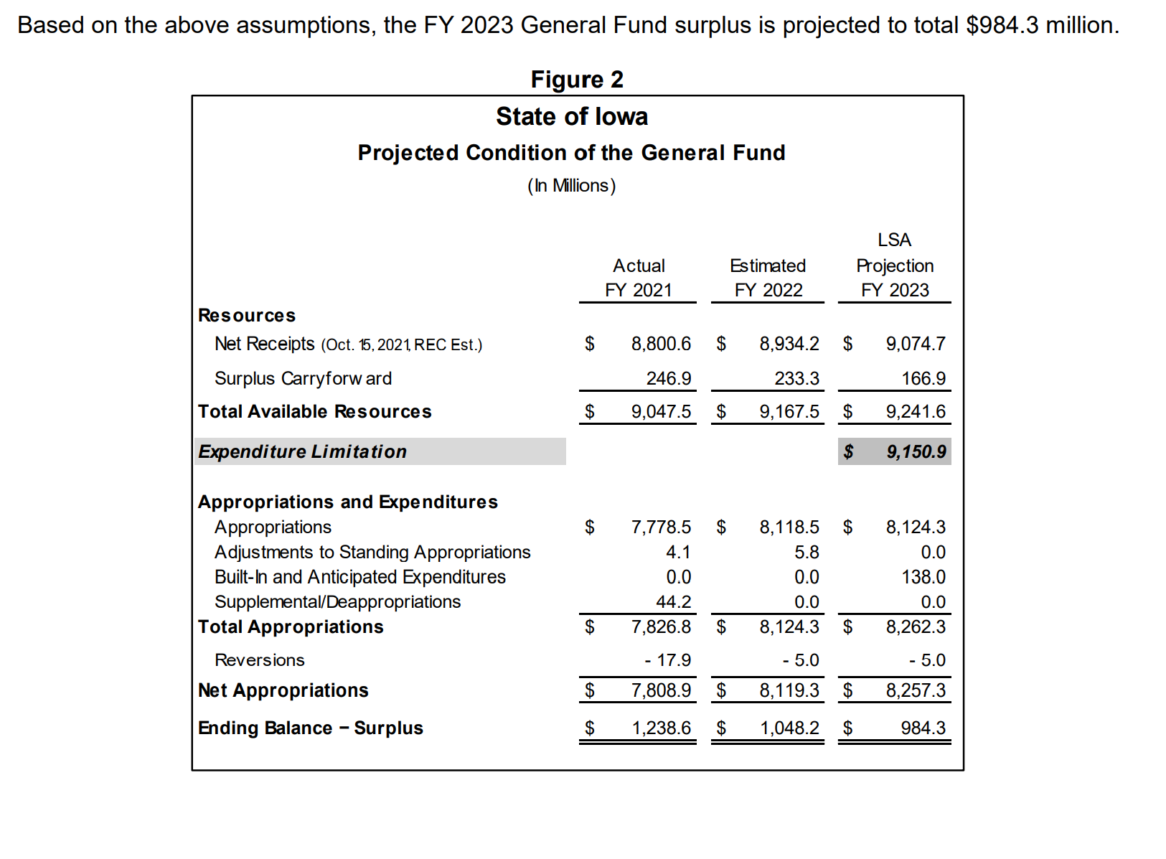
LSA General Fund Balance Sheet Update (October 2021)
Document published location: https://www.legis.iowa.gov/docs/publications/BL/1231137.pdf
FY 2021 Actual Surplus - $1.24 Billion
LSA revised balance sheet estimates additional surpluses for FY 2022 and FY 2023.

Slide 26
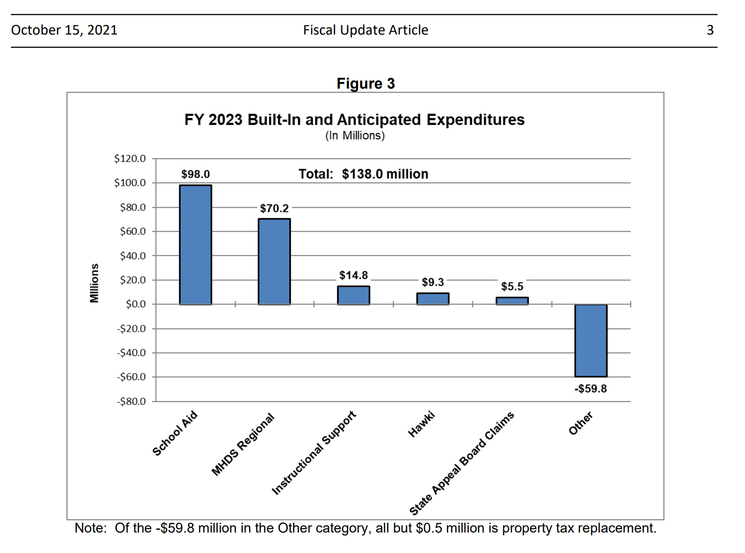
LSA Assumptions:
0 SSA
$23 M enroll growth
$15 M AEA funding
$59 million savings C&I
(net $23 million new funding for schools)

Slide 27
State Supplementary Assistance Preliminary Cost Estimates ISFIS
Assumptions:
State continues Additional Levy pickup
Property valuation growth of 3%
Student enrollment growth of 0.3%
Continuation of AEA reduction
Base on statewide enrollment and weighting changes. Final enrollments and valuations will cause the estimate to change.
Source:
CFPM Statewide Projection
SSA Rate |  | State Aid Change
0.00% |  | $18 million
1.00% |  | $65 million
2.00% |  | $115 million
3.00% |  | $163 million
4.00% |  | $213 million

Slide 28
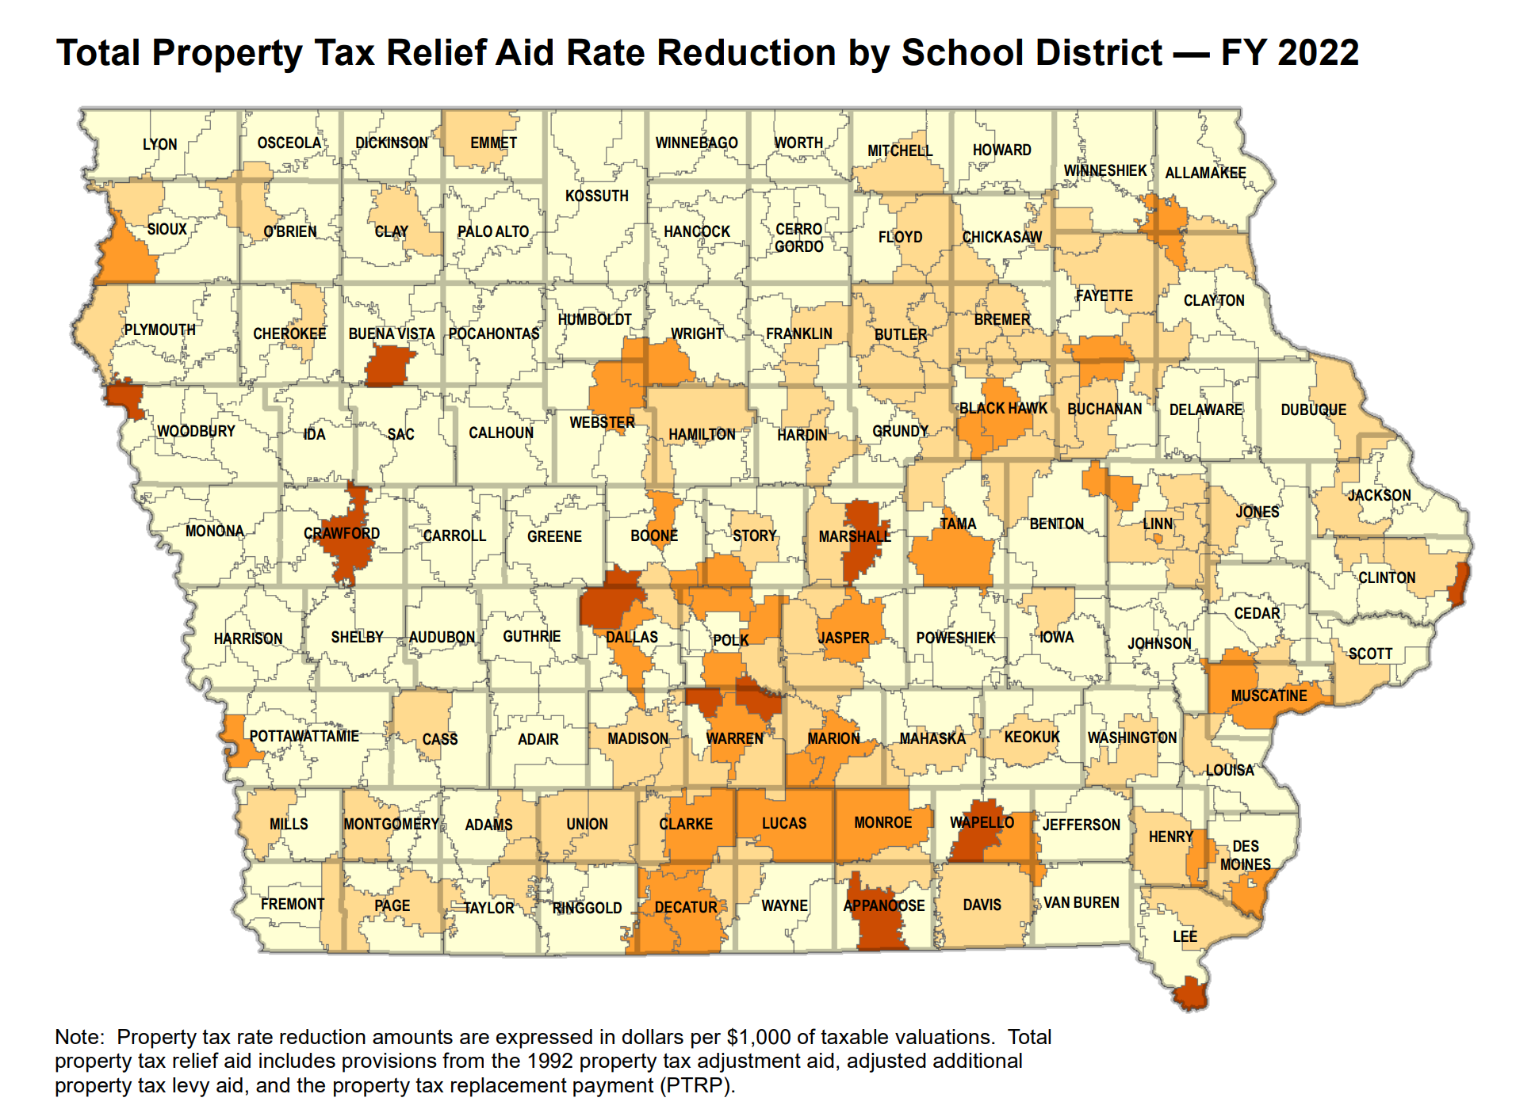
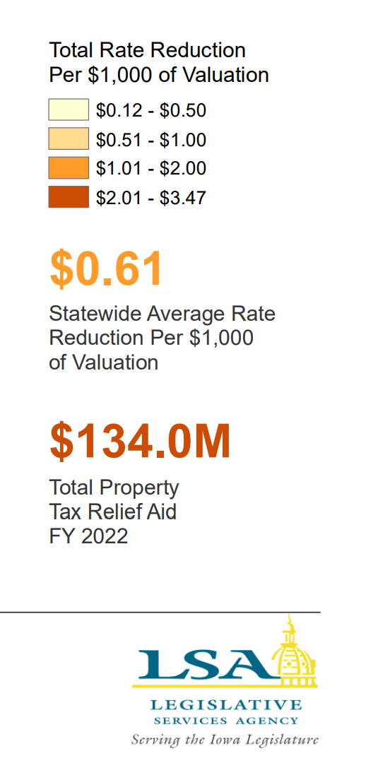
https://www.legis.iowa.gov/docs/publications/MOW/1230723.pdf

Slide 29
40th PP increase in USA

Slide 30
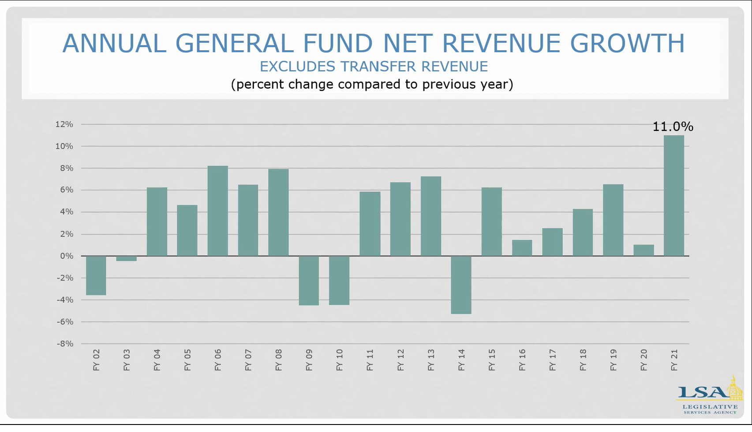
SSA rates:
4.0 4.0 4.0 4.0 4.0 2.0 0.0 2.0 2.0 4.0 1.25 2.25 1.11 1.0 2.06 2.3 2.4

Slide 31
SSA Compared to State Revenue
Since FY 2016, state general fund revenue has grown by about $1,990 million ($1.99 Billion).
Since FY 2016, SSA state appropriations have grown by $449.9 million, or 23% of total revenue growth (well below the metric of Education funding at 40% of the state general fund budget.)
By FY 2023, the state pick up of the formula that would otherwise increase property taxes has grown to $86.6 million. (State dollar instead of property tax dollar for education). So of that $449.9 million, about one fifth of it is property tax relief, not additional dollars for students.
Gov. Reynolds and Republican leaders have publicly stated that the surplus positions Iowa for significant income tax cuts, despite the Oct. 18 REC estimate of 1.5% revenue growth in FY 2022 and FY 2023.

Slide 32
What about all of that federal money?
Help policy makers (and the public) understand the federal ESSER funds:
  It’s reimbursement for expenditures – they didn’t send you a truckload of money
  It’s got strings (e.g., Davis Bacon wage requirements for construction, at least 20% must be spent on COVID learning recovery.)
  Pandemic increases expenditures (technology, staffing, health and safety, mental health supports, supply chain delays & inflation)
  It’s already gone in districts that received low per pupil amounts (Title I distribution formula based on census tract poverty, yet all districts had COVID-19 costs for safely holding in person school)
  Short term – used through Sept. 2024, so even if districts with large per pupil amounts, you can’t count on it to hire staff that you need to keep around for the long term.

Slide 33
Resource Needs:
Adequate increase in SSA to fund:
  Inflation (costs go up). Arbitration ceiling will be 3%, but CPI-U calculation on PERB Website for arbitrations in April 2022 shows inflation at 6.6%.
  Continued programs and new expectations: computer science, dyslexia training, school safety and emergency plans, internships and college-level coursework
  Educators to teach and lead our schools; adequate salaries, benefits, training and ongoing support
  Bus drivers and support staff (paras, food service, custodians, secretaries)
  Course supports: science lab materials, career and technical education costs, fees to community colleges or other school districts for shared courses and content, music/art/drama opportunities for students
  Student needs: offset fees waived, provide instructional materials (online and at school), social workers and mental health supports, translators and ELL instructional materials and supports, behavior supports all the way up to therapeutic classrooms and mental health placements, talented and gifted content, library materials and technology
  Extra- and co-curriculars: not just the heart of the community, but in many cases where students find their passion, learn to set goals and work collaboratively with others. Connect to peers and caring adults.
  ______________________________________________________________
  ______________________________________________________________

Slide 34

Student Inequities and At-risk Needs
In FY 2021, 200,207 Iowa public school students were enrolled in free and reduced price lunch programs, which is 42.8% of all Iowa public school students. This number may understate actual need since many schools provided free lunch to all students during the pandemic.
December 2019 School Finance Interim Committee recommended and 2020 House Education Committee approved a bill, HF 2490, to study of the impact of poverty on education and funding formula options to meet the needs of students. It has not progressed further.
A 2021 bill approved in the House Education Committee, HF 2497, would have allowed SBRC to grant spending authority up to 5% for Dropout Prevention (DoP), but died in the House Appropriations Committee.
COVID challenge: Federal funds tied to Title I distribution formula have provided significant resources to some schools districts. Opportunity for us to demonstrate that investments can make a difference and close the gap for low-income students.
FYI: Children from families with incomes at or below 130% of the poverty level are eligible for free lunch those 130-185% are eligible for reduced lunch. No change in the eligibility threshold but there’s been a big change in Iowa’s participation.

Slide 35
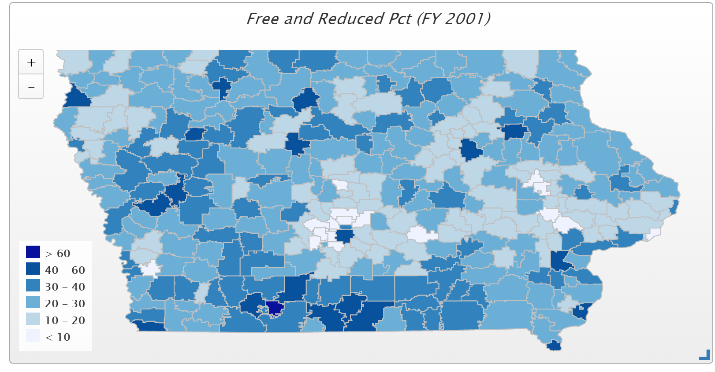
In 2001, only 6 districts had more than 50% of students eligible for FRPL: Waterloo, Keokuk, East Monona, Fox Valley, Wayne and Diagonal. Diagonal was the state high at 60.2% and the only district above 60%.

Slide 36
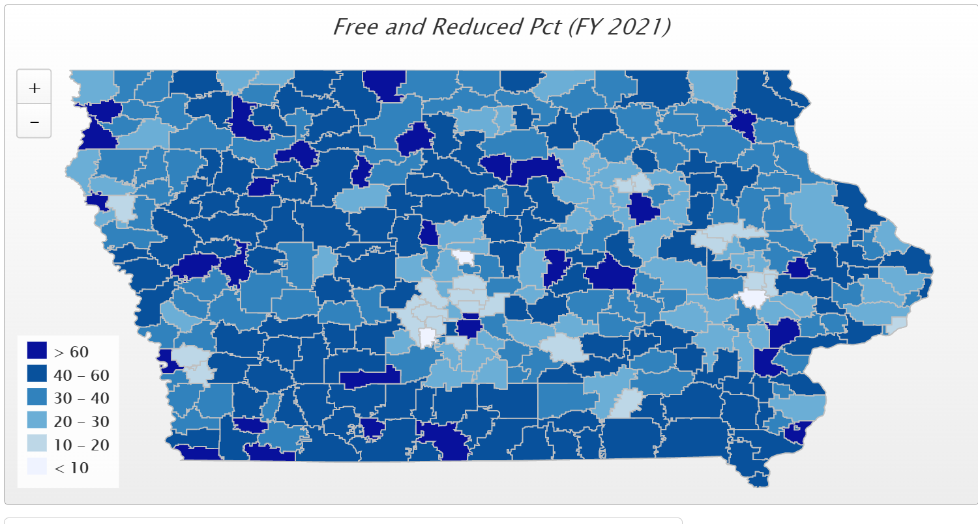
In FY 2021, 78 districts have more than half of their student on FRPL, and 31 districts have more than 60% of students eligible for FRPL. Those above 70% include Council Bluffs, Sioux City, South Page, Hamburg, Storm Lake, Clay Central-Everly, Denison, Marshalltown, Waterloo, Des Moines, LuVerne, Rock Valley, Postville and Stratford.

Slide 37
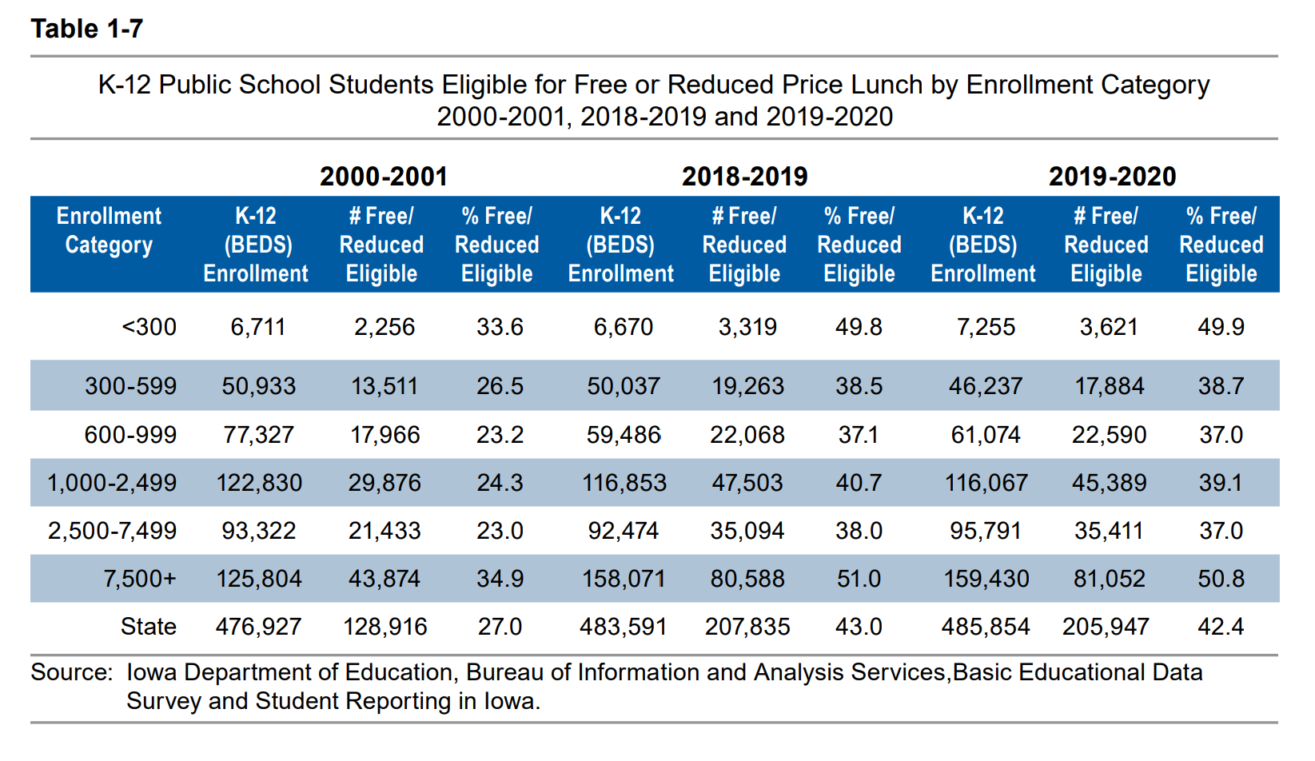
Districts in the largest and smallest enrollment categories had the highest percentage of students eligible for free or reduced price lunch (Table 1-7).

Slide 38
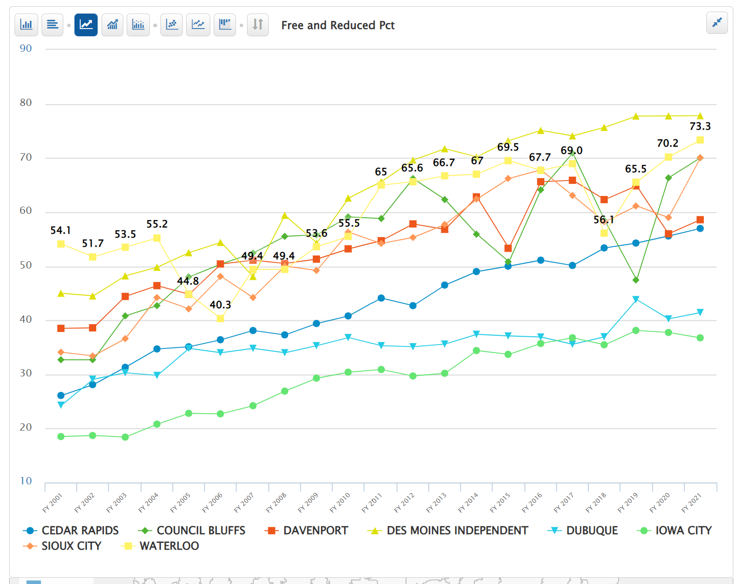
Original Urban Eight

Slide 39
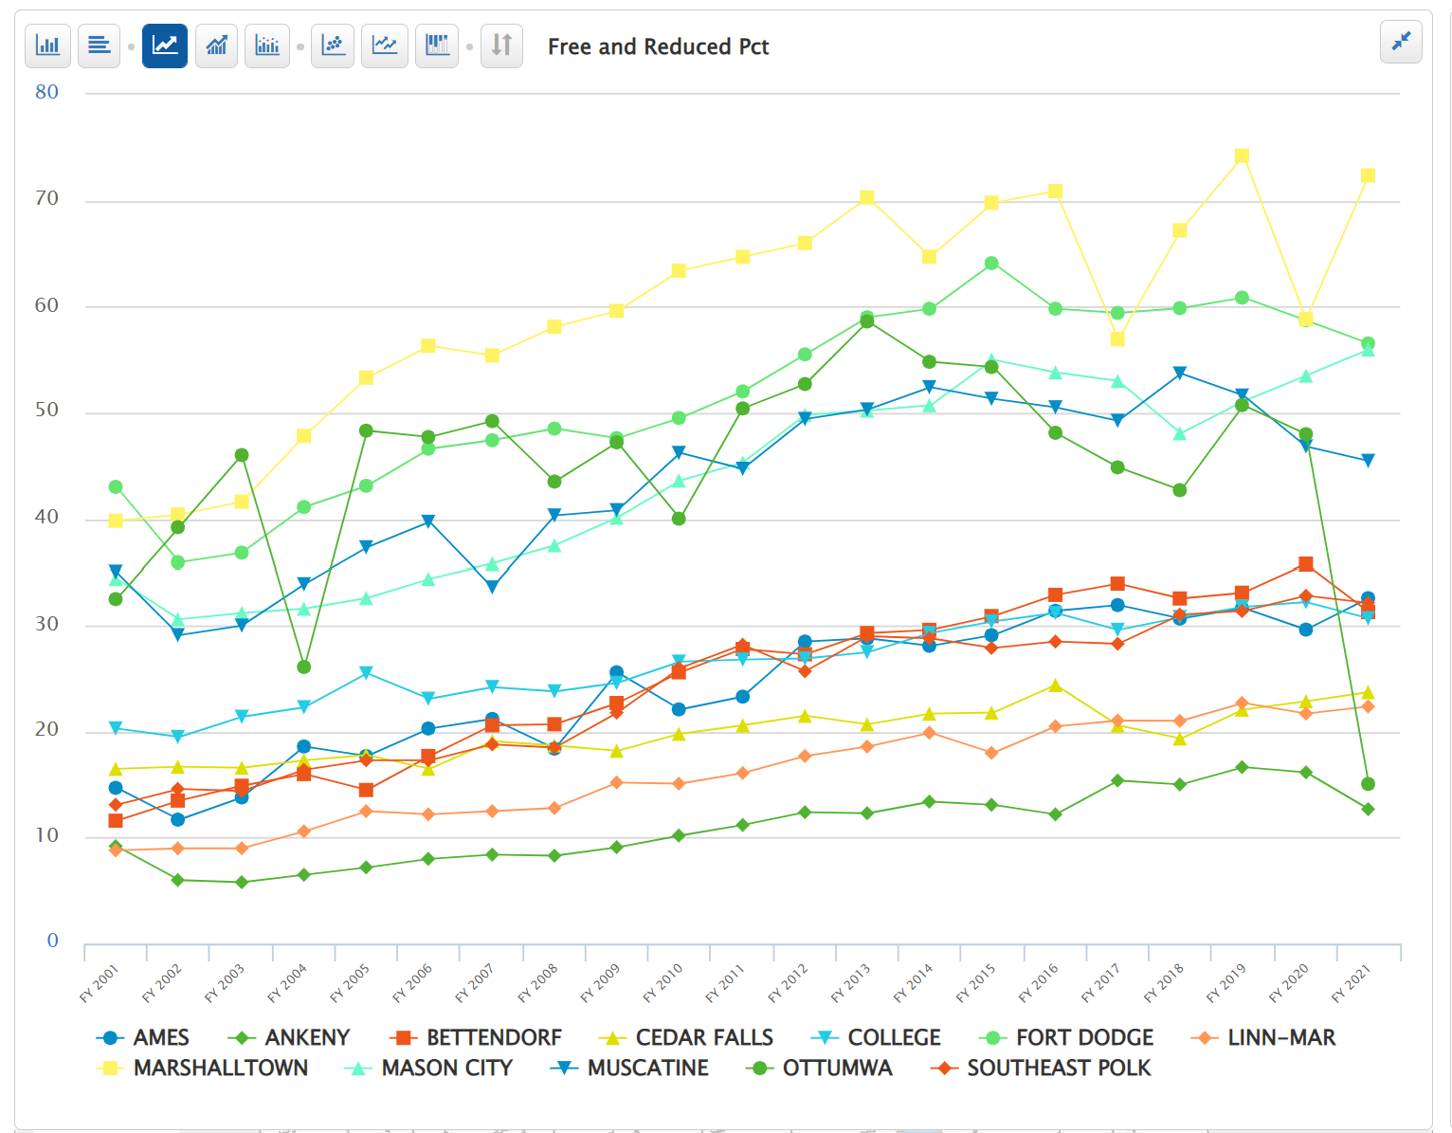
UEN Associate Member Districts

Slide 40

Iowa’s funding for at-risk and dropout prevention translates into less than 10% funding commitment for students in poverty, well short of the national average 29% beyond the base for low-income students. (AIR, Study of a new Method of Funding for Public Schools in Nevada, Sept. 2012)
Students from low-income families are more likely to begin school academically behind, exhibit nonproficient literacy skills, especially in early elementary, and fall further behind over summer breaks, unless schools have the resources, staff and programs to meet their needs.
Districts must waive student fees for FRPL-eligible families, meaning those districts with concentrated poverty have fewer resources for textbooks and drivers’ education.
High-poverty School Investments boost achievement. Education Week, Student Outcomes: Does More Money Really Matter? Fresh research bolsters the case for K-12 cash—and a rough road without it, Daarel Burnette II, June 4, 2019 reports: "More money does, in fact, make a difference, they (researchers) say—provided that you spend enough, and in the right manner. They point to research in the past five years that provides examples of instances where politicians and taxpayers invested more money in teacher salaries, school construction, and schools with high populations of low-income students and saw students’ test scores jump.”
The McCourt School of Public Policy, Georgetown, FutureEd, State Education Funding; The Poverty Equation, March 2020, states, “What’s more, when poverty is concentrated in a school—that is, when a significant portion of students in a school come from low-income households—the impact on performance is compounded. A body of research suggests that there is a ‘tipping point,’ somewhere between 50 to 60 percent of a school’s students living in poverty, where performance for all students there drastically declines.”
Low-income students are an important piece of Iowa’s workforce puzzle, will stay in Iowa, and will either be the backbone of our urban communities’ potential or a drain on future resources.

Slide 41

Quality Preschool

Slide 42
Quality Preschool
HF 318 would have allowed districts to serve and count young 5-year-olds in PK, was approved by the House, but did not get approval in the Senate. Without resources to add new sections, this bill would not serve more PK students in districts that already have waiting lists or unmet demand.
COVID-19 Impact: PK enrollments lower in Fall 2020. PK does not have an on-time funding component or budget guarantee, so your 2022 PK budget was based on the Oct. 1, 2020 enrollment count. Also, DE guidance prohibits school districts from using general fund for PK expansion.
UEN supported HF 868 Education Appropriations which allows districts with increased PK enrollment on Oct. 1, 2021 to apply to the SBRC for spending authority at the 0.5 PK weighting. SBRC will automatically grant the spending authority if the PK ending balance for the prior year is less than 25% and may grant authority if the balance is over 25%. The intent is that the Governor’s Education Emergency Recovery (GEERs) federal funding will cover the costs of the spending authority. We are waiting on the Governor’s office to confirm.

Slide 43
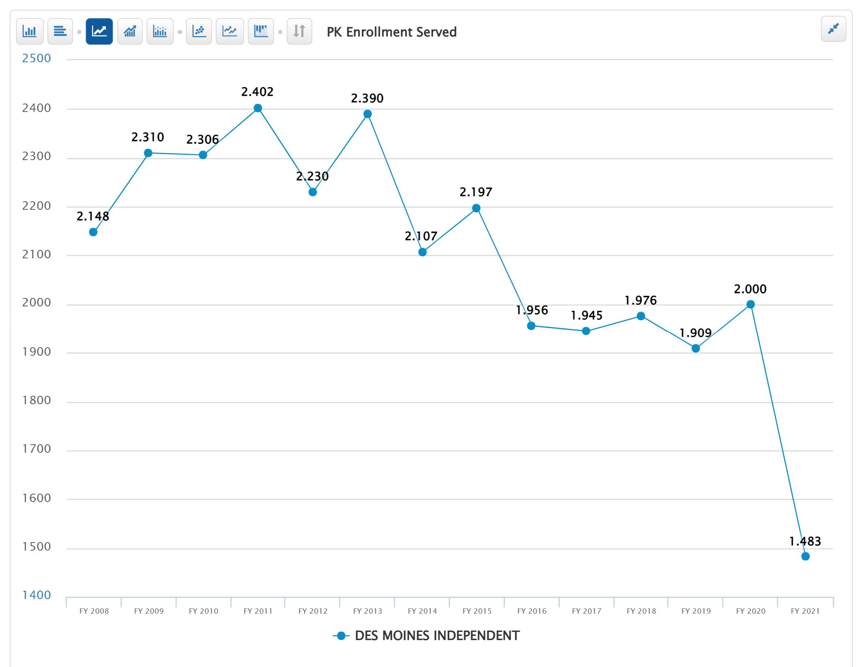
UEN PK History
PK dropped from 31,468 to 27,392 (down 4,076 Oct. 2020 compared to Oct. 2019).
Similarly, Kindergarten also fell from 39,839 to 37,746.
Des Moines down over 500 PK students.

Slide 44
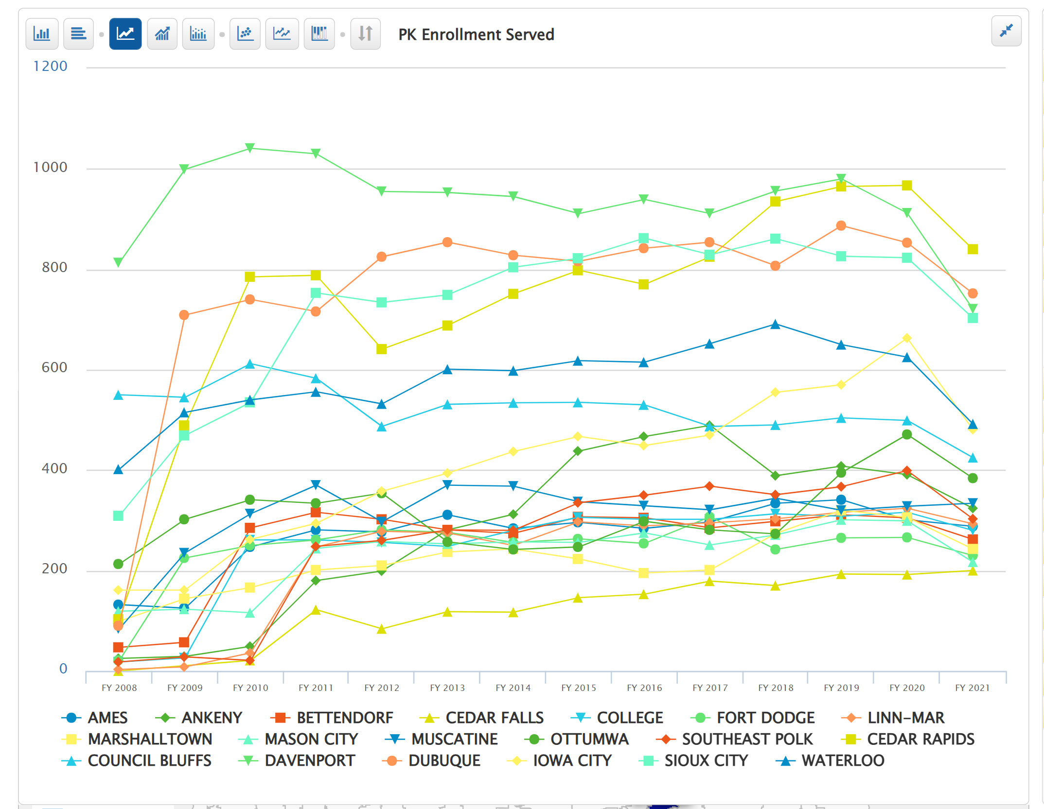
UEN PK History
Oct. 1 2020 drop here
PK dropped from 31,468 to 27,392 (Down 4,076 Oct. 2020 compared to Oct. 2019).
Similarly, Kindergarten also fell from 39,839 to 37,746.

Slide 45
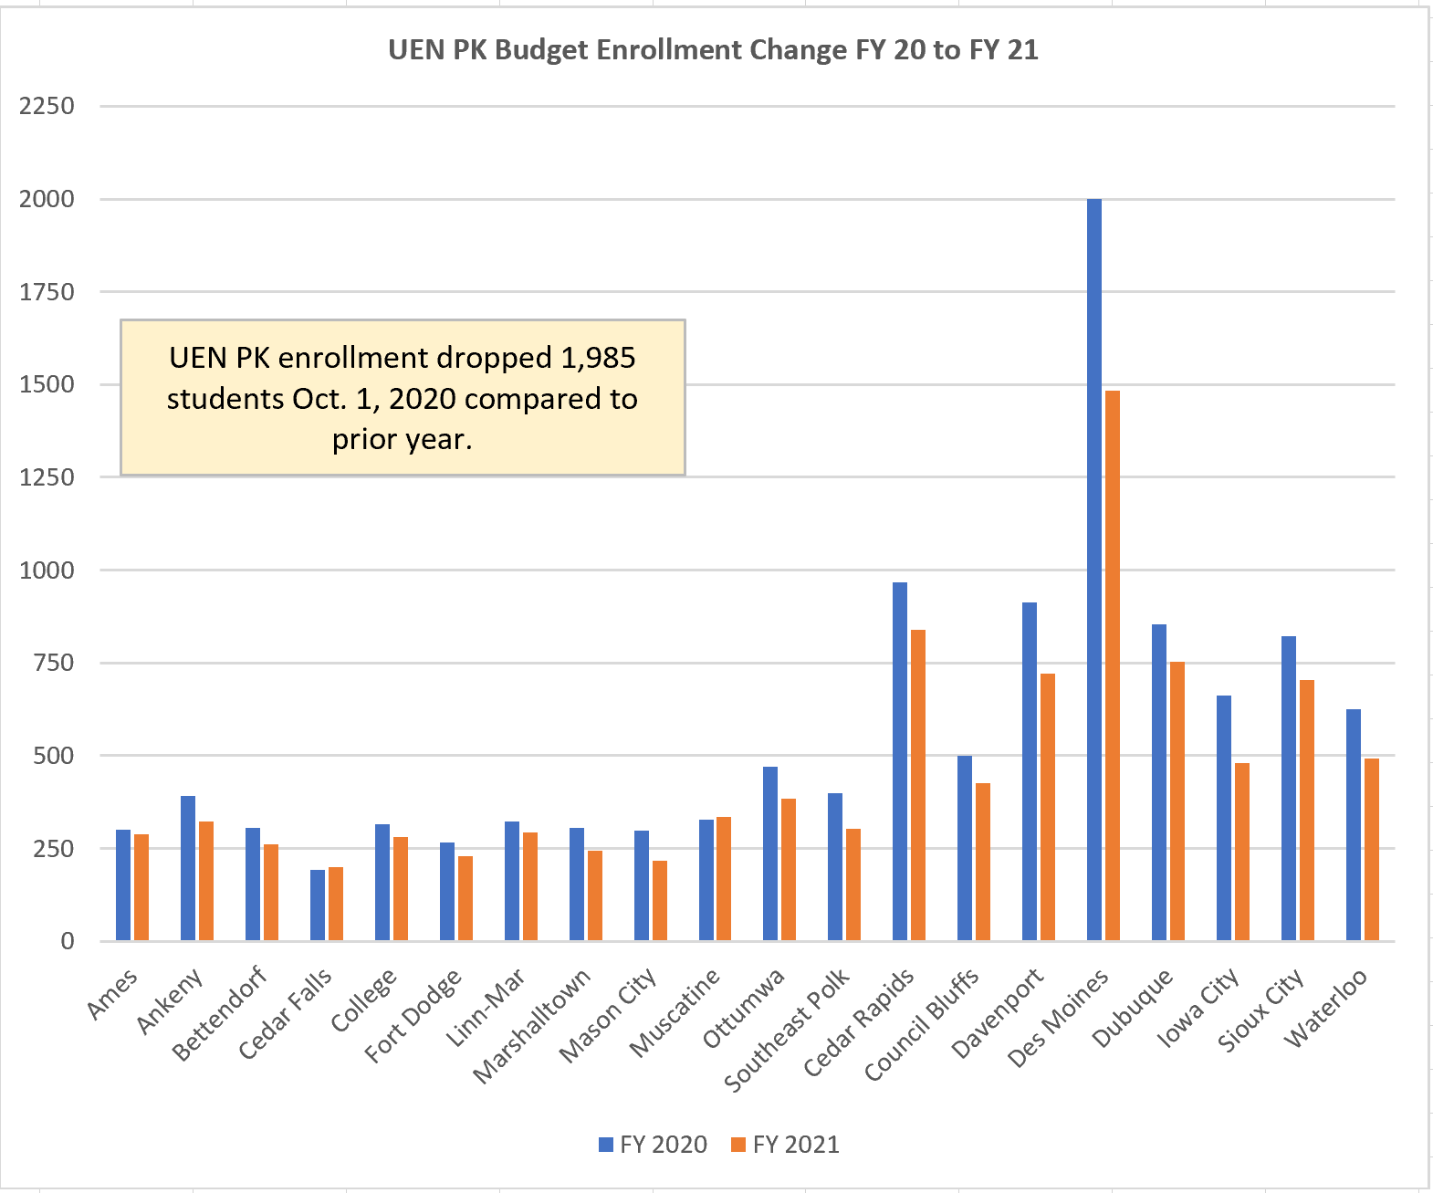

Slide 46
PK = Positive Cost Benefit Outcome
Education Commission of the States, http://www.ecs.org/docs/early-learning-primer.pdf Oct. 2014: Six rigorous long term evaluation studies have found that children who participated in high-quality preschool programs were:
    25% less likely to drop out of school.
    40% less likely to become a teen parent.
    50% less likely to be placed in special education.
    60% less likely to never attend college.
    70% less likely to be arrested for a violent crime.
Sarah Daily, Initiatives from Preschool to Third Grade: A Policymaker’s Guide, shows reductions in costly outcomes that quality preschool prevents. (Denver, CO: Education Commission of the States, October 2014) http://www.ecs.org/docs/early-learning-primer.pdf. The National Conference of State Legislatures quotes studies on long term return on investment. http://www.ncsl.org/research/human-services/new-research-early-education-as-economic-investme.aspx
What does your own data show?

Slide 47
Educator Shortage and Quality Instruction Recent Actions
HF 2627 Licensure Reciprocity (2020 Session). Reciprocity w/states for teachers, admin, and other licensed staff with 1 year experience.
SF 532 Licensed Behavior Therapists and Mental Health Professionals: this bill requires the BOEE to create a Statement of Professional Recognition for these positions.
HF 675 Substitute Authorization: this bill carries forward pandemic flexibility from the public health emergency declarations, allowing AA degree for subs or 60 hours of post-secondary credit. Has a process to extend the 10-day assignment to one classroom under certain circumstances.
HF 770 Professional Development CEU’s: this bill allows specified PD to count for ½ of required continuing education units (CEUs,) required for licensure renewal. The BOEE is required to allow either work on individual PD plan or courses offered by BOEE approved provider (AEAs, MISIC, etc.) to count for this credit.
UEN supported all of these bills.

Slide 48
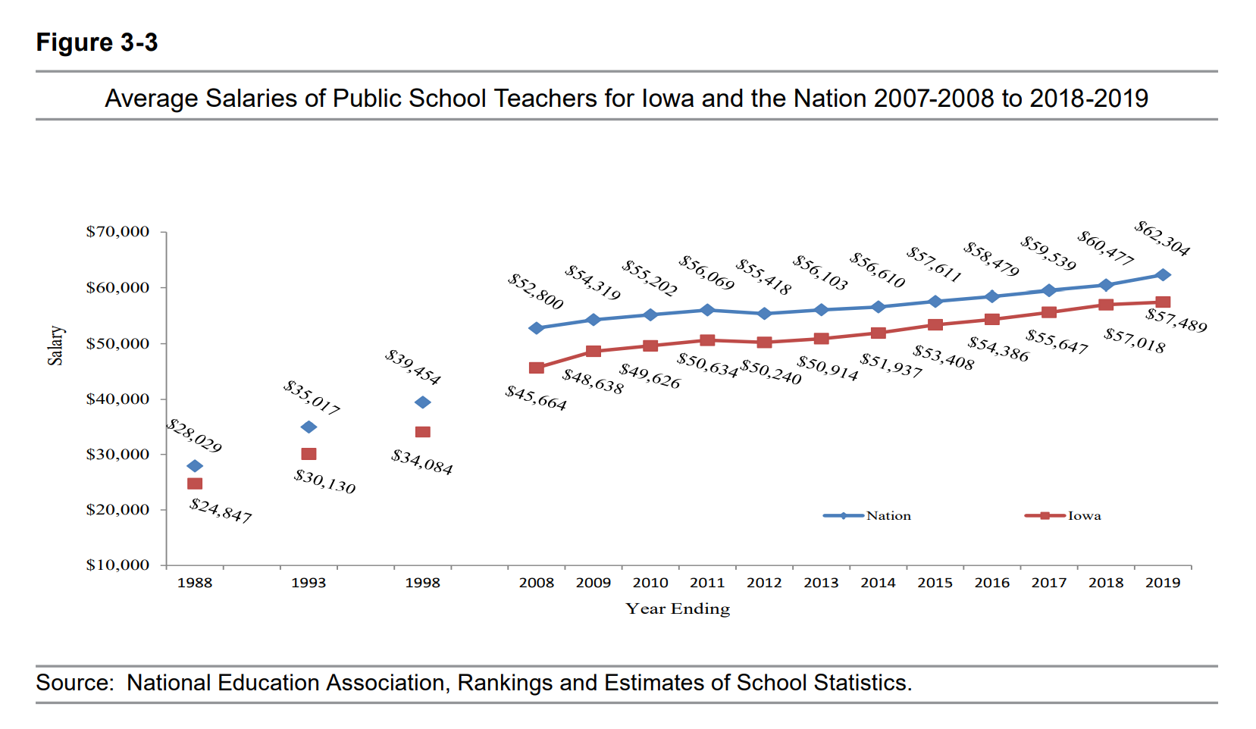
DE Annual Condition of Education 2020
Gap between Iowa Average Teacher Salary and the National Average in 2019 is $4,815 (in 1988, the gap was $3,182). With significant teacher shortages across the nation, beginning teacher pay is also a critical comparison.

Slide 49
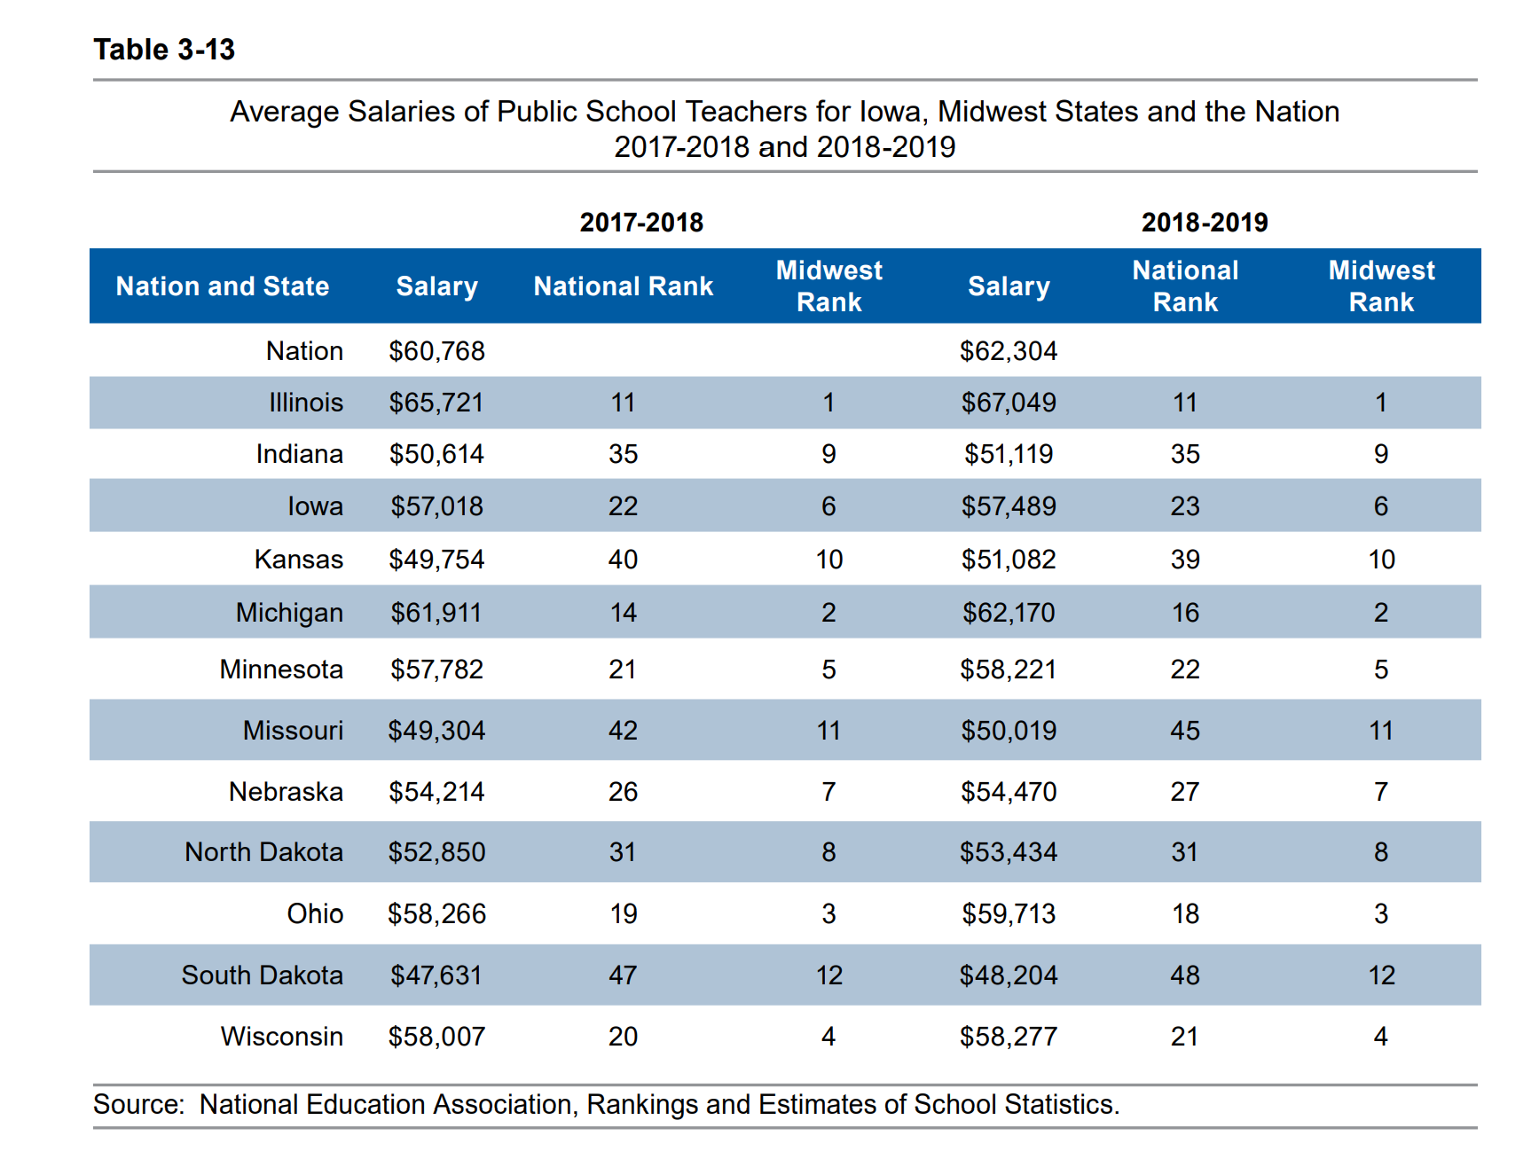
DE Annual Condition of Education 2020

Slide 50
Educator Shortages
Money isn’t everything, but salaries are measurable and comparable
Culture and climate of the school district, adequate support and good leadership also matter to teacher retention. Current level of teacher absences may indicate retention challenges ahead.
Iowa’s Teacher Leadership and Compensation Initiative was improving retention of teachers in Iowa schools* (see your own goals for retention in your TLC plan.) For young teachers, student loan debt requires a sufficient salary to make payments.
There’s a shortage if your school experiences 1) not enough applicants 2) no qualified applicants 3) more teachers working under conditional licensure 4) full time subs in the classroom for longer periods 5) not enough substitutes to cover teacher absences
*Reported prior to COVID-19 p

Slide 51
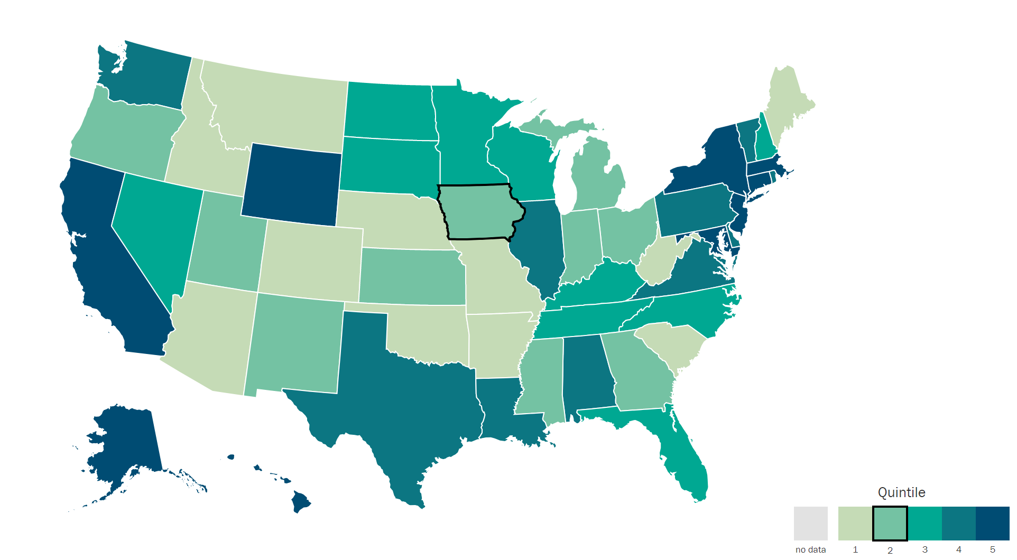
Understanding Teacher Shortages: 2018 Update
A State-by-State Analysis of the Factors Influencing Teacher Supply, Demand, and Equity https://learningpolicyinstitute.org/product/understanding-teacher-shortages-interactive
IL | $38,820
ND | $38,032
MN | $37,644
SD | $37,419
WI | $36,983
IA | $35,766
KS | $34,883
MO | $31,842
IA 6 out of 8 in Midwest.
IA is in the second to lowest quintile, ranking 30th in starting teacher pay.

Slide 52
Teacher Retention and Recruitment:
Shortages in Iowa/Nation
50-state Comparison of Strategies
Policies Iowa Legislature Could Consider
Education Commission of the States

Slide 53
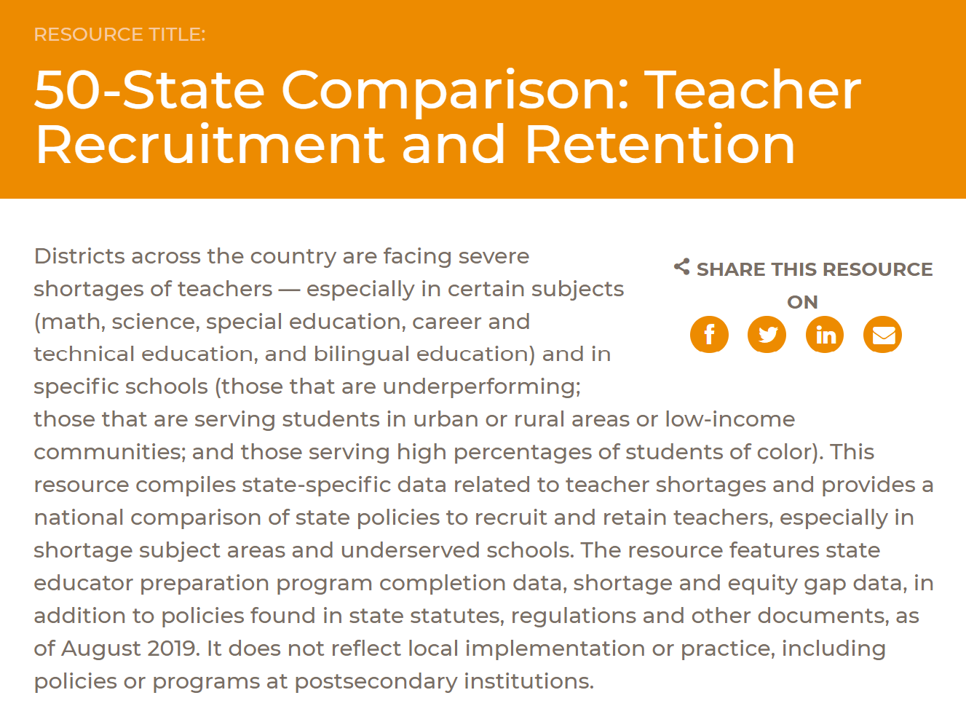

Slide 54
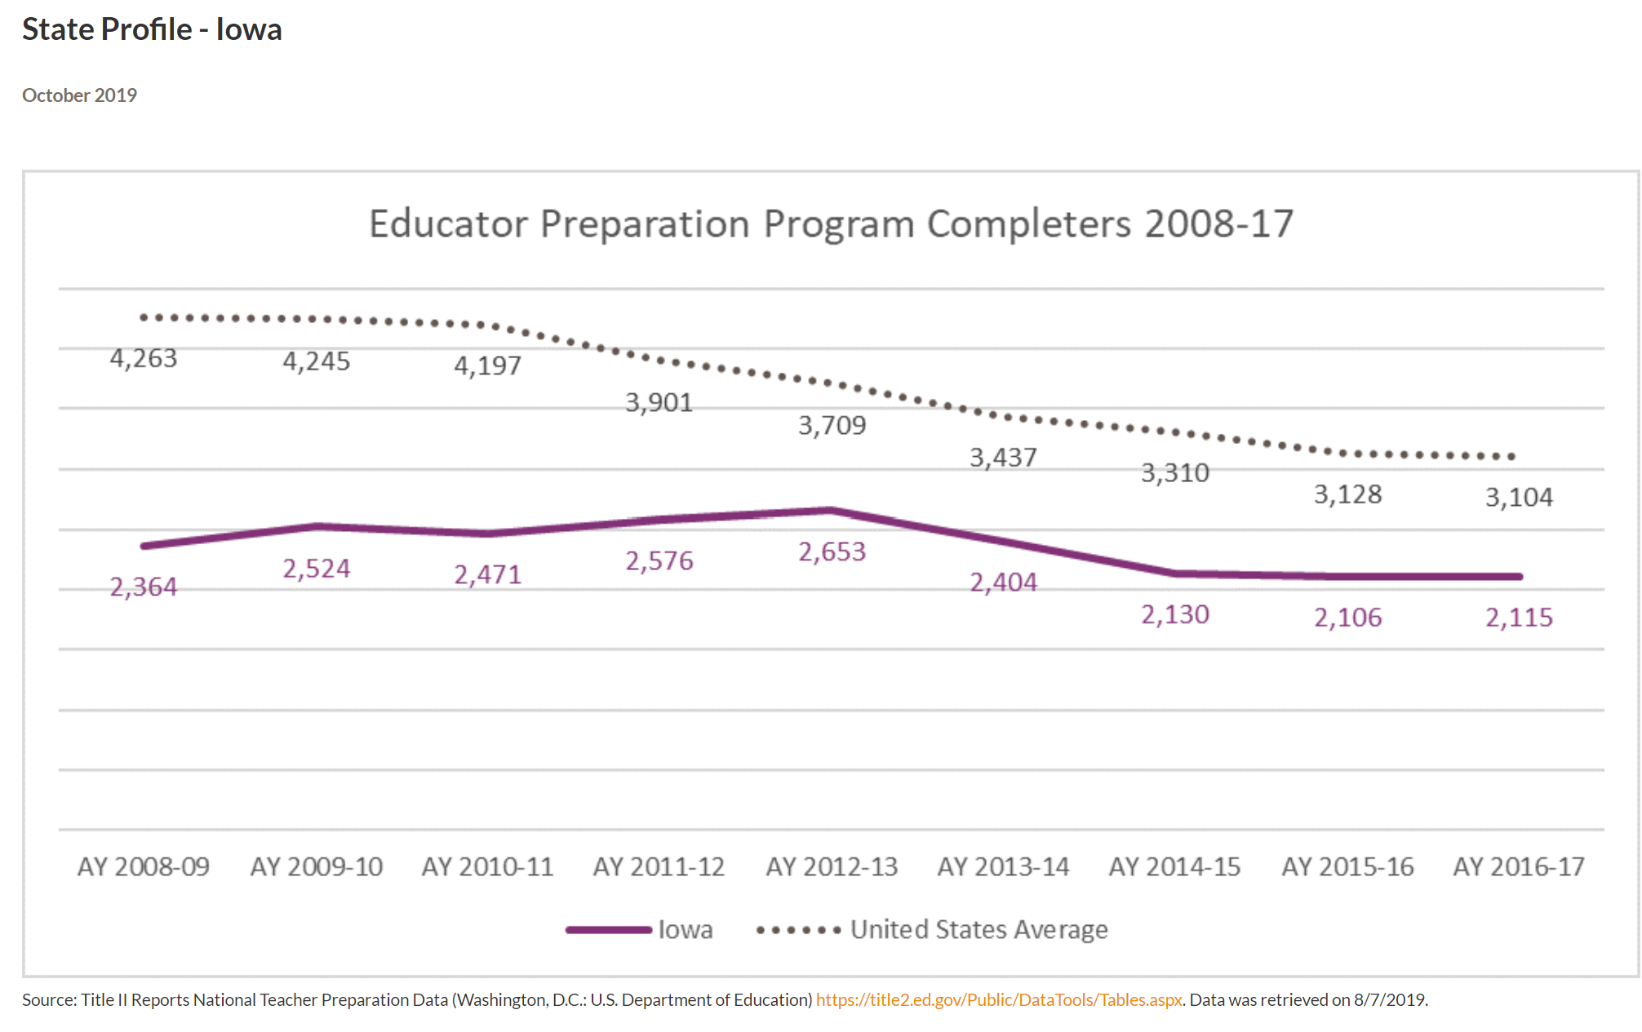
Completers Iowa and the Nation

Slide 55
What does this mean?
Teacher production and overall teacher supply in the United States has grown steadily since the mid-1980s. However, national data trends show an overall decrease in educator preparation program enrollment and completion in recent years. Although new teacher supply data provide an incomplete* picture of a state’s teacher labor market, a decrease in new teacher supply may contribute to new shortages and exacerbate already present shortages within a state. This chart details trends in educator preparation program completion in Iowa, compared with the United States average.
*New teacher supply data do not capture whether graduates are prepared to teach in high-demand subject areas or willing to teach in underserved schools. They do not capture whether graduates meet the requirements for licensure and go on to teach within the state or at all. They also do not capture teachers who are prepared out-of-state or teachers who temporarily leave the profession and then re-enter. Finally, they do not capture the quality of the individuals seeking employment. Supply and demand considerations vary considerably within states. State leaders can consider multiple factors — including, for example, district and school staffing, vacancy data and educator equity gaps — when evaluating their teacher labor market and considering policy solutions.
Last updated: August 2019. To view 50-State Comparisons, click here.

Slide 56
Midwest total reduction in teacher prep completions was 8,183 over this 10-year period, for an average loss of 17%.

Slide 57
Direct impact: states with growing enrollment are producing less teachers, so as Iowa is producing less teachers, other-state recruiting strategies are competing for our completers
Indirect impact: low unemployment generally means private sector business also competes for teachers to fill their labor-pool needs

Slide 58
Teacher Shortage Data
ECS asked: Has the state published state-specific teacher shortage data within the past five years?
ECS Reports that Iowa is one of 8 states that has not published teacher shortage data.
Last report was the EARLY CAREER TEACHER RETENTION IN IOWA by DE evaluated 2006-07 BEDS data. That report stated, at that time, Iowa was better at retaining teachers beyond the initial 5 years (30% leakage) compared to the rest of the nation (around 40-50% leakage)
Studying the problem in Iowa would be a good first step.

Slide 59
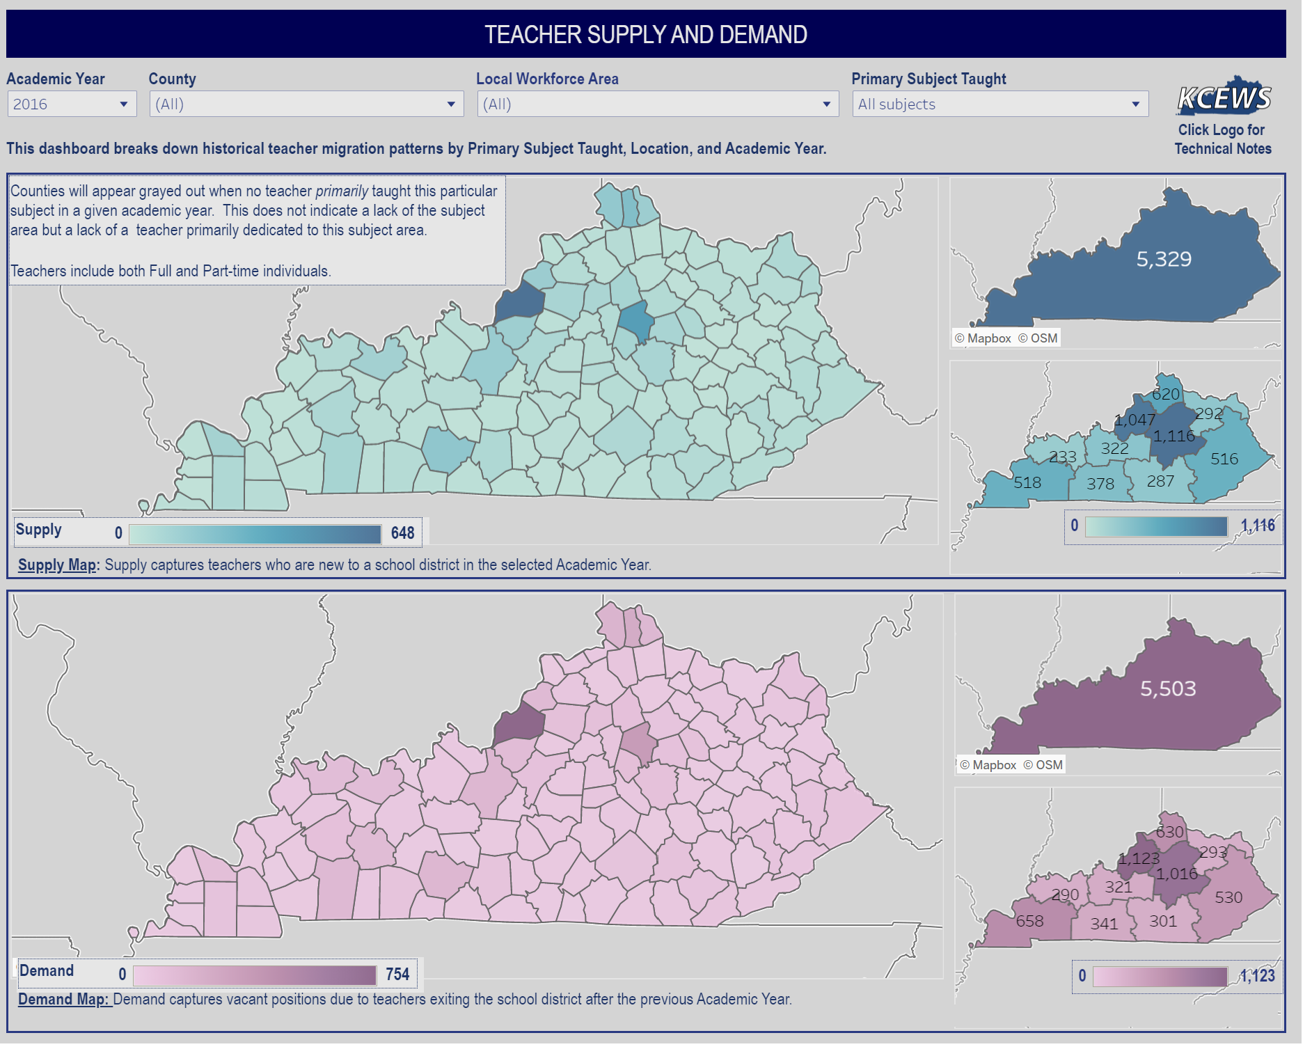
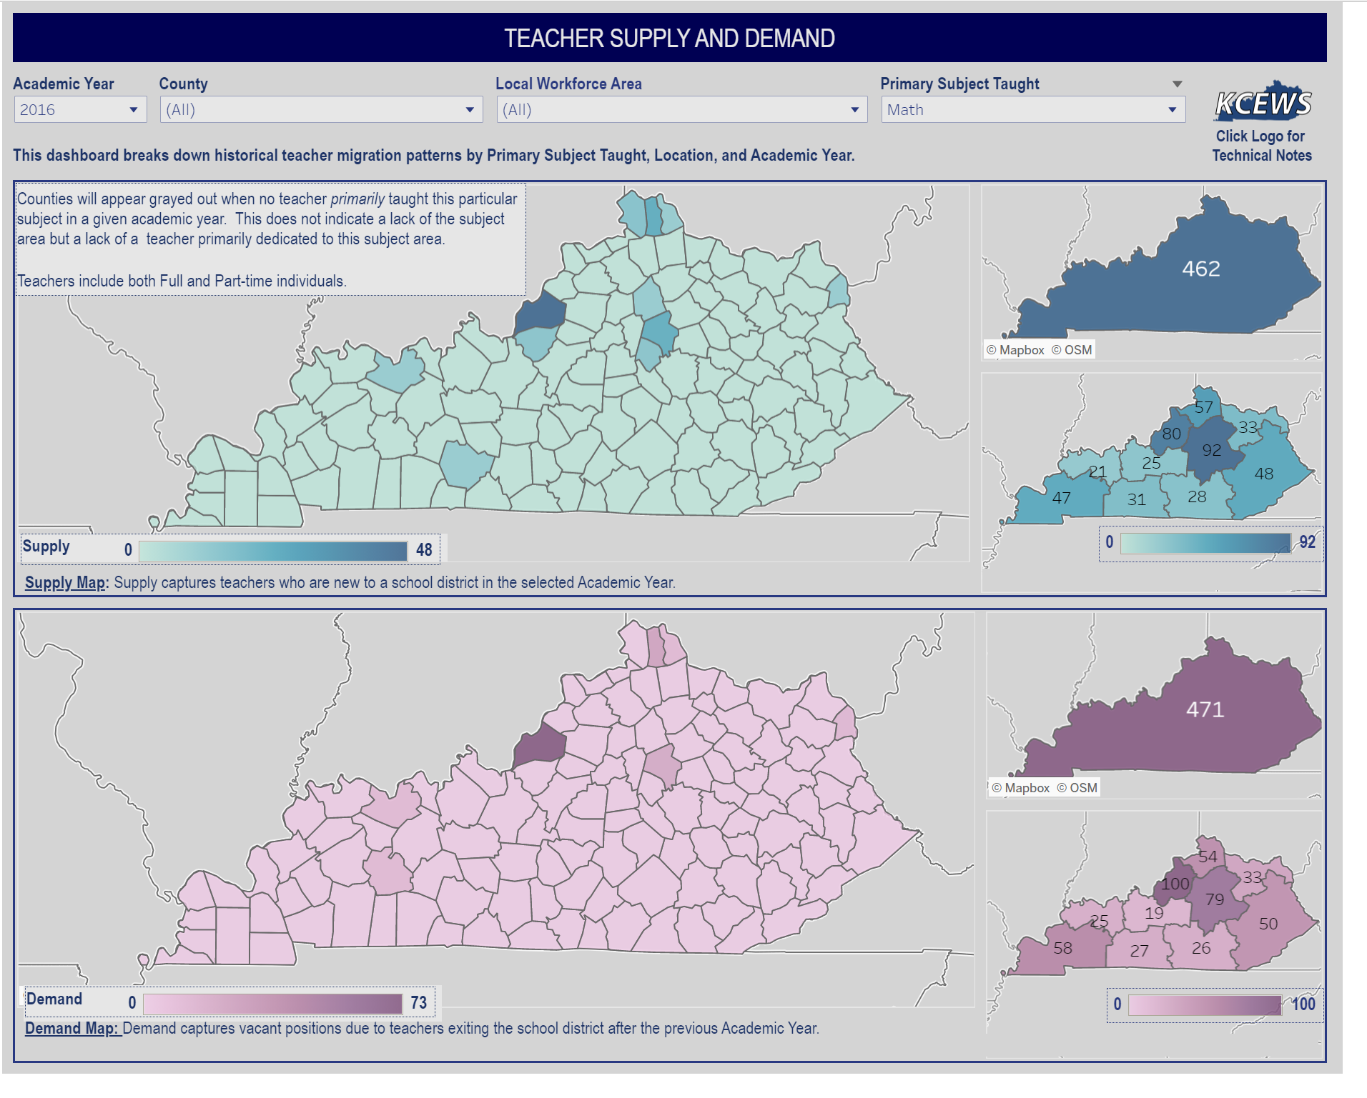
Example Kentucky
https://kystats.ky.gov/Reports/Tableau/TSD

Slide 60
ECS Policy Inventory
Expanding the pool of teacher candidates
Does the state offer a pathway, program or incentive through statute or regulation to recruit high school students into the teaching profession?
Does the state offer a pathway, program or incentive through statute or regulation to recruit paraprofessionals into the teaching profession?
Does the state create opportunities for teacher residency programs through statute or regulation?
What percentage of educator preparation program graduates came from alternative preparation programs in the year the data were last reported (2016-17)?
Teacher pay and financial incentives
Does statute establish requirements for minimum teacher pay?
Does statute define at least one statewide scholarship or grant program to help recruit teachers to underserved schools and/or shortage subject areas?
Does statute define at least one statewide loan forgiveness program to help recruit teachers to underserved schools and/or shortage subject areas? (Teach Iowa loan forgiveness targets high achieving students but doesn’t recruit to underserved or shortage area positions)
Teacher pay and financial incentives Cont’d
Does statute require or explicitly encourage additional pay for teachers who work in underserved schools and/or shortage subject areas? (high needs schools grants from 2013, never funded, originally intended to do this)
Does statute define at least one statewide financial incentive program for teachers of color?
Does the state require or explicitly encourage additional pay for teachers who obtain advanced licensure?
Does the state require or explicitly encourage additional pay for teachers who obtain National Board Certification?
Early and ongoing supports
Does the state require induction and mentoring support for new teachers? If so, what is the required length? (part of TLC local plans)
Does the state require or explicitly encourage reduced teaching loads for new and/or mentor teachers?
Does the state require that an established portion of a teacher’s work day/week be designated exclusively for teacher planning?
Iowa has these policies in purple

Slide 61
Promising Practices
Indiana AA degree at High School Graduation, 2 years of University, articulated community college credits, plus support to attract diverse and talented high school students into teaching
Western Governor’s University, online program for Iowans in full time jobs, wanting to complete degree and transition to teaching. Allows school districts to support and recruit paras and others connected to community into teaching.
Others?? State across the nation are looking for answers. Common themes: 1) partnerships with universities, community colleges and school districts 2) recruiting early (in high school) or later (nontraditional college students from paras or more seasoned private sector people ready for a second career) 3) supports needed - help with FAFSA or Praxis, tutoring, mentoring, pay for or alternative route for student teaching, 4) credit for competency or content knowledge rather than seat time/hours, 5) grow your own
Specific urban challenges: 1) employing a diverse workforce to reflect student make-up. 2) supporting teachers with larger class sizes and range of student performance (what additional level of pay and benefits, supports, culture and climate work is required to recruit and retain staff?)

Slide 62
Any questions on priorities so far?

Slide 63

Governor and Legislature expanded school choice options in 2021:
  Charter Schools (chartered by school boards or unaffiliated entity)
  Eliminated voluntary diversity plan open enrollment regulation
  Increased School Tuition Organization Tax Credits by 33% ($20 Million total) and increased the credit to 75% of the contribution.
  Applied Tuition and Textbook Tax Credits to home school and doubled the credit
  Created additional open enrollment good cause exemptions
Vouchers/Education Savings Accounts were proposed by the Governor, approved in the Senate, but not supported in the House.

Slide 64
Governor Reynolds on Nov. 3 became the first Governor to sign The Education Freedom Pledge:
“I pledge to support policies that promote parental rights in education and educational freedom. This includes the right of parents to voice their opinions at school board meetings and to take their children’s taxpayer-funded education dollars to the education providers of their choosing – whether it be a public, private, charter, or home school.”

Slide 65
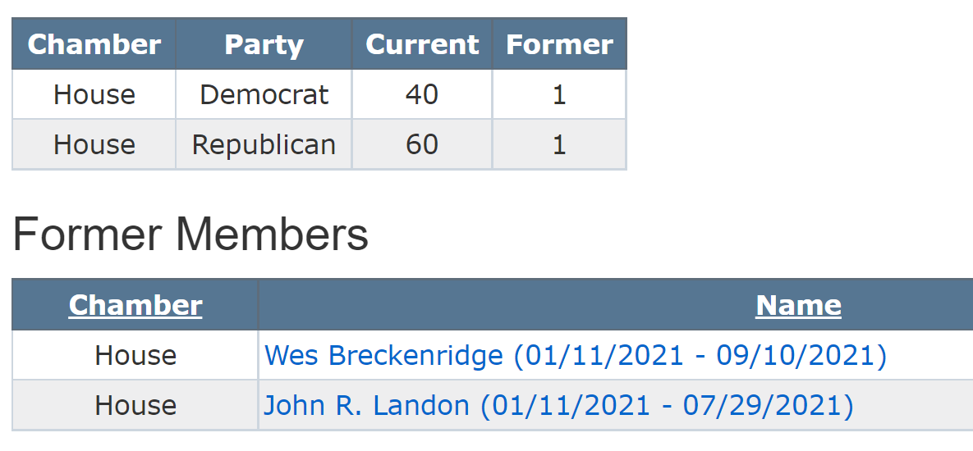
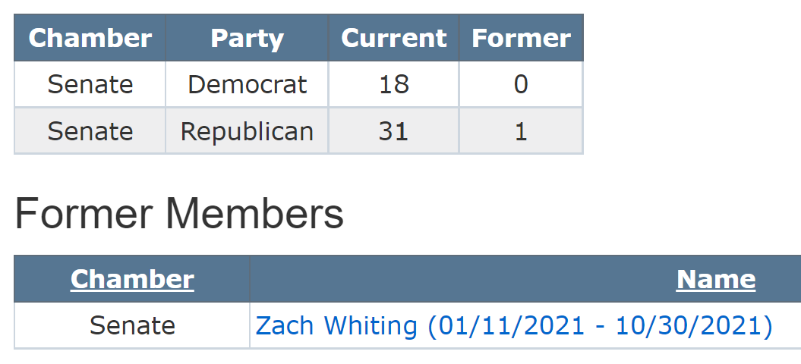
Political Make-up at Capitol
51 R House votes to Pass
26 R Senate votes to Pass

Slide 66
Cost to taxpayers of the freedom pledge, fully implemented, assuming no change in exercising this freedom (everybody choose what they were already doing):
2019-20 | Note: 33,833 student open enroll to another public school
22,050 | Home school (DOR estimates in HF 847 T&TTC report)
32,887 | Private school enrollment (DE Annual Condition of Education Report)
54,937 | Total Students in Private School/Home School
$ 7,227 | State Cost per Pupil 2022
$ 397,029,699 | Cost of school choice for existing choices

Slide 67
Vouchers or ESA Costs Outweigh Benefits:
Competition: Iowa already has it; if competition provides positive pressure, it’s worked. Charter schools are just starting. Will this next step “increase outcomes?”
No Student Achievement Increase: Economic Policy Institute Report, School vouchers are not a proven strategy for improving student achievement, Feb. 28, 2017, “Research does not show that vouchers significantly improve student achievement.” Report concludes there are more effective ways to increase graduation and college attendance rates, that vouchers programs have hidden costs, including shrinking the teacher pipeline, and supports for privatization detract from more proven methods of improving student learning.
Diverts Resources from Public Schools: Diverting funds to private education further stresses public school resources. From State Tax Subsidies for Private K-12 Education, Oct. 2016; “30 neovouchers across 20 states are draining over $1 billion in public revenues from state coffers every year. Every dollar of revenue diverted toward private schools is revenue that cannot be invested in the public education system.”

Slide 68
Vouchers or ESA Costs Outweigh Benefits:
No Oversight: The Institute also finds insufficient budgetary oversight of voucher programs. There is no publicly elected school board or Department of Education regulating and reporting allowable expenditures. The public does not have access to records or public meetings. Good stewardship of tax dollars requires transparency and clearly articulated expectations.
Level the Playing field: Public schools are accountable to taxpayers, parents, communities, i.e., the public, and serve all students. Public schools cannot refuse to enroll or expel students that are not meeting expectations or refuse enrollment based on specific student needs, such as students with disabilities, who are non-English-speaking, minority or low income. If additional state dollars are used to fund vouchers, it is only fair that the private schools receiving those tax dollars also comply with testing, reporting, enrollment and service requirements.

Slide 69
Advocacy: Building the Relationship Next Steps
Send list of UEN Priorities to your legislators. Let them know how important these issues are to your students, school board, staff and community.
Press release – media about attending the UEN annual meeting and include a quote about the importance of these issues to students, school board, staff and community.
Thank legislators for the things they have done that you appreciate: Funding flexibility expansions, ELL-tiered weighting, PK spending authority, broadband expansion, formula equity, licensure reciprocity and substitute credential flexibility.

Slide 70
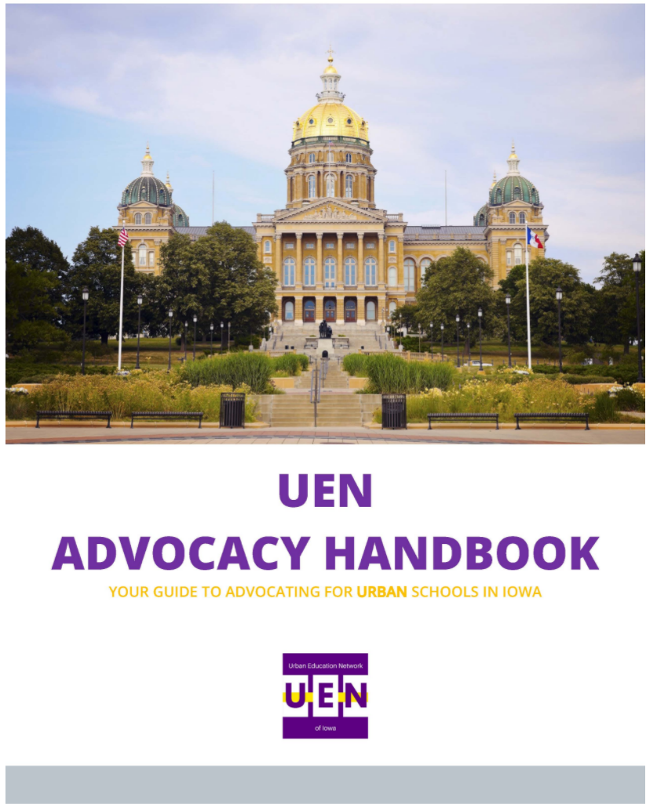
Advocacy
Actions
See the UEN Advocacy Handbook on Legislative Page of Website

Slide 71
Networking and Advocacy Prep – It’s your turn!
Theory about Core Values
Practice with School Uniforms
Thinking about Vouchers
Turn in your take-aways and we’ll share with all later.

Slide 72
Core Values in our Democracy
What do Americans care about?
What do lawmakers strive to deliver?
What is the promise of our Constitution?

Slide 73
Boyle, Local School Board Governance, Spring 2004
“Public decisions involve choices and public choices always involve values.”
  Liberty: freedom, autonomy, choice, opportunity, individuality, privacy;
  Community: safety, security, belonging, social order, quality of life;
  Equality: fairness, justice, tolerance, diversity, equal treatment, equal opportunity; and
  Prosperity: productivity, efficiency, growth, markets.

Slide 74
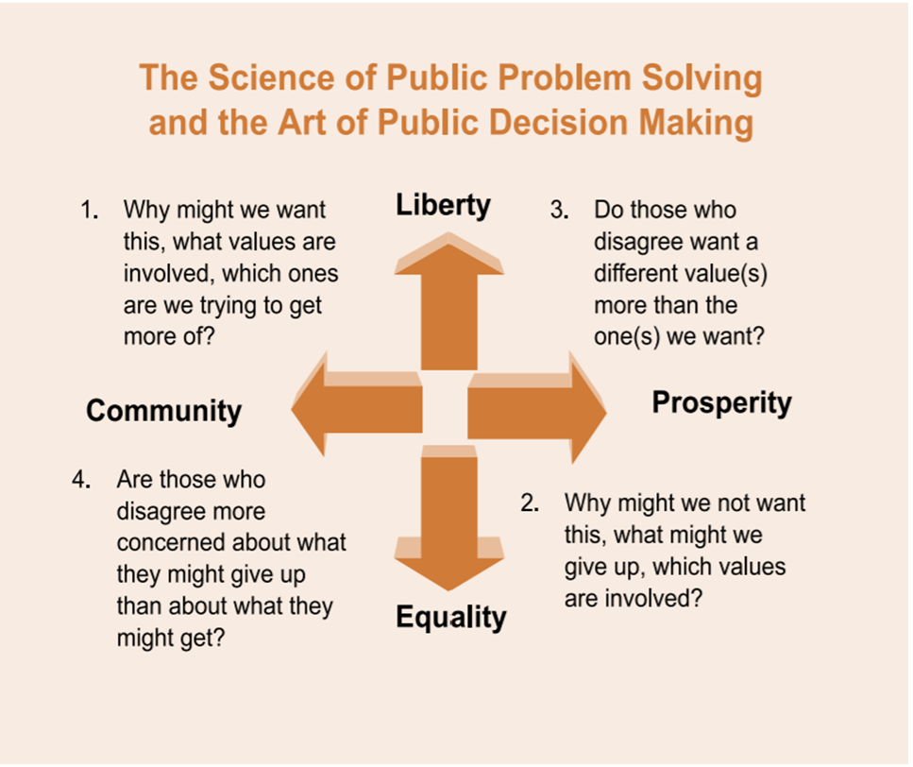


Slide 75
Boyle’s policy/discussion questions:
1. Why might we want this? What values are involved? Which ones are we trying to get more of?
2. Why might we not want this? What might we give up? What values are involved?
3. Do those who disagree want a different value(s) than the one(s) we want?
4. Are those who disagree more concerned about what they might give up than about what they might get?
One other thing:
Are there any policy limitations we can consider to address the opposition’s fear or concerns?

Slide 76
First Policy Discussion
Should the Our Town Community School Board require school uniforms for students?
What core values are in play? (Hint: all four)
Talk through the 4 policy questions at your table. Think about a policy limitation to address any opposition.

Slide 77
Second Policy Discussion
Should the Iowa Legislature allow parents to “take their children’s taxpayer-funded education dollars to the education providers of their choosing?”
What core values are in play? (Hint: all four)
Talk through the 4 policy questions. Think about a policy limitation to address any opposition.

Slide 78
Share your thinking
Notetaker: Write down the best ideas of the group that you think your legislators would find compelling to help them oppose this idea?
Take a pic of your notes with your phone and text or email to Margaret
(515) 201-3755 Margaret@iowaschoolfinance.com

Slide 79
THANK YOU FOR YOUR VOICE on behalf of Iowa students, parents, your school staff and communities!
Margaret Buckton,
ISFIS Partner, UEN Executive Director, RSAI Professional Advocate margaret@iowaschoolfinance.com
1201 63rd Street, Des Moines, IA 50311 (515) 201-3755 cell
Larry Sigel, ISFIS Partner
larry@iowaschoolfinance.com
1201 63rd Street, Des Moines, IA 50311
(515) 490-9951 cell
Stay connected through the Interim and into the Legislative Session
Let us know what you need to support your advocacy efforts.

