Slide 1
Welcome!
Nov. 20, 2024
Urban Education Network
Annual Meeting
6:00 – 8:30 PM

Slide 2
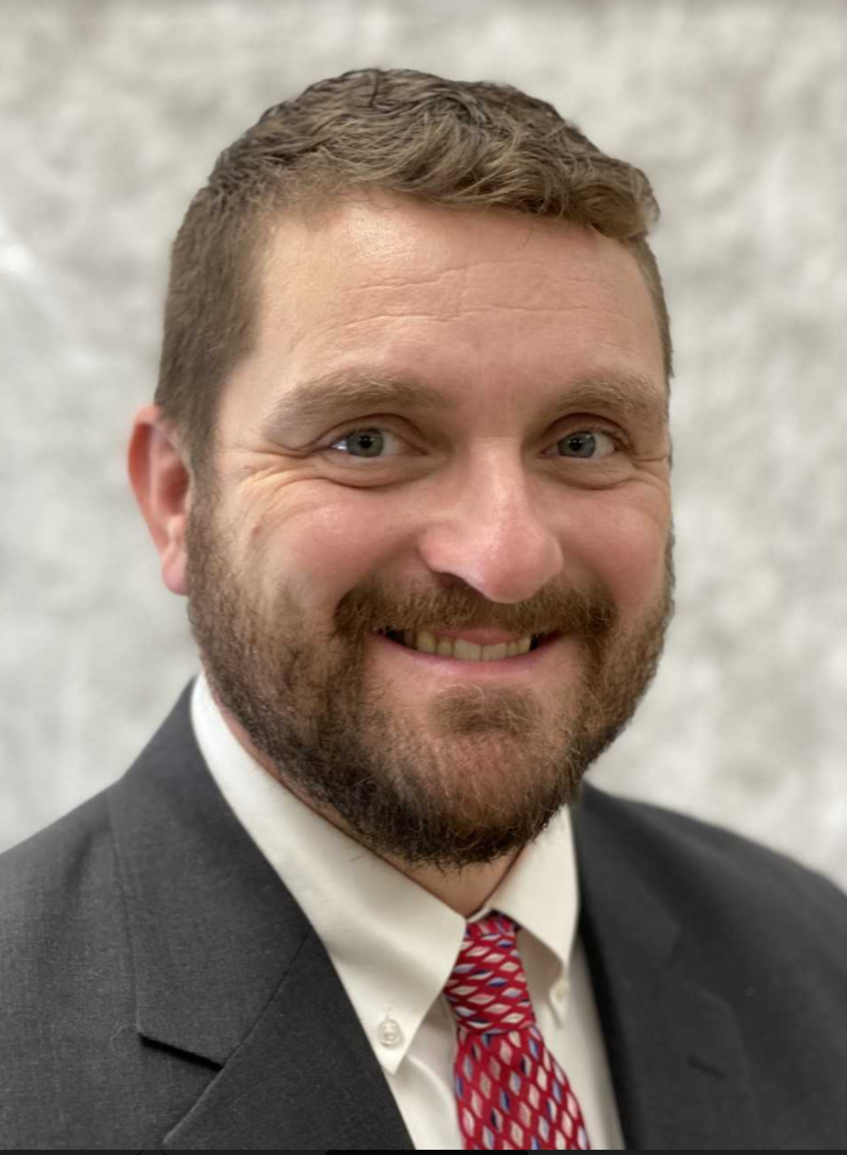
T.J. Schneckloth
Davenport Superintendent
UEN Chair

Slide 3
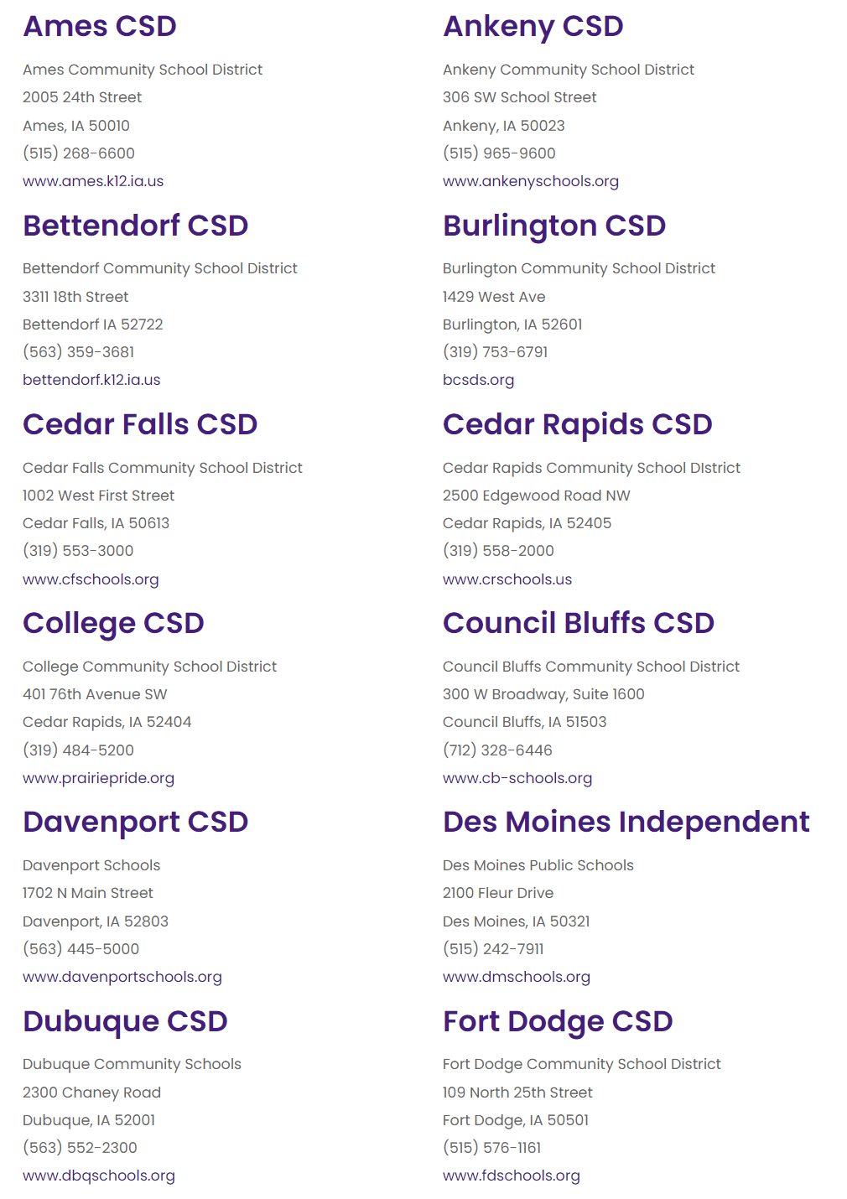
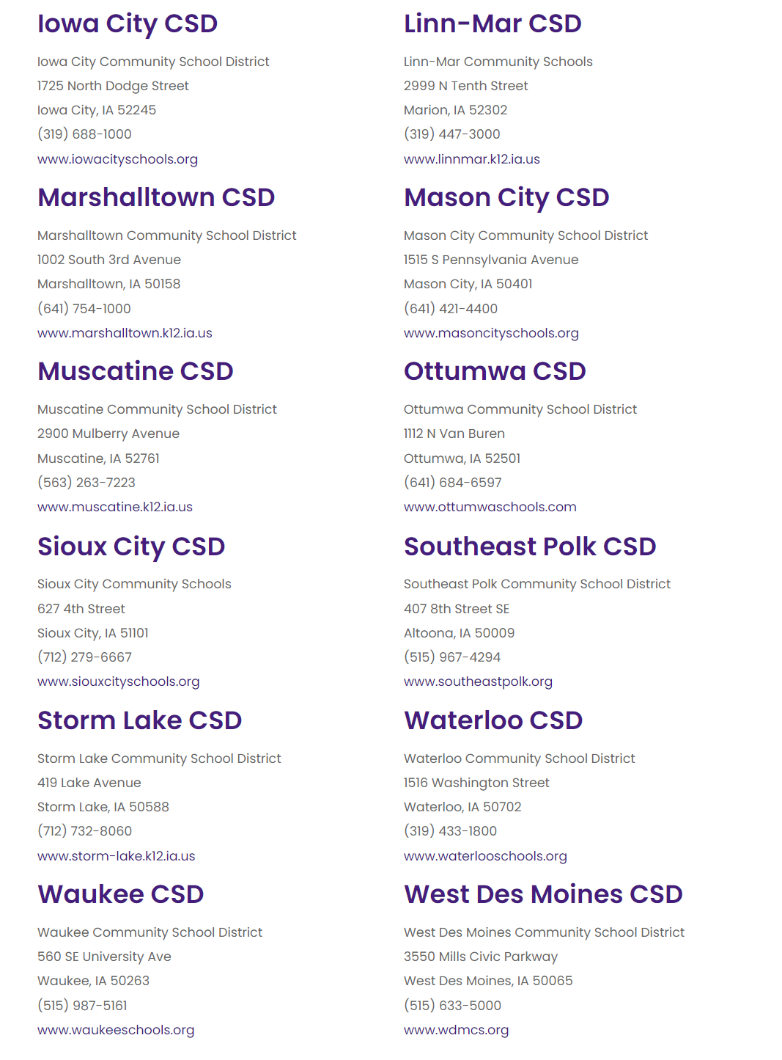
UEN Member Districts 2024-25

Slide 4
Thanks for your service!
New school board members and new superintendents.
Matt Degner, former UEN Chair
Vickie Murillo, former Past Chair
Jan George, former Steering Committee member
Dan Gosa, former Steering Committee member

Slide 5
The UEN. . .keeps the state’s lawmakers, media, and public informed about the progress and problems in our state’s largest and most diverse schools, through advocacy, legislation, communications and research.

Slide 6
The UEN. . . helps to build capacity in urban education by facilitating connections between member districts to improve student academic performance, narrow achievement gaps, improve professional development; and strengthen leadership, governance, and management

Slide 7
The UEN. . . Joint efforts with other state organizations and policymakers extend the UEN’s influence and effectiveness to the broader community that will ultimately benefit from the contributions of today’s urban students.

Slide 8
UEN Association Management: ISFIS
Support and staff, accounting, association management, website development and maintenance, billing, meeting organization and tech support. New procedures and policies for UEN operations.
Policy development, strategic planning, legislative and fiscal analysis.
Job-alike meetings for 20 different director-level positions to share best practice, learn together, receive updates and connect with state-level experts.
Lobbying services, legislative advocacy, communications, media, sharing best practice, survey tools.
Jen Albers jen@iowaschoolfinance.com
Larry Sigel larry@iowaschoolfinance.com
Margaret Buckton margaret@iowaschoolfinance.com

Slide 9
UEN Steering Committee is Governing Board
Steering Committee Duties:
Set legislative priorities
Set policy
Fiduciary oversight
Employs Executive Director
Approves Contracts

Slide 10
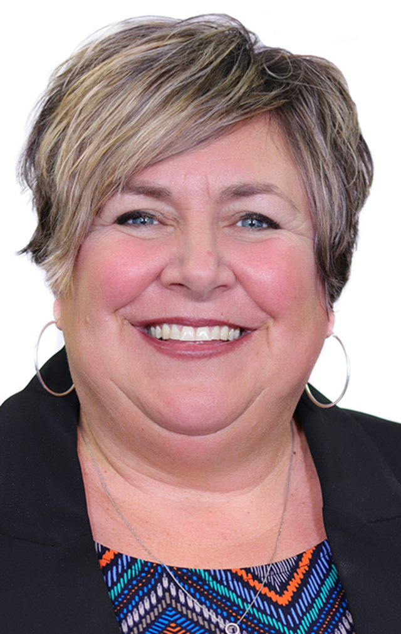
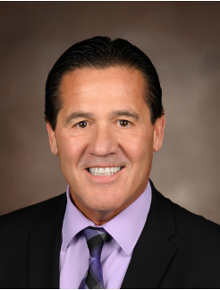
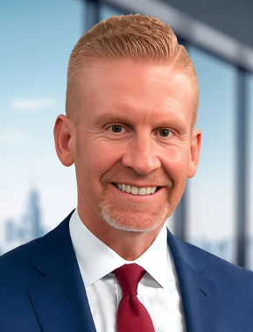
UEN Officers
T.J. Schneckloth Amy Hawkins Rod Earlywine Matt Degner Jared Smith Davenport Dubuque Sioux City Iowa City Waterloo
UEN Chair Chair-Elect Chair Elect II Past Chair Treasurer

Slide 11
Report of the Steering Committee: 2025 Legislative Priorities
Chronic Absenteeism: Intersection of Local, State and Federal Policy
Margaret Buckton
UEN Executive Director
ISFIS Partner

Slide 12
Report of the Steering Committee: 2025 Legislative Priorities

Slide 13
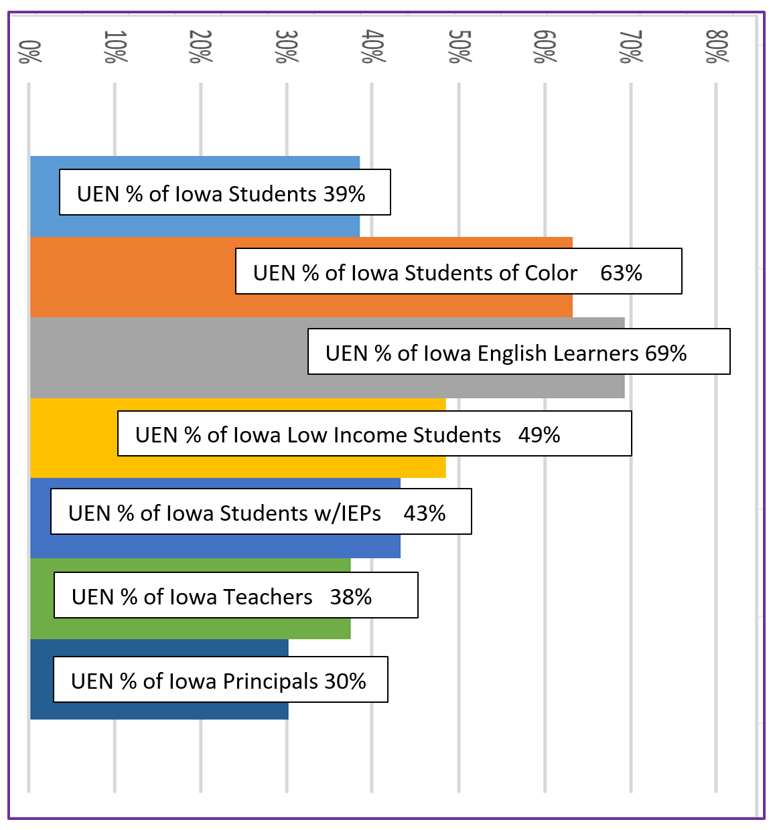
Facts About UEN Members
Ten of Iowa’s largest districts in urban communities with two or more high schools, along with 14 other large school districts with one high school and other urban tendencies, make up the UEN membership. Below are some facts about UEN member districts based on the 2022-23 school year:

Slide 14
Invest in Iowa’s Future / SSA / Equity | English Learner Programs and Services | ESAs and School Choice
Teacher, Administrator, Staff Shortage | Literacy: Research-Based Supports and Flexibility | Mental Health Services
Quality PK (1.0 weighting) | High School Programming | District Authority/Local Control
Opportunity Equity/Poverty | Special Education ID and Instruction | Cybersecurity and Safety
More information coming soon www.uen-ia.org

Slide 15
Chronic Absenteeism Intersection of Local, State and Federal Policies

Slide 16
Chronic Absenteeism Crisis
From Chronic Absenteeism Task Force DE Presentation, July 2024

Slide 17
District Chronic Absenteeism 2021-22
From Chronic Absenteeism Task Force DE Presentation, July 2024

Slide 19
From Chronic Absenteeism Task Force DE Presentation, July 2024

Slide 20
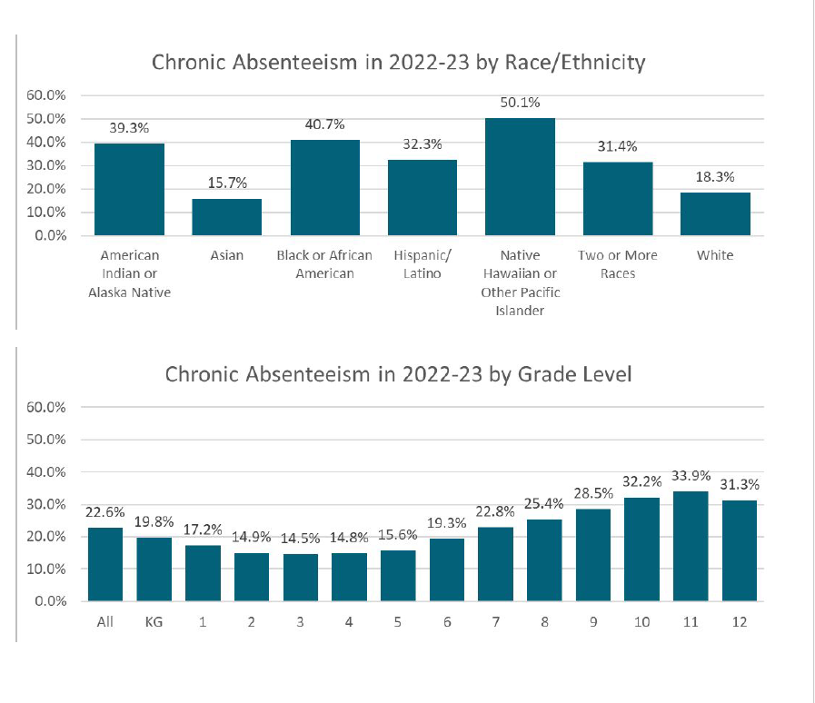
From Chronic Absenteeism Task Force DE Presentation, July 2024

Slide 22
State Report Card: Summary

Slide 23
For 2023-24 School Year (Spring Student Reporting in Iowa data) State Averages:
21.6% of Iowa Public School Students were Chronically Absent (2023-24)
29.2% of Els
31.9% of Low-Income (FRL)
30.5% of Disabilities/IEP
For 2023-24 School Year (Spring Student Reporting in Iowa data)
Growth from 2022-23:
2022-23 Attendance Rate 81.6%
2023-24 Attendance Rate 83.8%
2.2% Growth State Average
Retrospective Measure

Slide 24
SF 2435 Chronic Absenteeism State Policy
Board Policy / Rules must address:
How the board of directors determines whether a child is chronically absent (this directly implies local authority)
The different interventions that the board of directors may use when a child is chronically absent.
The different penalties associated with a child being chronically absent.

Slide 25
SF 2435 Chronic Absenteeism State Policy
Mandatory exemptions for absences counting toward notification, prevention plan and school engagement meeting steps. Must not count absences for students who:
have completed graduation requirements or attained a G.E.D,
are excused for sufficient reason by any court or record or judge,
are attending religious services or receiving religious instruction,
are unable to attend school due to a legitimate medical reason, or
have an IEP or 504 plan that affects attendance.

Slide 26
ESSA Definitions
Don’t confuse ESSA metric with local measure for district action to support students.
NOT IN SF 2453: Remember “Chronically absent” for federal reporting purposes means any absence from school for more than 10% of the days or hours in the grading period established by a public school. (Although exceptions may apply for local board policy purposes, this definition includes all absences.
10% or more of any absence is defined for a school or district as chronic absenteeism
2025 Legislative Session could revisit SF 2345 requirements, but the state plan negotiated with the feds would take more significant work to change.

Slide 27
Think Abouts???
Is earlier notice helpful for parents? What method?
Carrot or stick? What works best to motivate cooperation between schools and families to support students?
Think of the Absenteeism Prevention Plan (APP could also stand for Attendance Progress Plan if you want a positive spin on it.)
Does the student’s proficiency/academic achievement impact what interventions the district engages?
Do some interventions or actions drive students and/or families to another district, home school or private school?

Slide 28
https://www.attendanceworks.org/

Slide 29
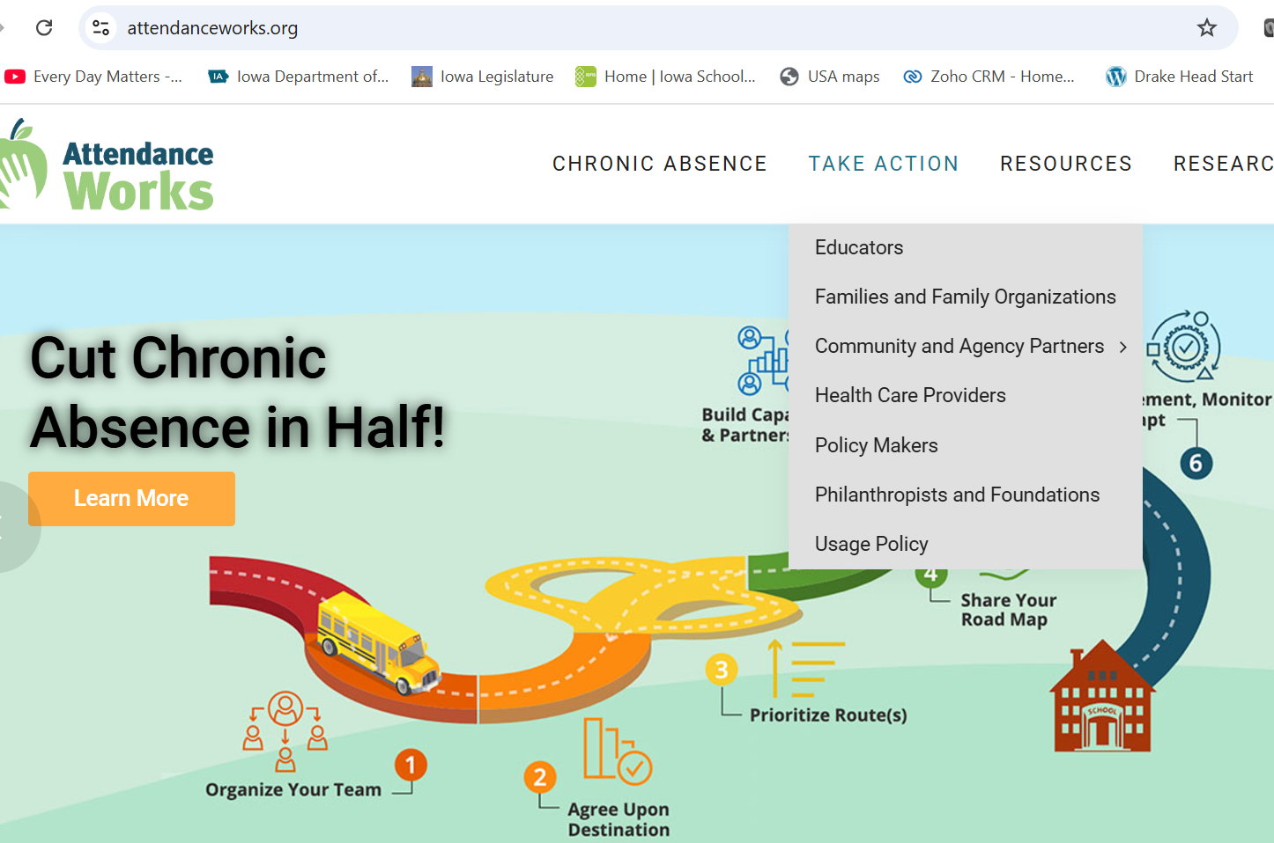

Slide 30
Attendance Works Research https://awareness.attendanceworks.org/wp-content/uploads/Research2016.pdf
Allensworth, E. M., and Easton, J. Q., What Matters for Staying On-track and Graduating in Chicago Public High Schools: A Close Look at Course Grades, Failures, and Attendance in the Freshman Year, University of Chicago, Consortium on Chicago School Research, Chicago, IL, 2007. In this study of the freshman year of high school, researchers found that attendance in this pivotal transition year was a key indicator of whether students would finish high school. The study also found attendance and studying more predictive of dropout than test scores or other student characteristics. In fact, 9th grade attendance was a better predictor of dropout than 8th grade test score
Bruner, Charles, Anne Discher and Hedy Chang, Chronic Elementary Absenteeism: A Problem Hidden in Plain Sight, Child and Family Policy Center and Attendance Works, November 2011. This study confirms the premise that districts and schools may fail to detect high levels of chronic absence because the problem is easily masked by average daily attendance, one of the most commonly calculated attendance measures. While many educators assume a 95% ADA rate is an indicator of good attendance, the authors find that this is often not the case.

Slide 31
Chronic Absenteeism Task Force
DE convened a group of stakeholders to study other states’ resources and supports, best practices, sample APP plans, FAQs and other DE supports for districts.
Information, Frequently Asked Questions, Sample Plans and Resources are posted on their page here (many of the resources were developed with input from the task force members discussion and review)
https://educate.iowa.gov/pk-12/student-services/prevention/attendance-chronic-absenteeism
A panel of the four UEN superintendents serving on the task force will come before you later this evening (likely as some of you are finishing desert) to share some insights on local district actions and on the task force. Be listening for hints about what is the board’s role and what is the district/superintendent’s job in addressing chronic absenteeism.

Slide 32
After the Task Force Panel. . . .
Networking and Table conversations
Note taking on the back is for your reference.
Start the introductions and sharing what you are looking forward to this year (questions 1 and 2) before the panel.
Questions 3-5 will be after the panel.

Slide 33
Table Reflections (green form)
One or two reflections of the board’s role in addressing chronic absenteeism
What else does your board need to know more about?
What can UEN do to help your team address these important issues?
Leave on the table – Tammi and Margaret will ask for a couple of tables to share a thought or two as your discussions finish, around 8:15.

Slide 34
Closing Remarks
T. J. Schneckloth
Davenport, UEN Chair

Slide 35
THANK YOU FOR YOUR VOICE on behalf of urban Iowa students, parents, your school staff and communities!
Margaret Buckton,
ISFIS Partner, UEN Executive Director, RSAI Professional Advocate margaret@iowaschoolfinance.com 1201 63rd Street, Des Moines, IA 50311 (515) 201-3755 cell
Larry Sigel, ISFIS Partner
larry@iowaschoolfinance.com
1201 63rd Street, Des Moines, IA 50311
(515) 490-9951 cell
Jen Albers, Director of Finance and Operations
jen@iowaschoolfinance.com
(515) 251-5970 x4
Stay connected through the Interim and
into the Legislative Session
Let us know what you need to support your advocacy efforts.

