Slide 1
Welcome!
Nov. 16, 2022 Urban Education Network Annual Meeting
6:00 – 8:30 PM

Slide 2
Welcome to New UEN Districts!!!

Slide 3
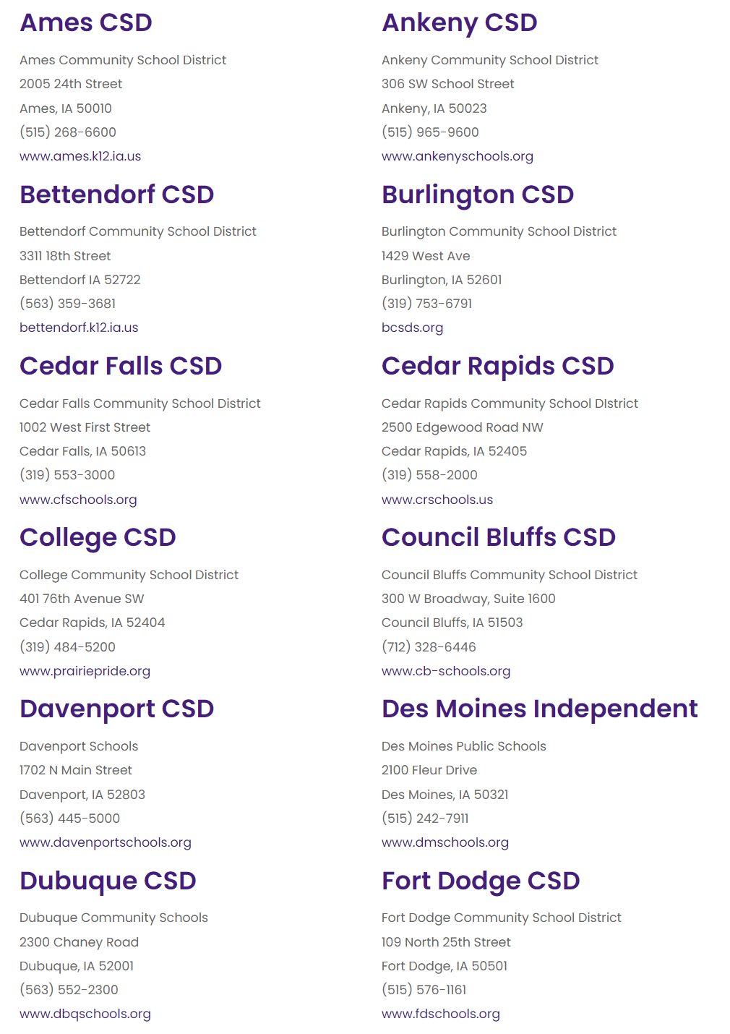
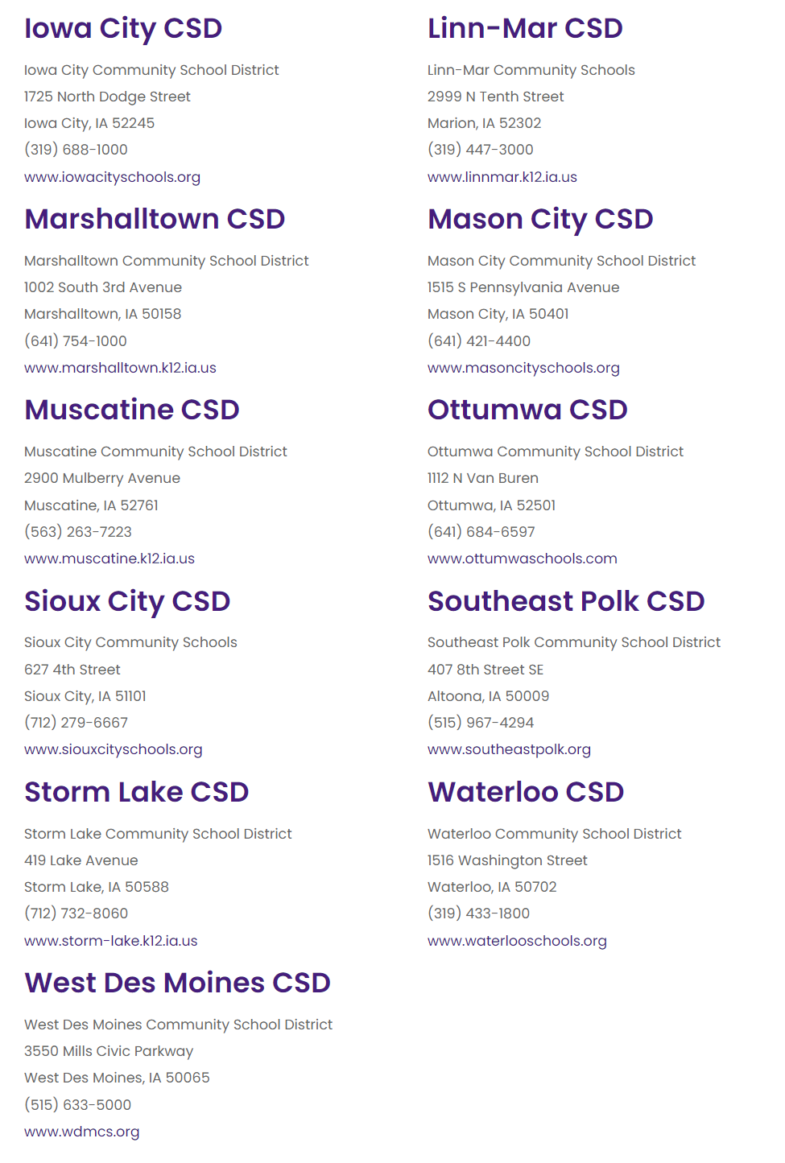
UEN Member Districts 2022-23

Slide 4
The UEN. . .keeps the state’s lawmakers, media, and public informed about the progress and problems in our state’s largest and most diverse schools, through advocacy, legislation, communications and research.

Slide 5
The UEN. . . helps to build capacity in urban education by facilitating connections between member districts to improve student academic performance, narrow achievement gaps, improve professional development; and strengthen leadership, governance, and management

Slide 6
The UEN. . . Joint efforts with other state organizations and policymakers extend the UEN’s influence and effectiveness to the broader community that will ultimately benefit from the contributions of today’s urban students.

Slide 7
UEN Association Management: ISFIS
Support and staff, accounting, association management, website development and maintenance, billing, meeting organization and tech support. New procedures and policies for UEN operations.
Policy development, strategic planning, legislative and fiscal analysis.
Job-alike meetings for 20 different director-level leaders to share best practice, learn together, receive updates and connect with state-level experts.
Lobbying services, legislative advocacy, communications, media, sharing best practice, survey tools.
Jen Albers jen@iowaschoolfinance.com
Larry Sigel larry@iowaschoolfinance.com
Margaret Buckton margaret@iowaschoolfinance.com
and Susie Olesen
Susie@iowaschoolfinance.com

Slide 8
UEN Steering Committee is Governing Board
Steering Committee Make-up:
Four Superintendents and Four Board members from original 8 UEN charter districts, of which 5 constitute a quorum.
All other districts have a vote on the Steering Committee too.
Steering Committee Duties:
Set legislative priorities
Set policy
Fiduciary oversight
Employs Executive Director
Approves Contracts

Slide 9
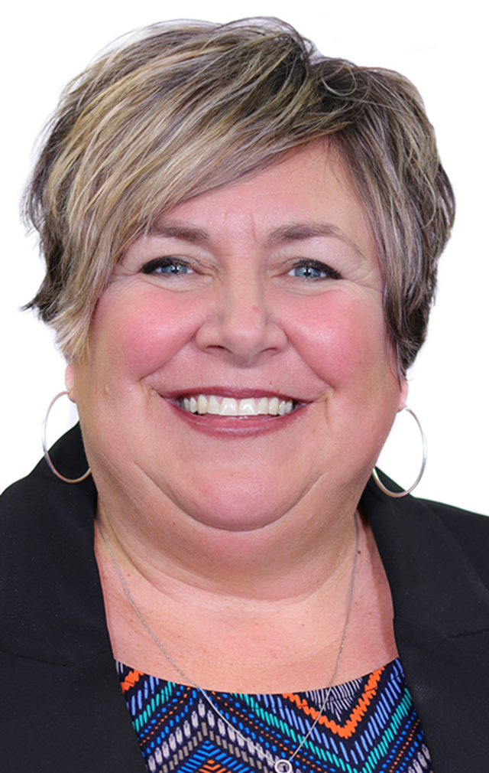
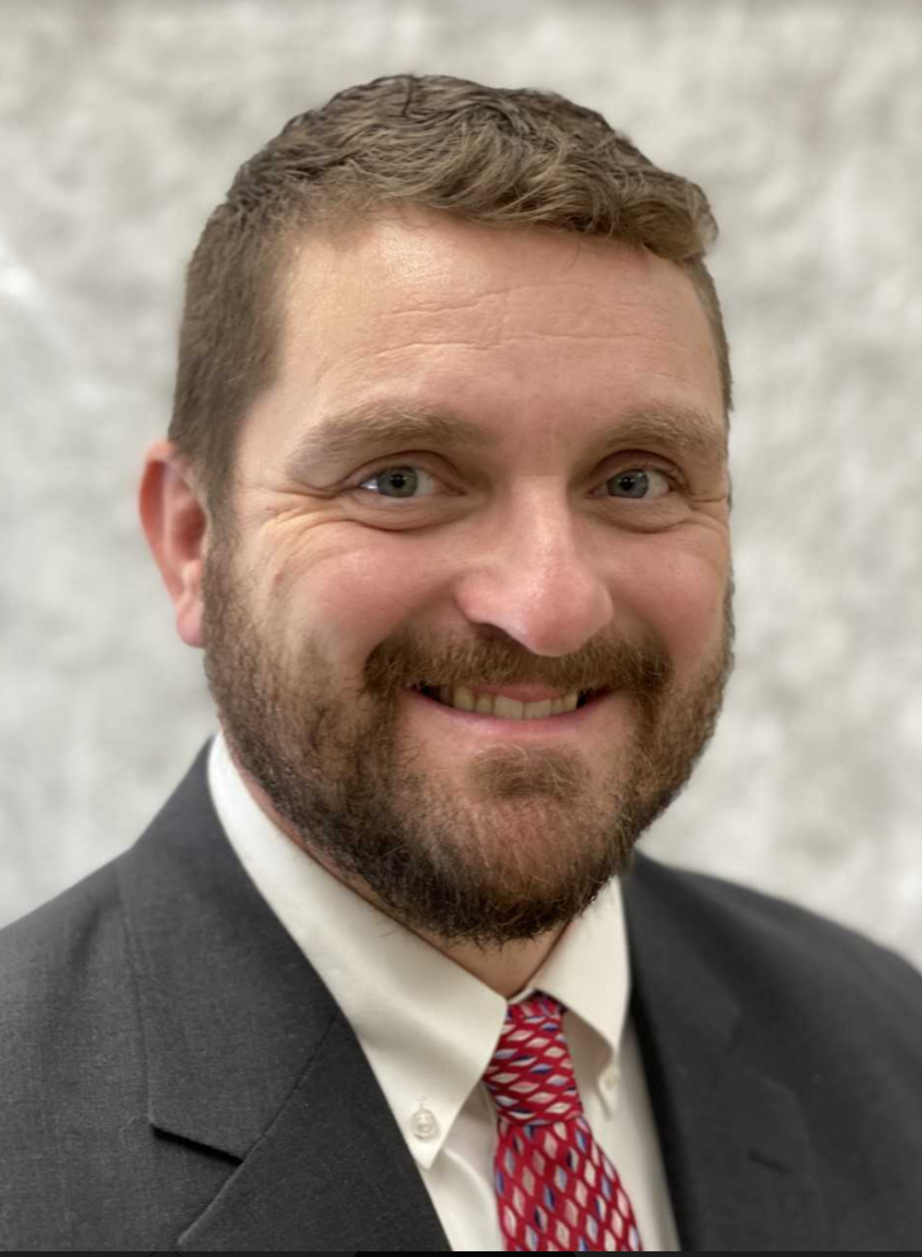
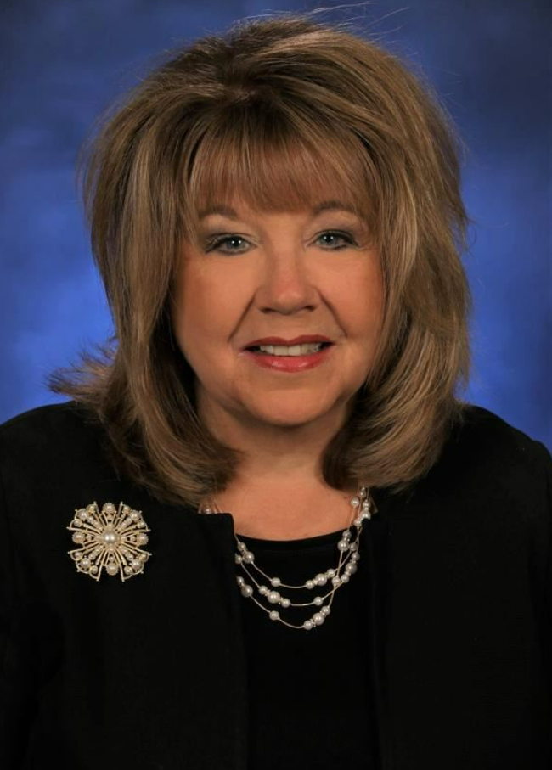
UEN Officers
Matt Degner Amy Hawkins T.J. Schneckloth Vickie Murillo
Iowa City Dubuque Davenport Council Bluffs
UEN Chair Chair-Elect II Chair-Elect Past Chair

Slide 10
Vickie Murillo
Tribute to Noreen Bush
Cedar Rapids Superintendent and 2021-22 and 2022-23 UEN Chair

Slide 11
After dinner, look forward to Info about our 2023 UEN Legislative Priorities and Networking conversations about successes in our Urban Schools.

Slide 12
Larry Sigel and Margaret Buckton More About UEN General Election Update 2023 Legislative Priorities Networking/Table Conversations about Urban School Success

Slide 13
Facts About UEN Members
Nine of Iowa’s largest districts in urban communities with two or more high schools, along with 14 other large school districts with one high school and other urban tendencies, make up the UEN membership. Below are some facts about UEN member districts based on the 2021-22 school year:
UEN certified enrollment percentage of Iowa total enrollment 42%
Percent of Iowa’s PK-12 students of color in UEN 77%
Percent of Iowa’s English Learners in UEN 70%
Percent of Iowa’s K-12 low-income students in UEN (FRPL eligible) 52%
Percent of Iowa’s school principals in UEN schools 31%

Slide 14
A few more facts . . . UEN Districts
UEN educates 28,926 students with Individual Education Plans (IEPs) (44% of state total)
Maintain 548 permanent school buildings with a total replacement cost of $5.4 billion (FY 2014 dollars X 25.88 cumulative inflation)
Transport students 8.2 million route miles (FY 2021)
Have an average daily student attendance rate of 93% (FY 2020)
Graduate over 91% of students in the 5-year graduation cohort (if UEN was a state, we’d be in the USAs top 20)
What else? College credits or credentials earned in high school? Opportunities for fine arts, speech, drama, programs connecting academics and passions for students? We will talk more about these things later tonight.

Slide 15
General Election Update Iowa Legislative News Services (IALNS) 11.9.22 Edition IA SOS Website https://electionresults.iowa.gov/IA/115641/web.307039/#/summary WHO TV Election Coverage: https://who13.com/election-results/ New York Times Interactive Election Coverage: https://www.nytimes.com/interactive/2022/11/08/us/elections/results-senate.html?action=click&context=election_recirc&module=election-

Slide 16
Grassley by 12%
Reynolds by 20%+
All of Iowa’s US House seats Republican. Congress will have a slight Republican majority.
Why this matters? Issues of IDEA federal funding (relieves IA special education deficits), Free school lunch, civil rights protections for students, Internet expansion, Ag farm support, etc.
With Democrats retaining control of the Senate and President Biden, any policies and $$ must be bi-partisan to move forward over the next 2 years.

Slide 17
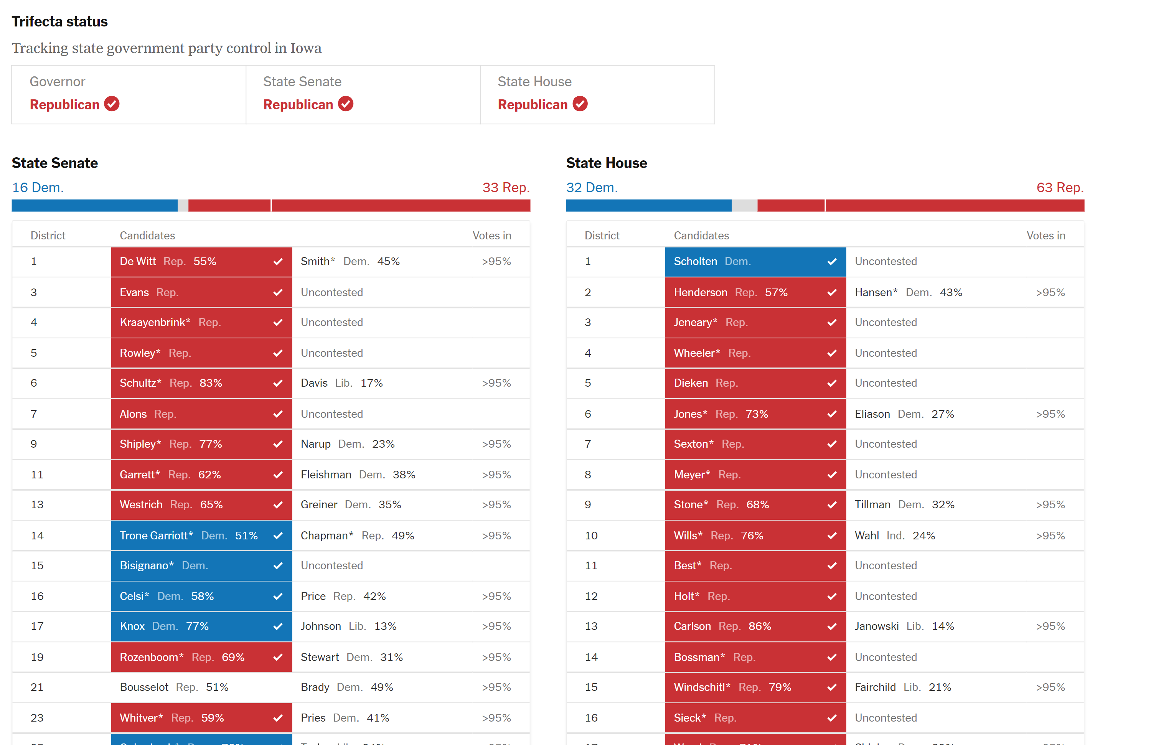
1 Senate Seat (R) and 5 House Seats (D) pending

Slide 18
Incumbents Beaten IALNS Analysis states:
Sen. #14 President Jake Chapman lost to Sen. Sarah Trone Garriott. He was the only R incumbent to lose in the Senate.
Sen. #46 Kevin Kinney and Sen. #1 Jackie Smith lost. The D’s also lost the seat previously held by Sen. Ragan now Sen. #30. with Sen. Brown.
For House #42 Rep. Garrett Gobble lost to Heather Matson in a rematch of the 2020 race. R’s also lost House #42 in Ankeny to Molly Buck, previously held by Rep. John Landon. R’s held onto three seats lost by incumbents in the primary (Bush, Thorup and Hite).
For D’s, Reps. Steve Hansen House #2, Phyllis Thede House #94 and Dennis Cohoon House #99 were taken out by Republicans Henderson, Vondran, and Rinker respectively. Cohoon was the longest-serving member in the Legislature. The D’s also lost seats previously held by Reps. Todd Prichard, Dave Williams House #54 won by Meggers and Mary Wolfe.
Several races seem close enough for a recount. Those have to be requested by this week and completed by Dec. 5.

Slide 19
Around 50 New Faces (1/3)
Scholten (D)
Henderson (R)
De Witt (R)
Dieken (R)
Evans (R)
Rowley (R)
Carlson (R)
Alons (R)
Wood (R)
Turek (D)
Wilz (R)
Harris (R)
Young (R)
Srinivas (D)
Madison (D)
Bagniewiski (D)
Baeth (D)
Knox (D)
Kniff-McCulla (D)
Gustoff (D)
Buck (D)
Matson (D)
Bousselot (R)
Gehlbach (R)

Slide 20
Around 50 New Faces (1/3)
Meggers (R)
M Thompson (R)
C Thomson (R)
Amos (D)
Determann (R)
Wilson (D)
Wulf (R)
Cooling (D)
Scheetz (D)
Stoltenberg (R)
Golding (R)
Gerhold (R)
Gruenhagen (R)
Hayes (R)
Levin (D)
Zabner (D)
Sherman (R)
Hora (R)
Weiner (D)
Vondran (R)
Collins (R)
Webster (R)
Croken (D)
Rinker (R)
Graber (R)

Slide 21
First Day of a New School Year
With new students, we welcome them warmly and start working on relationship.
We assess their needs and determine appropriate instruction. We don’t make any assumptions.
We connect with their parents and try to learn more about what they need and what is important to them at home.
Some need something special

Slide 22
Find New Contact Info
Sec. of State’s General Election Candidate List https://sos.iowa.gov/elections/pdf/Candidates/generalcandidatelist.pdf

Slide 23
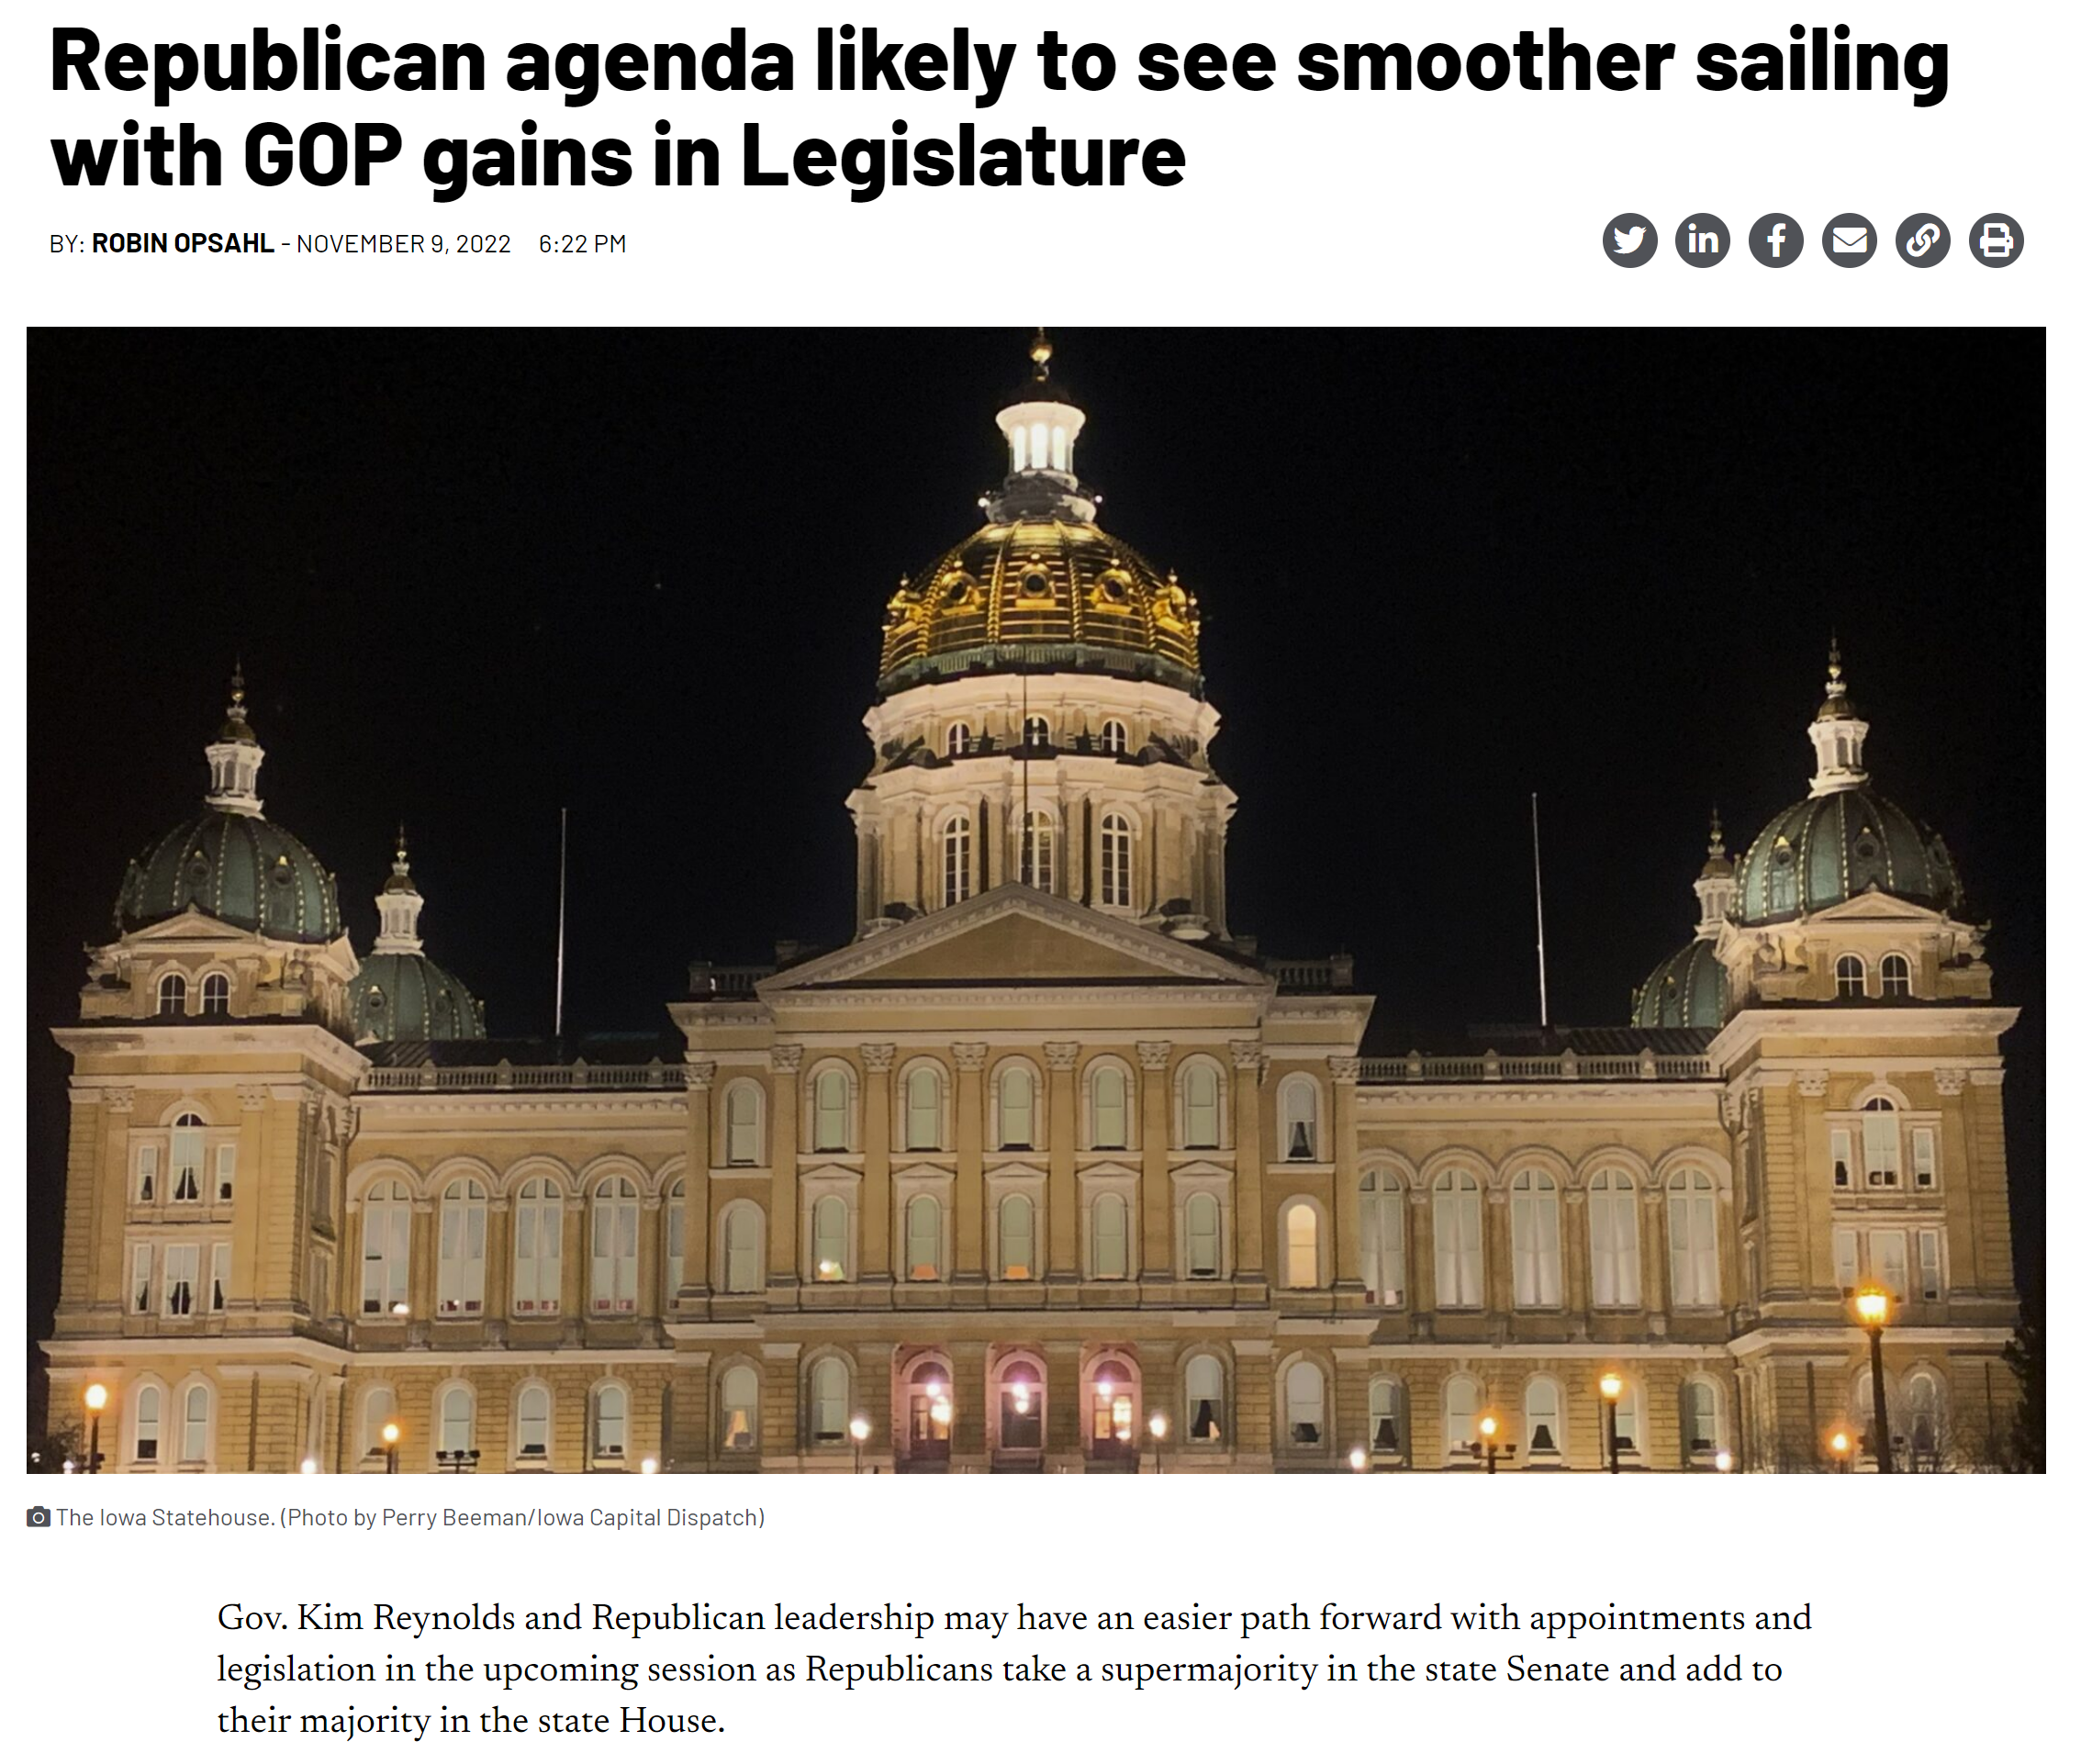
Iowa Capitol Dispatch reports on the supermajority in the House and Senate. However, new legislators still represent the Iowans who were opposed to some of these issues last year. There is a long way to go before ESA legislation is on the Governor’s desk.

Slide 24
What’s Next?
R’s championed continued tax relief (focus on property taxes) and Governor is still championing parent choice.
Caucuses elected leaders (Sinclair is new Sen. President and Whitver remains Sen. Majority Leader. House Leaders Grassley, Windschitl, Wills, Sexton & Stone). House Republicans set Committee chairs today. Rep. Skyler Wheeler is House Education Chair. Speaker Grassley is chair of a new Education Reform Committee.
Watch for other committee members from your area
Issues: Education Reform Package is likely, including additional flexibility and funding.
Assume a clean slate: Everything starts over in the new Session.

Slide 25
Report of the Steering Committee

Slide 26
Steering Committee Action
1. Welcome, Call to Order by Matt Degner (UEN Chair), Introductions
2. Approval of Agenda and 3. Approval of Minutes from the Steering Committee on September 23, 2022
4. YTD Financial Report
5. Update on General Election
6. 2023 UEN Legislative Priorities Consideration and Approval
7. UEN Annual Meeting Steering Committee Responsibilities
8. Executive Director Report
9. Steering Committee Member Updates
10. Memorial Donation $500 to Cedar Rapids School Foundation in memory of Noreen Bush
11. Upcoming Meeting Dates ‐ https://www.uen‐ia.org/calendar
a. February 10, 2023 at 11am (Zoom) – Steering Committee
b. May 12, 2023 at 11am (Zoom) – Steering Committee
12. Adjourn

Slide 27
UEN 2023 Legislative Priorities Margaret Buckton and Larry Sigel

Slide 28
Invest in Iowa’s Future:
Fund Iowa’s public schools at a level sufficient to deliver the quality education all Iowa students deserve and need to be successful. Adequate funding provides program options, delivery options and individual student place-based choice within their neighborhood public school. The goals of public education are to close achievement gaps, provide career exploration and work-based learning experiences, fine arts, and extra-curriculars to help students uncover their skills and passions. This quality education prepares all students for engaged citizenship, further postsecondary study and/or credentialed workforce participation.
Iowa’s funding formula includes meaningful and significant categorical funds which support teachers, school improvement and students. Adequate funding positions public schools to respond to needs deepened by the pandemic, do better for our most at-risk students, provide supports and enhancements for special needs and gifted students, provide more individualized attention and build better relationships via smaller class sizes, provide a more diverse, multi-lingual workforce, and hire and competitively compensate the dedicated teaching and support staff who nurture and challenge today’s students, tomorrow’s leaders. Iowans expect top-notch public schools with many programming choices for students.

Slide 29
Invest in Iowa’s Future:
The funding level should demonstrate Iowa citizens’ recognition that PK-12 Education drives family decisions for where to live, where to work and where to go to school in every community. Our high-quality public schools in Iowa provide our business community with a great recruitment and economic development tool.
Adequate and timely SSA, at least meeting the inflation rate, is needed to deliver and sustain world-class educational opportunities for students. Funding should be set predictably, timely, sustainably and equitably. Continued progress on inequity within the formula is important. Districts must have adequate funding to address growing inflation and teacher and other staff shortages in Iowa’s competitive employment economy.
Messaging: return on investment, programs for students, individual supports/choice, learning gaps, workforce, citizenship, keeping up with inflation & Iowa’s strong economy.

Slide 30
2022 Session Historic Tax Cuts
$1.8 B revenue loss by FY 2027 (about 20%)

Slide 31
If 2.5% is the best state effort with a full state savings account and a Billion plus surplus, what happens when revenues drop $1.8 Billion AND religious private school support increases?

Slide 32
Evidence that Funding is Not Keeping Pace
2019 US Census data, May 2021 https://www.census.gov/data/tables/2019/econ/school-finances/secondary-education-finance.html
By the end of 2019, Iowa pupil public elementary and secondary school system expenditures slipped to $1,280 below the national average.
Since 2014, Iowa elementary and secondary education spending has increased 11.6%, while the national average increase has been 19.9%.
In the Midwest region, Nebraska is the only state outpaced by Iowa. Iowa ranks 40th nationally in the per pupil expenditure increase from 2014 to 2019.

Slide 33
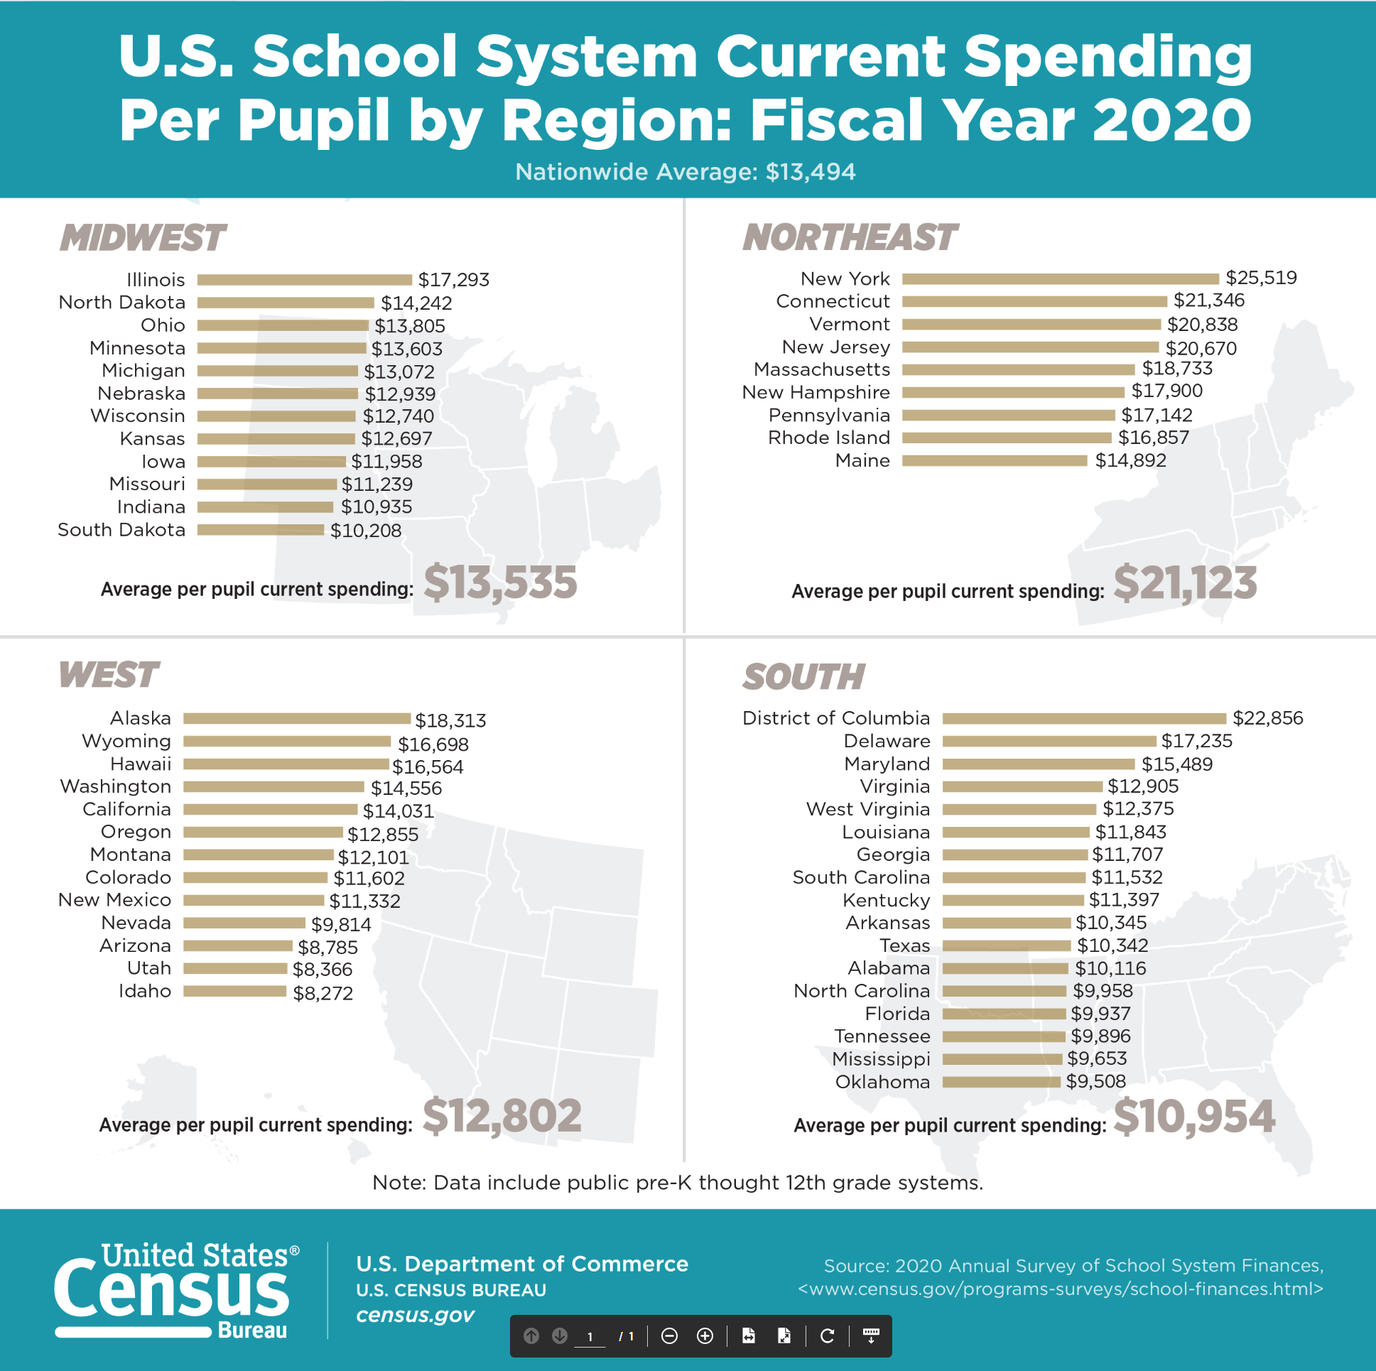
The Gap widens.
US Census data from May 2022 shows Iowa now $1,536 below the national average.
Iowa ranks 30th in the nation in per pupil expenditures.

Slide 34
NAEP Student Achievement
National Assessment of Educational Progress Iowa Scale Scores and Difference from USA Average
Iowa’s ranking: In the 90s, Iowa was in the top 10 of every measure. By 2019, Iowa is slightly above to right at the national average in most. 2020, post pandemic, other states slipped more than Iowa did.
In the 90s, schools could opt out of NAEP and Iowa was less diverse. Mostly level or higher scores despite doubling of poverty.
Subject and Grade | 1990 or 1992 Scale Score/ | 2019 Scale Score | 2020 Scale Score
Math – 4 | 221 / +11.30 | 241 / +0.68 | 240 / +4.97
Reading – 4 | 225 / +10.66 | 221 / +1.06 | 218 / +1.91
Math – 8 | 278 / +16.22 | 282 / +0.68 | 277 / +4.00
Reading – 8 | (Oldest data 2003) 268 / +6.33 | 262 / +0.33 | 260 / +0.66
https://www.nationsreportcard.gov/profiles/stateprofile/overview/IA?cti=PgTab_OT&chort=1&sub=MAT&sj=IA&fs=Grade&st=MN&year=2022R3&sg=Gender%3A%20Male%20vs.%20Female&sgv=Difference&ts=Single%20Year&tss=2022R3&sfj=NP

Slide 35
What has changed since the 80s despite demographics?
There are so many sources for the per pupil comparisons. One of the most credible is the National Center for Education statistics. These numbers come from what states report to the federal government.
https://nces.ed.gov/programs/digest/d21/tables/dt21_236.65.asp
The differences between Iowa and USA total expenditures per pupil in fall enrollment have changed over time.
In the 1970s and 1980s, Iowa spent more per pupil than the national average.
By 1989-90, Iowa was $453 below the national average.
By 2018-19, that shortfall had grown to $1,254.
2019-20 shows Iowa now $1,536 below the national average.
With continued low per pupil increases in the school funding formula in Iowa from 2021-2023, Iowa’s expenditure shortfall per pupil is likely even greater.

Slide 36
What does the $$$ buy?
Staff, supports and programs proven to close achievement gaps so all students graduate prepared for their next adventure
Sufficient compensation and benefits packages to attract diverse and expert talent so all student have great teachers, mentors, counselor, coaches and support.
Music and art programs, extracurriculars, theater/speech/debate, career exploration/internships and college credit while in high school all help students find their passions and develop their skills. These programs, sometimes thought of as “extras” are primary to student engagement and success.
Staff training, curriculum, software and instructional materials are all critical to improved instructional and student success.
People: 80% of school general funds typically provide the staff, or human capital, to support and educate students. Fewer adults means increased class sizes, fewer course offerings/choices, less student engagement.
Calculating Return on Investment: e.g., How many college credits or credentials were earned while in high school? How much did that save parents and college students? How much sooner was someone producing tax revenue at the state and local level?

Slide 37
Student Opportunity Equity (Close the Gap)
Many Iowa students start school behind their peers, some by several grade levels. Iowa’s funding formula should include targeted funding based on the actual costs of closing achievement gaps for at-risk students living in poverty. Iowa’s preschool program, initiated with strong support from the business community nearly a decade ago, should generate 1.0 weighting for full-day programming, including wrap-around services and child care for low-income or non-English speaking four-year-old students. Such funding delivers a proven return on investment for both student achievement and taxpayers, while also freeing up childcare slots for younger children and allowing parents to fully participate in full-time employment. Increased weighting to provide services for Iowa’s English-language learners, low-income and at-risk students will close learning gaps while building a strong workforce.
Messaging: Keep up with the nation, close achievement gaps, future workforce, ROI, long term tax savings, prevention is an efficient and affordable strategy (PK), 1.0 PK weighting for low income/ELL is a win-win-win for students, employers and taxpayers.

Slide 38
Student Inequities, Poverty and At-risk Needs
A little history: the School Finance Interim Committee recommended in 2019 and the House Education Committee approved a bill in 2020, HF 2490, the study of the impact of poverty on education and funding formula options to meet the needs of students. This bill died in House Appropriations Committee in 2020.
Then COVID happened. No bills moved forward in either the House or Senate in 2021 or 2022, taking a step backwards in the policy discussions.
2022 Session: HF 2008 and SF 2003 were introduced in both the House and Senate Education Committees to bring equity in the DoP ceiling for districts below 5% (Most UENs are already at the 5% ceiling). Died in Education Committees.
FYI: Children from families with incomes at or below 130% of the poverty level are eligible for free lunch and those with income from 130-185% are eligible for reduced lunch. Contrast: threshold for “low-income” for ESA or STO eligibility is 400% of the FPL, or $111,000 for a family of 4.

Slide 39
In 2001, only 4 districts had more than 50% of students eligible for FRPL (Waterloo, Keokuk, Wayne and Diagonal. Diagonal was the state high at 60.2% and the only district above 60%)

Slide 40
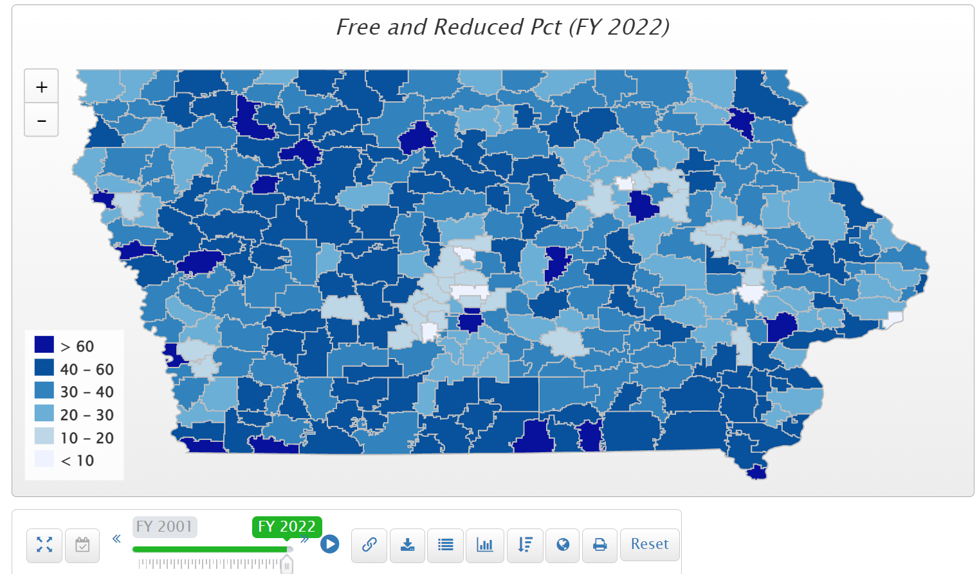
In FY 2022, of the 63 districts with more than half of their student on FRPL. 19 are urban (54 are rural). 18 districts have more than 60% of students eligible for FRPL. Those above 70% include Postville, Storm Lake, Council Bluffs, Waterloo, South Page, Hamburg, Des Moines.

Slide 41
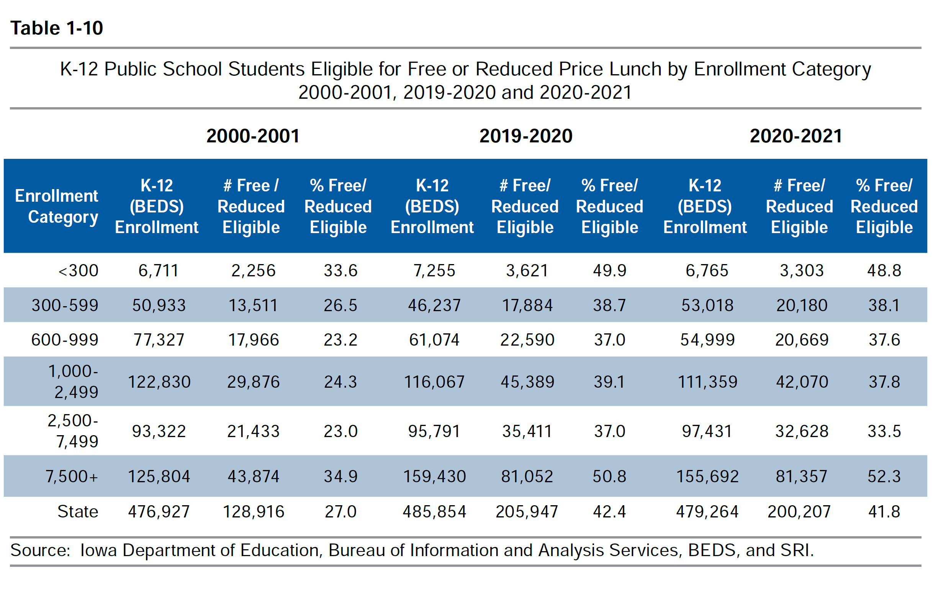
Districts in the largest and smallest enrollment categories had the highest percentage of students eligible for free or reduced price lunch (DE Annual Condition of Education Report Table 1-10).

Slide 42
Poverty Concentration: Cost of Education
The McCourt School of Public Policy, Georgetown, FutureEd, State Education Funding; The Poverty Equation, March 2020, states,
“What’s more, when poverty is concentrated in a school—that is, when a significant portion of students in a school come from low-income households—the impact on performance is compounded.
A body of research suggests that there is a ‘tipping point,’ somewhere between 50 to 60 percent of a school’s students living in poverty, where performance for all students there drastically declines.”
Nevada Study in Oct. 2018 studied successful school systems and costed out the staffing models of instruction and other services to determine the appropriate weighting commensurate with the programs needed at around .35 (would equate to $2,595 per low-income student in Iowa’s 2023 formula)
Nevada School Finance Study, Augenblick, Palaich and Associates, Education Commission of the States, Picus Odden and Associates October 22, 2018

Slide 43
Funding Formulas in Iowa and Other States
Iowa’s formula provides a total of $148.9 million in 2022-23 for at-risk and dropout prevention programs, neither tied to “at-riskness.”
Dropout Prevention MSA: $136.5 million, capped at between 2.5% and 5% of regular program district cost, based on enrollment and history (most but not all UEN’s at 5%)
At-risk weighting in the formula: $17.2 million, based half on enrollment and half on grades 1-6 FRPL (translates to about 0.5% weighting based on low income)
By 2018, 47 states provided at-risk funding based on poverty or other metrics, for a national average weighting of .22 and well below the outcomes-based study which showed .35 provided the staffing and programs that made a difference.

Slide 44
Did you know. . . .
Iowa’s Statewide Voluntary Preschool Program (SVPP), first implemented in 2007-08, has grown to serve 31,468 4-year-olds in 2019-20 (still about 8K less than the kindergarten class). Pandemic reversed the trend, now serving about 2,000 four-year-olds below the peak PK enrollment.
In 2019-20, Iowa schools identified 12.4% of students requiring special education services, while the national average was 14%. (Studies show effective PK program reduces likelihood of student needing special education over the long haul by 50%.)
Iowa is #1 in the nation in college credits earned while in high school per capita 12 years after initiating SVPP.
There are no funds to expand PK and school districts are prohibited from using general fund for PK expenditures.

Slide 45
PK = Positive Cost Benefit Outcome
Education Commission of the States, http://www.ecs.org/docs/early-learning-primer.pdf Oct. 2014: Six rigorous long term evaluation studies have found that children who participated in high-quality preschool programs were:
25% less likely to drop out of school.
40% less likely to become a teen parent.
50% less likely to be placed in special education.
60% less likely to never attend college.
70% less likely to be arrested for a violent crime.
Sarah Daily, Initiatives from Preschool to Third Grade: A Policymaker’s Guide, shows reductions in costly outcomes that quality preschool prevents. (Denver, CO: Education Commission of the States, October 2014) http://www.ecs.org/docs/early-learning-primer.pdf. The National Conference of State Legislatures quotes studies on long term return on investment. http://www.ncsl.org/research/human-services/new-research-early-education-as-economic-investme.aspx
What does your own data show?

Slide 46
Teacher, Administrator, Staff Shortage
Adequate funding is essential for public schools to compete with the private sector in hiring new and retaining experienced employees. Recent steps to simplify licensure reciprocity with other states and eliminate IPERS barriers to rehiring retirees are welcome relief, but insufficient to eliminate staff shortages urban schools experience today. New policies should be implemented to help schools meet the challenge of attracting and retaining tomorrow’s educators and recruiting teachers that mirror our diverse students. UEN supports flexibility in certification requirements such as a K-12 special education credential, minimizing barriers for educators with international experience to teach in our schools, additional teacher intern programs that include adequate pedagogy/on-the-job classroom exposure, and continued support for grow-your-own programs, para and teacher apprenticeships, tuition support and loan forgiveness programs. Iowa’s Future Ready Workforce efforts should include an educator focus to replenish the talent pool and attract high school and college students to a career in education. UEN supported last year’s discussion in the Iowa Senate to use the Management Fund for loan forgiveness and recruitment programs. Of critical importance is the dedication of state and local leaders to generate enthusiasm for teaching by speaking about and treating educators with the respect the profession deserves and keeping great Iowa teachers in classrooms in Iowa.
Messaging: Iowa’s growing economy and inflation have made private sector jobs more attractive. Fewer college students are choosing education careers. Student loan debt and lower beginning teacher pay drives new teachers to other states. Expansion of private school will create another drain of the pool of teachers and staff. Political rhetoric targeting teachers diminishes the appeal of the job.

Slide 47
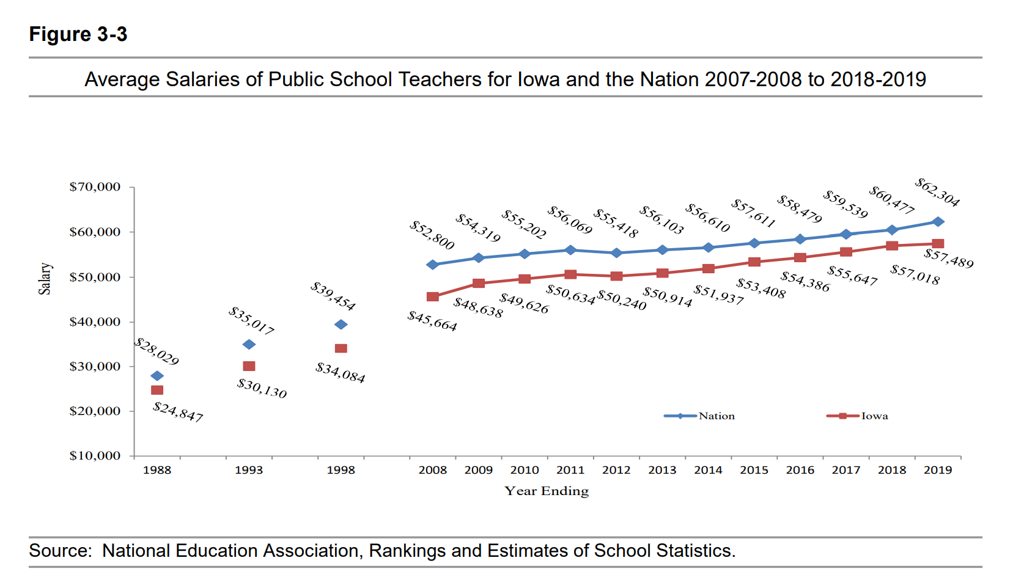
Gap between Iowa Average Teacher Salary and the National Average in 2019 is $4,815 (in 1988, the gap was $3,182). With significant teacher shortages across the nation, beginning teacher pay is also a critical comparison.
DE Annual Condition of Education 2020
 | 2018-19 | 2019-20 | 2020-21 | 2021-22 est’d
Iowa | $ 57,489 | $ 58,184 | $ 58,831 | $ 59,262
USA | $ 62,304 | $ 64,133 | $ 65, 293 | $ 66,397
IA-USA | ($4,815) | ($5,949) | ($6,462) | ($7,135)
https://www.nea.org/sites/default/files/2022-04/2022%20Rankings%20and%20Estimates%20Report.pdf

Slide 48
In 2019-20, Iowa ranked 38 in beginning teacher pay.
https://learningpolicyinstitute.org/product/understanding-teacher-compensation-state-by-state-analysis

Slide 49
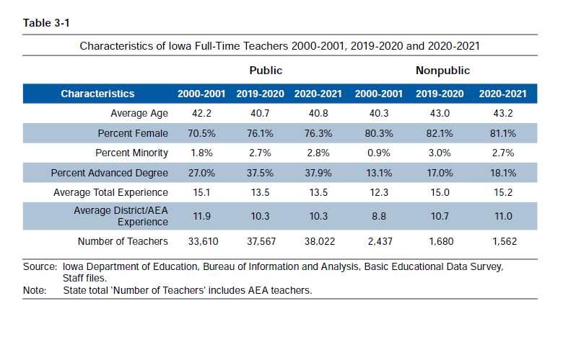
Although minority students now make up 26.1% of the public-school K-12 enrollment, Iowa’s full time teachers are only 2.8% minority. Since UEN districts educate 77% of minority students, this lack of diversity is even more concerning.

Slide 50
Pre-pandemic
Data was Reported in Teacher Retention and Recruitment: Shortages in Iowa/Nation, 50-state Comparison of Strategies, Education Commission of the States. ISFIS created the chart from the ECS tabular data.

Slide 51
Teacher Shortage
Wage inflation and economic growth have outpaced school funding
80% of Iowa School budgets pay for staff
Shortage is a result of many things, inadequate pay and negative media and political rhetoric about teachers among them. Some concerns about the pandemic or safety, too.
Iowa school funding is based on enrollment: fewer students and/or low SSA has only two possible outcomes. Increase class size or continued lower pay compared to private sector.
If private schools expand, they will have to hire teachers from this limited pool.

Slide 52
ESAs and School Choice
Iowa already has significant school choice. UEN opposes the creation or expansion of programs/plans that redirect or designate additional taxpayer funds for private school, homeschooling or other private services, regardless of whether those funds are provided indirectly through education savings accounts or directly through appropriations or tax credits. The priority of public schools demands adequate funding and support by the state. Investments in education savings accounts, voucher programs, school tuition organizations or homeschool remove resources from public schools in four ways:
1. Funding is enrollment based
2. Pending tax cuts: State can’t afford to fund two educational systems when faced with $1.8 B revenue decline
3. ESA pilots typically expand to statewide, full scale implementation down the road.
4. For-profit private schools/online academies, motivated by the money, will come to Iowa.
Messaging: Public funds should be used for public schools. Private school programs do not include accountability for expenditures, are not required to educate all children or provide special education services, and are insulated from public oversight. With unlimited open enrollment, Iowa students and parents already have choices for which taxpayers have transparent access and accountability. Private and home schools in Iowa already cost the state over $80 million annually.

Slide 53
Iowa Has School Choice
Within District Transfer: A neighborhood public school or a public school in another neighborhood within the school district (transfers regulated by the local school board).
Open Enrollment to Public School in Another District (including on-line academies): 35,227 students exercised open enrollment to another school district in 2020-21.
Charter Schools: HF 813 and HF 847, effective July 1, 2021, create new charter school options for school boards or independent founding groups.
Accredited Nonpublic Schools: 33,840 students enrolled in 2020-21. Iowa provide tax credits for school tuition organization scholarships and tuition and textbook tax credits, appropriates funds for transportation/textbooks to private schools, requires public school and AEA support for special education, and public/private partnerships for private PK in the SVPP community partners.
Home School Options: competent private instruction or independent private instruction. HF 847 in 2021 applied the tuition and textbook tax credit to home school for the first time.
Public Funding for Private Education: In 2018, over $66 million in state tax dollars supported the education of Iowa students in private and home school settings, according to the Iowa Fiscal Policy Project Analysis Nov. 2018. The additional fiscal impact of HF 847, if the fiscal note assumptions prove correct, would raise that total to $91 million.

Slide 54
Heritage Foundation ranked Iowa 9th in the nation in school choice before changes to charter schools, open enrollment and diversity plans.
https://www.heritage.org/educationreportcard/pages/state-v-state-comparison.html

Slide 55
Private School /Homeschool Expansion in Iowa
© Iowa School Finance Information Services, 2022

Slide 56
Nonpublic School Enrollment
Source: DE Education Statistics nonpublic school enrollment files https://educateiowa.gov/data-reporting/education-statistics-pk-12

Slide 57
https://www.legis.iowa.gov/docs/publications/SD/1023535.pdf

Slide 60
https://www.legis.iowa.gov/docs/publications/SD/1023536.pdf

Slide 61
Recent Policy Shifts Expanding Choice
Elimination of voluntary diversity plans regulating open enrollment out of five districts with concentrated minority and low income students
Created charter schools which can be chartered by the State Board of Education despite local school board opposition (or created by local school boards)
Open enrollment expansion without an enrollment deadline
Doubled the Tuition and Textbook tax credit to 25% of the first $2,000. This is likely most beneficial to families with tuition paid to private school. Public School fees are limited.
Added home school to the eligibility for the tax credit.

Slide 62
ESA Examples in Other States
Remember, Iowa already has significant choice, so effects may not be applicable
Recent expansions in open enrollment may make the voucher call for action even less attractive for some House members.
Both Florida and Mississippi have come up as good models. Let’s take a look:

Slide 63
ESA Examples in Other States
NAEP scores for public schools went up in Florida after vouchers. Other FL actions:
Statewide initiative, Every Child Reads, which provided resources and training for public schools and new universal PK for 4-year-olds.
Florida has also invested in increasing teacher pay along the way
Retention of non proficient students in their prior grade
Dig deep into the data . . . so many students with special education IEPs and nonproficient students received the vouchers, removing them from the testing pool.
Iowa 8th grade students who are not receiving special education services scored 1 point higher in 2019 NAEP than similar FL students.

Slide 64
ESA Examples in Other States
Private schools participating in the FL scholarship program must comply with a long list of requirements, among them:
ensure all staff submit to background checks,
return any funds for which services were not provided,
administer state assessments/norm referenced tests for all students attending via the scholarship annually,
annually submit to an independent audit if the private school receives $250K in scholarship support from the STO.
Find more information on the FL DOE website here: https://www.fldoe.org/schools/school-choice/private-schools/requirements-for-participating-in-state-scholarship-programs.stml
There are no accountability requirements in SF 2369.

Slide 65
The Opposite of Accountability on Page 17 of SF 2369
*Privates do not have to accept every child or provide special education services
*Privates are not accountable to the state (no testing, data re achievement, or expenditures)
*Privates are given maximum freedom

Slide 66
ESA Examples in Other States
The Mississippi legislature did a review of their $5 million ESA program for students with disabilities in 2020.
Many vouchers weren't spent and had to be returned. 36% of surveyed parents said that no private school would take their child.
Parents finding a school had to sign a contract waiving special education rights if they enrolled in the private school.
Less than 10% of what Gov. Reynolds suggested as the starting point for Iowa (and parents returned over $2 million.)
Here's a link to the PEER Committee's Legislative Report: https://www.peer.ms.gov/Reports/reports/rpt649.pdf

Slide 67
ESA Examples in Other States
Programs start small and expand
(Camel’s nose is soon followed by the humps)
Milwaukee public schools, expanded to statewide
Florida started with just low income and special education but has since eliminated criteria completely and open to all.
Arizona – started with low income and special education, gradually increasing income limits
Iowa’s SF 2389 – 400% FPL or IEPs, Students in public schools for 2 semesters, new kindergarteners (typically about 3,100 students annually)

Slide 68
Key Messages re ESA’s
Unlevel playing field (public schools have more stringent rules and privates do not have to accept all students)
Accountability (private schools are not transparent or accountable, no elected school board or stewardship for tax dollars)
Shifts money away from public schools (Fiscal note assumes a $79 million reduction in public school funding which only counts state savings – impact to public schools is greater)
No better results for students in controlled studies
Oh, and we already have lots of school choice in Iowa.

Slide 69
Mental Health Services
UEN leaders understand that mental health challenges must be addressed through a system that recognizes students and families with mental health needs are experiencing symptoms not only in school, but during the 17 hours a day and full days when they are not in school. Iowa needs an improved mental health system for children, including the structure and funding to eliminate the shortage of professionals. Schools should be partners to serve students and families, but educators are not trained providers of mental health care, nor do they have the capacity to meet the mental health needs of students.
Students who have no outward indicators of mental illness suffer quietly, even leading to suicide. Many Iowans already recognize risk factors which include but aren’t limited to: students adjudicated or in residential placements, students with refugee trauma, and students experiencing adverse childhood experiences. Providing appropriate mental health services would position these students and their families for better academic, social and economic success. Iowa should engage in every opportunity to maximize school access to Medicaid claiming for health services for all students, not just students with individual education plans.

Slide 70
Mental Health Services
Funds to provide case management and service coordination are required when Medicaid, special education or other categorical funds do not cover it. School districts require capacity and/or funding to provide: 1) transition support and services for students returning to school after a mental health placement, 2) ongoing teacher, administrator, and support staff training to improve awareness and understanding of child social-emotional, behavioral and mental health needs, 3) actionable classroom strategies to address student needs, and 4) integration of mental health promotion into instruction when appropriate.
Messaging: the pandemic has intensified student needs and continues to shine a light on barriers to services. Schools can not do this alone. We must work with communities, providers, payors and the state to provide a system of service opportunities to meet student needs. Federal Pandemic funds can help for those districts with significant distributions. However, ESSER funds are time limited and will be exhausted soon.

Slide 71
District Authority
Home Rule in Iowa Code 274.3 requires the executive branch and the courts to interpret Iowa Code impacting schools and school boards and develop administrative rules with deference to local control. UEN members strongly believe the legislature and Governor should focus efforts on flexibility rather than state-mandated one-size-fits-all action. UEN supports two specific areas of expanded flexibility:
1) flexibility to use school general fund to pay for expanded preschool slots, and
2) management fund flexibility to cover safety and security costs, including security personnel and cyber security measures (both of these most certainly qualify as risk management and litigation cost avoidance, which are current goals of the management fund).
Messaging: locally elected officials are closest to the needs of students and communities. Local voters will hold school boards accountable. Local leaders not only listen to but engage parents and communities to best serve and prepare students for a successful future.

Slide 72
Cyber Security
Cyber criminals pose a malicious threat to the instructional delivery and operation of school districts. When school districts are the target of nefarious attacks, students, families and communities are most impacted. The Iowa Legislature and executive branch should coordinate efforts to support school districts’ cyber security needs, create a consortium that curates, vets and establishes professional services and supports from which school districts may elect to use or purchase for cybersecurity needs. To the maximum extent possible, the consortium should create options and preserve the local decision-making authority of school boards and districts in choosing services and supports needed for their community school. School districts should be able to expense cybersecurity systems, services, improvements, and training from the management fund, the state penny for school infrastructure (SAVE) fund and the physical plant and equipment levy, including the costs of cybersecurity staff.
Messaging: New priority. State has more expertise than local districts but must still prioritize local control in choosing. Without support, disruptions in academic and operational systems are at risk. Funding sources make sense to save technology and litigation expenses later via SAVE and Management Fund.

Slide 73
What about all of that federal money?
Help policy makers (and the public) understand the federal ESSER funds:
Reimbursement for expenditures – they didn’t send you a truckload of money
Strings attached (e.g., Davis Bacon wage requirements for construction, at least 20% must be spent on COVID learning recovery.)
Pandemic increases expenditures (technology, staffing, health and safety, mental health supports, supply chain delays & inflation)
Already spent in districts that received low per pupil amounts (Title I distribution formula based on census tract poverty, yet all districts had COVID-19 costs for safely holding in person school)
Short term – may be used through Sept. 2024, so even districts with large per pupil amounts can’t count on it to hire staff needed for the long haul (unless you have a sustainability plan.)

Slide 74
Advocacy Actions
See the UEN Advocacy Handbook on Legislative Page of Website

Slide 75
After the Election Advocacy
Send a congratulations / Thank you Note
If you don’t yet know it, ask how best to connect with them during the session (email, text, cell phone, home phone, letter through the post)
Find advocacy moments: coverage of education in the media, share successes from your school, share list of priorities from organizations
Reach out and sit down and talk. Ask about them – their educational experience, where they (their kids) go (went) to school, what they think is good about your school and what their constituents talked to them about education while campaigning. E.g., how many constituent parents asked you to pass ESA’s because they couldn’t go to private school and wanted to?
Talk to them about issues, one or two at a time, follow-up with more information.

Slide 76
Invite Legislators to Schools
Let them see and hear students
Recruit a business voice to talk about the quality of education related to workforce
Talk about economics, employment markets, competitive salary and benefits, what the money buys and the long term return on investment.
Stress individual choice within public schools: how do students get to choose program or school?

Slide 77
Learn More
Advocacy Handbook, List of Successes, Issue Briefs, Weekly Videos, Legislative Update Reports, Calls to Action and more, on UEN’s Legislative Web page
https://www.uen-ia.org/blogs-list

Slide 79
Write it Down!
Please identify a person at your table (or two if you divide into two discussion groups) to record the highlights of your conversation
Plan to leave the notes on the table.
Work through the questions.
Enjoy learning from and listening to each other!
We will compile a list and share back with UEN districts.

Slide 80
Closing Remarks
Matt Degner
Iowa City, UEN Chair

Slide 81
THANK YOU FOR YOUR VOICE on behalf of urban Iowa students, parents, your school staff and communities!
Margaret Buckton,
ISFIS Partner, UEN Executive Director, RSAI Professional Advocate margaret@iowaschoolfinance.com 1201 63rd Street, Des Moines, IA 50311 (515) 201-3755 cell
Larry Sigel, ISFIS Partner
larry@iowaschoolfinance.com
1201 63rd Street, Des Moines, IA 50311
(515) 490-9951 cell
Jen Albers, Director of Finance and Operations
jen@iowaschoolfinance.com
(515) 251-5970 x4
Stay connected through the Interim and
into the Legislative Session
Let us know what you need to support your advocacy efforts.

